Slide 1


Summative 1: Investigating a Real Business
Theme: Investigating a Real Business Summative
Unit 3: Local and Global Markets
Grade 6: Individuals & Societies

Slide 2

Today’s Inquiry Questions & Learning Targets
Inquiry Questions:
How can I create research questions to investigate a real business?
How can I follow my action plan and record my information?
How can I present my findings?
Learning Targets (By the end of this lesson…):
I can create factual, conceptual, and debatable questions to investigate a real business.
I can follow an action plan and systematically record my information.
I can present my findings in a logical manner.

Slide 3
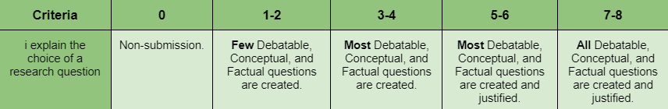

Choosing Factual Research Questions
Thinking: Critical Thinking Skills
In order for us to explain the choice of our research questions, (Criterion B Strand i) we will need to use our critical thinking skills to apply existing knowledge to generate new ideas, products, or processes that we drew upon.
Factual Questions (Choose one question for each):
How could we ask local businesses about the production, distribution, and consumption of their product/s?

Slide 4
Choosing Conceptual Research Questions
Thinking: Critical Thinking Skills
In order for us to explain the choice of our research questions, (Criterion B Strand i) we will need to use our critical thinking skills to apply existing knowledge to generate new ideas, products, or processes that we drew upon.
Conceptual Questions (Choose 1-2 questions to ask about Globalization):
How could we ask about the globalization of the local business? Think about if the business imports or exports for their product globally, in order to produce it. Think about if the product is made elsewhere and imported. Think if the business exports their product, or if the product is consumed elsewhere.

Slide 5
Choosing Debatable Research Questions
Thinking: Critical Thinking Skills
In order for us to explain the choice of our research questions, (Criterion B Strand i) we will need to use our critical thinking skills to apply existing knowledge to generate new ideas, products, or processes that we drew upon.
Debatable Questions (Choose 1 question to ask about Sustainability):
How could we ask a local business about sustainability? Think about the three parts of sustainability the economy, the society and the environment. Remember that sustainability means it meets our own needs now, without compromising the ability of future generations to meet their own needs.

Slide 6
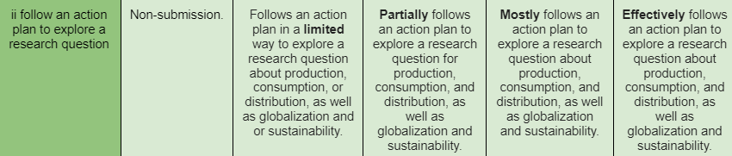

Action Plan
Self Management: Affective
In order for us to follow our action plan to explore our research questions,(Criterion B Strand ii) we will need to use self-management skills to keep an organized and logical system to document the new information we learn.
Next Steps:
Get your Research Questions and Action Plan approved by a teacher.
Prepare to record your interview on the phone and take notes in case your phone recording quality is poor.

Slide 7
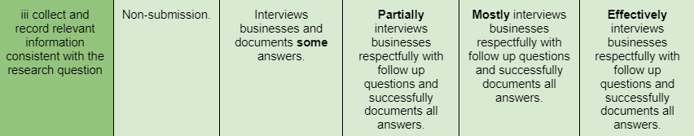

Recording your information
Research: Information Literacy Skills
In order for us to collect and record relevant information consistent with our research questions, (Criterion B Strand iii) we will need to use our information literacy skills to access information to be informed when interviewing a local business and inform others about it after.
Next Steps:
If you recorded your interview, transcribe what you hear on your paper.
If you took notes, make sure the answers are comprehensible and in proper sentences.

Slide 8

Recording your information
After this class we will give you formative feedback. This feedback will be posted on Toddle and your parents will be able to view the feedback.
You will use this feedback to enhance your presentation. This means you must focus well for this class in order to get good feedback. If you submit very little then you will receive very little feedback.
First, one group member should share the slides, and you will all write on the same slide show.

Slide 9

Presenting your Findings
Communication Skills
In order for us to reflect on the process and results of our investigations, (Criterion B Strand iv) we will need to use our communication skills to organize and depict our information logically.
Presentation Expectations:
All group members must present an equal amount of information.
Stand to the side of the board and present your slide.
Make eye contact with the audience.
Speak loud and proud (have confidence).
If a group member falters, help them out.

Slide 10

Respond to formative feedback
Read your feedback.
Type it in the ‘messages’ section.
Show Ms. Smith and Mr. Larson your screen.
We will let you edit it.
You will present on Tuesday (AB).

Slide 11
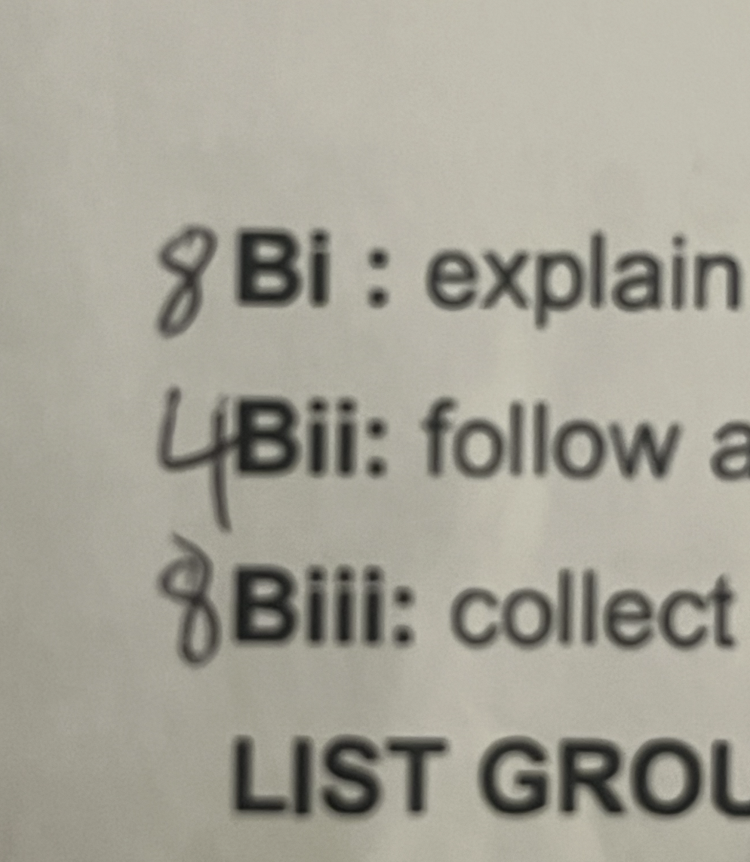
Respond to formative feedback
On your Graphic Organizer or Toddle, you’ve received feedback.
Use the next slides to understand what you can improve/change if you wish to raise your grade
After you finish making changes, turn in your organizer, & work on other classwork quietly

Slide 12
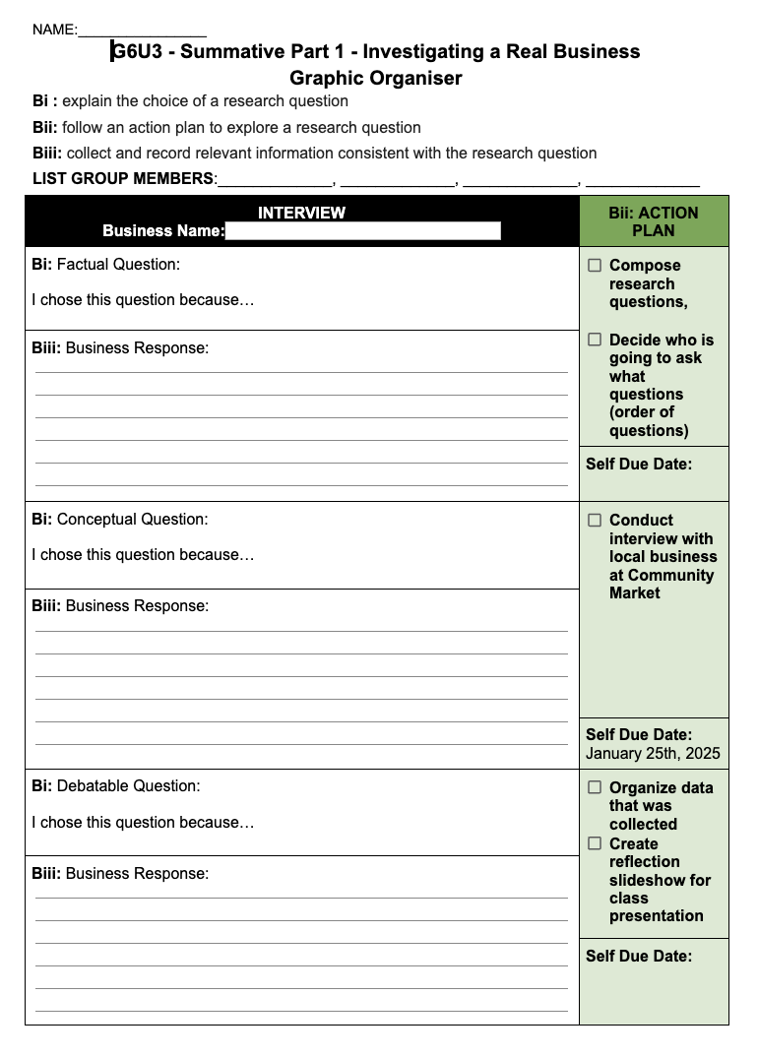
Many students can raise their criteria B by simply finishing their Bii dates sections

Slide 13
Bi: 7-8: Great questions!
Bi: 5-6: One of your questions is close ended, please edit it to make it open ended. For your presentation you can include both versions of the same question and explain you changed it due to feedback.
Bi: 3-4: Two of your questions are close ended, please edit them to make it open ended. For your presentation you can include both versions of the same question and explain you changed it due to feedback.
Bii: 7-8: Great Action Plan!
Bii: 5-6: Don't forget to fill out one box in your action plan.
Bii: 3-4: Don't forget to fill out two boxes in your action plan.
Biii: 7-8: Fantastic transcription of your interviews!
Biii: 5-6: One of your questions has a very limited answer. Please do additional research online to add one or two additional facts about the business to compensate.
Biii: 3-4: Two of your questions have very limited answers. Please do additional research online to add two or three additional facts about the business to compensate.
Biv: 7-8: Your reflection presentation slides are all complete!
Biv: 5-6: One of your slides are incomplete.
Biv: 3-4: Two of your slides are incomplete.

Slide 14

Lesson 1: Introduction to Concepts: Scarcity
Date: Fri Jan 10 (AB) & Mon Jan 13 (CD)
Theme: Investigating a Real Business
Unit 3: Local and Global Markets
Grade 6: Individuals & Societies

Slide 15
Today’s Inquiry Questions & Learning Targets
Inquiry Questions:
Why is Economics like a Deserted Island?
Where can I find the syllabus?
Learning Targets (By the end of this lesson…):
I can participate in a Deserted Island activity that will help me understand why economics is about choices of what to do with limited resources.
I can find the syllabus on Toddle.

Slide 16
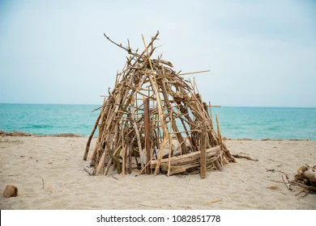
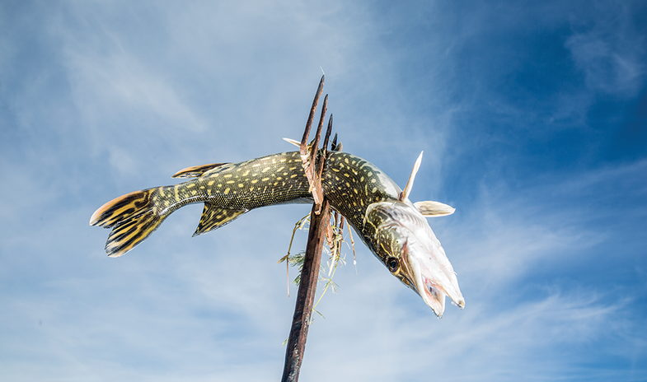
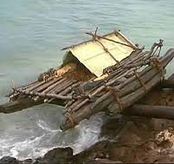
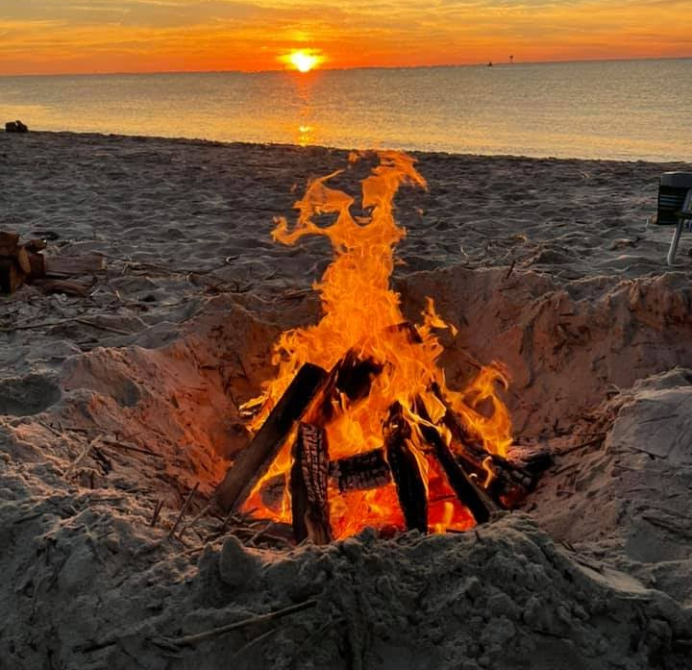
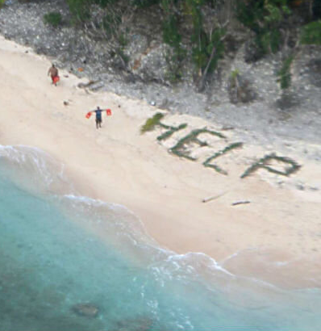
Economics is like a Deserted Island
Your boat crashed against the rocks of a deserted island. Just before the boat crashed you sent for help on your phone. It will take at least 4 days before you are rescued… but there is a chance that nobody finds you. You look around on the island and you find 50 branches that you can use to survive. How will you use your branches?
10 branches: Build a small shelter.
2 branches: Build a small fishing spear.
50 branches: Build a raft to escape the island.
5 branches: Build a
small fire.
5 branches: Spell HELP in small letters.
20 branches: Build a large shelter.
5 branches: Build a large hunting spear for big animals.
10 branches: Build a
large fire
10 branches: Spell HELP in large letters.

Slide 17
Day 1
Day 2
Day 3
Day 4
Island in the:
The weather is perfect, if you built a raft, you sailed to Hawai’i.
A plane flies at night. If you built any fire or a large help sign, you are rescued.
It is extremely hot. If you did not build any shelter, you die of heatstroke.
South Pacific Ocean
Boat arrives to rescue survivors.
If you did not build a large shelter, you freeze to death.
If you did not sharpen a fishing spear, you starve to death
If you built a raft you sail to South Africa. If you stay on the island, nobody finds you.
If you did not build a large fire, you freeze to death.
Antarctic Ocean
North Atlantic Ocean
The weather is stormy. If you built a raft, you drowned.
A plane flies during the day. If you built any help sign, you are rescued.
If you did not sharpen a fishing spear, you starve to death
Boat arrives to rescue survivors. If you built a raft, you drift until you starve.
A tiger attacks you. If you don’t have a large spear, you are eaten.
It is extremely hot. If you did not build any shelter, you die of heatstroke.
A plane flies at night. If you built any fire or a large help sign, you are rescued.
If you built a raft you sail to Madagascar. If you stay on the island, nobody finds you.
Indian
Ocean
The weather is perfect, if you built a raft you sailed to Mexico.
A jaguar attacks you. If you don’t have a large spear, you are eaten.
A plane flies during the day. If you built any help sign, you are rescued.
Caribbean Sea
Boat arrives to rescue survivors.

Slide 18

Economics is like a Deserted Island
You all had a limited amount of resources but you had to choose which one to prioritize. Some of you survived, some of you didn’t.
This is similar to how the economy works. Nobody has infinite money so they have to choose what to spend their money on. Some countries get rich and some countries get poor. Sometimes it’s a result of luck and sometimes it’s a result of their choices.
Economics is about choices of what to do with limited resources. It can also help us understand strange events that happen in our world such as…

Slide 19
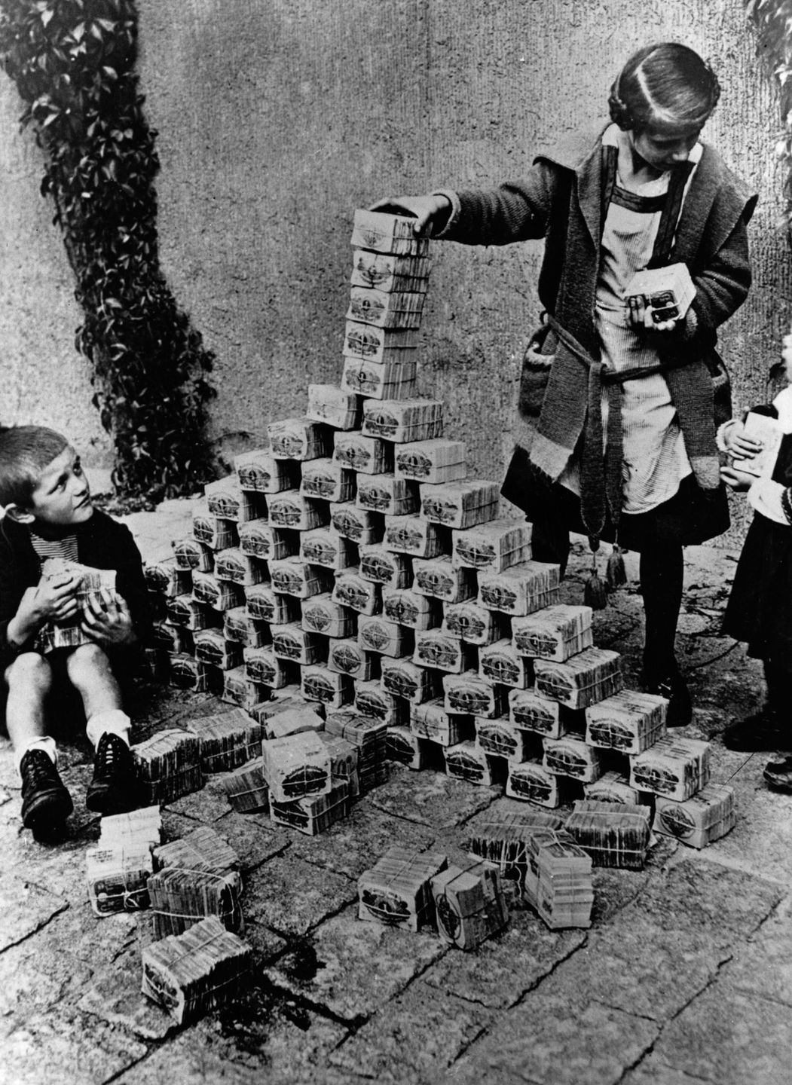
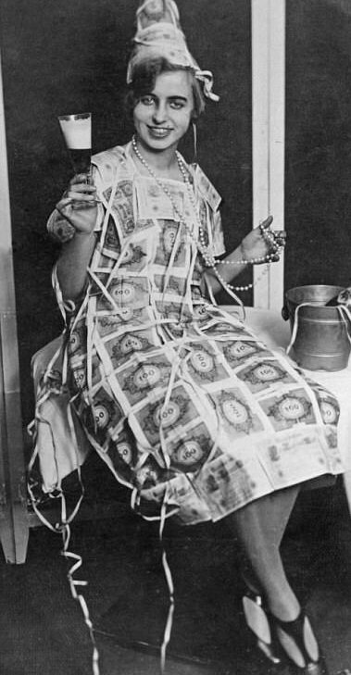
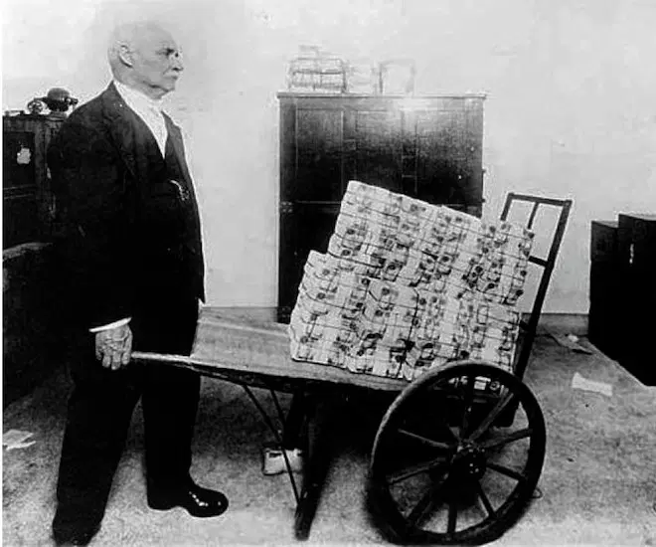
Are these people rich or poor?

Slide 20
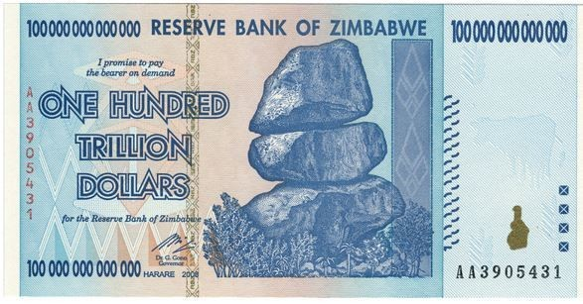
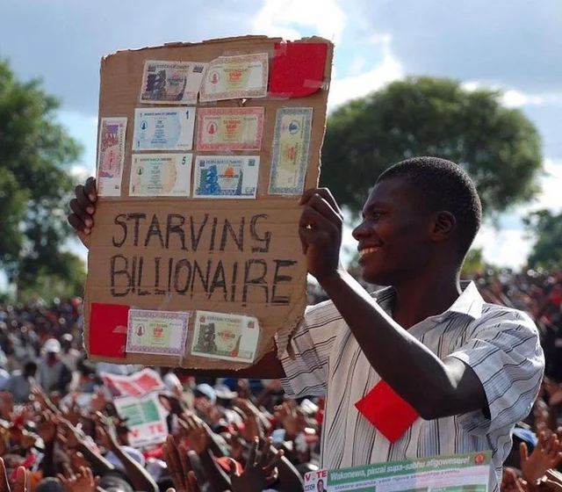
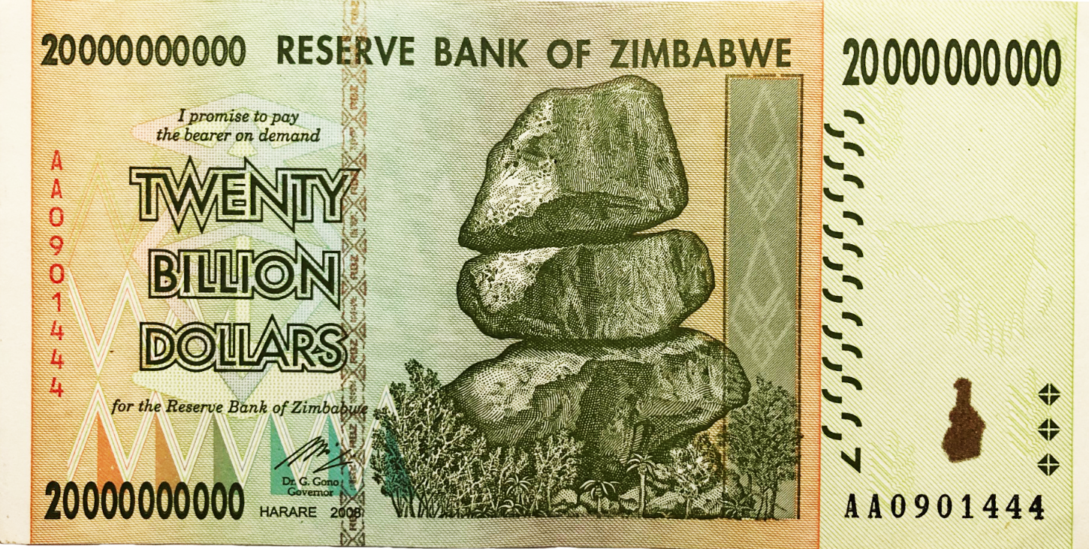
Why is this person a “starving billionaire”?

Slide 21
How do we measure the wealth of nations?
GDP (Gross Domestic Product) =
Add up all of the money the country has.
United States: $20.89 trillion
China: $14.72 trillion
Japan: $5.06 trillion
Germany: $3.85 trillion
United Kingdom: $2.67 trillion
India: $2.66 trillion
France: $2.63 trillion
Italy: $1.89 trillion
Canada: $1.64 trillion
South Korea: $1.63 trillion
GDP (Gross Domestic Product) per capita =
Add up all of the money the country has and divide it by the population.
Qatar: $128,647
Luxembourg: $107,641
Singapore: $94,105
Brunei: $79,003
Ireland: $76,745
United Arab Emirates: $74,035
Kuwait: $72,096
Switzerland: $66,307
San Marino: $63,549
Norway: $62,183

Slide 22
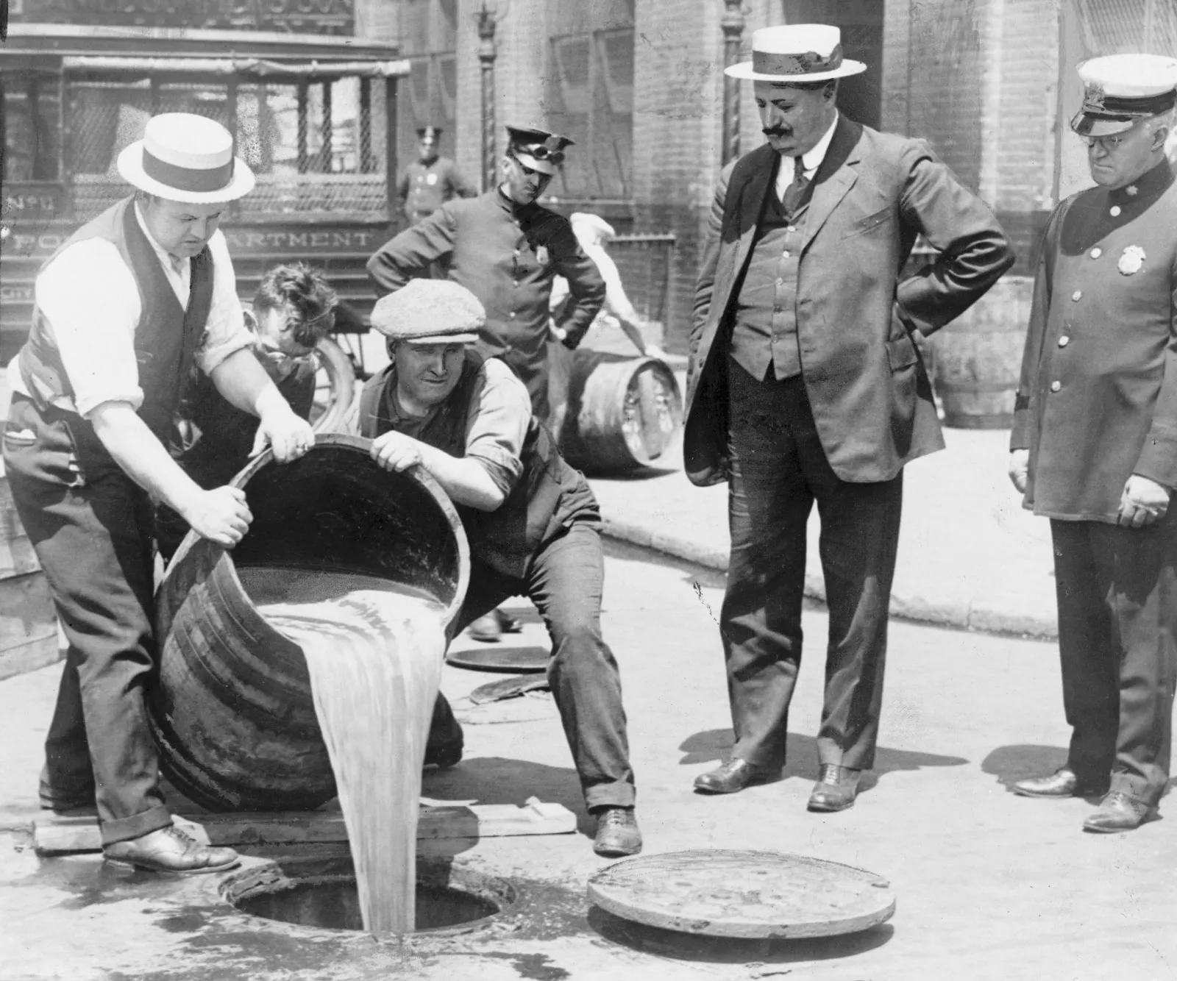
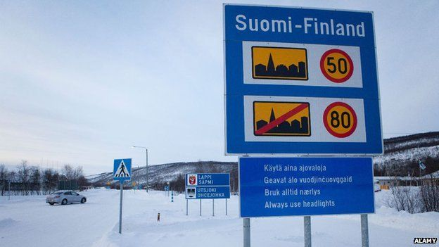
Think, Pair, Share.
In 1920, the United States banned alcohol. Do you think crime rates increased or decreased?
In Finland, a man was caught speeding his car and had to pay over 100,000 euro fine. What happened to his life afterwards?
The crime increased! But why?
Nothing, his life carried on as normal. But how?

Slide 23
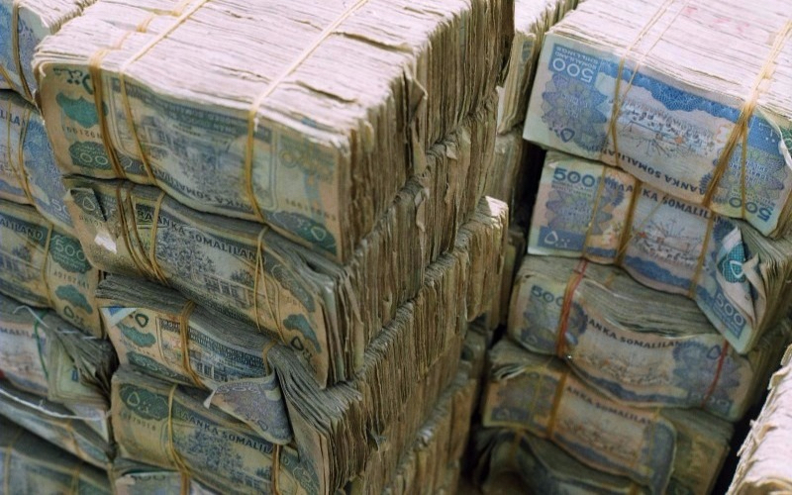

Think, Pair, Share.
Why is money
valuable?
What do you think is expected to become even more expensive than oil in the future?
Because we say it is! But why?
Water! But why?

Slide 24

Lesson 2: Introduction to Concepts: Stations
Date: Thu Feb 1 (B) & Fri Feb 2 (A)
Theme: Investigating a Real Business
Unit 3: Local and Global Markets
Grade 6: Individuals & Societies

Slide 25
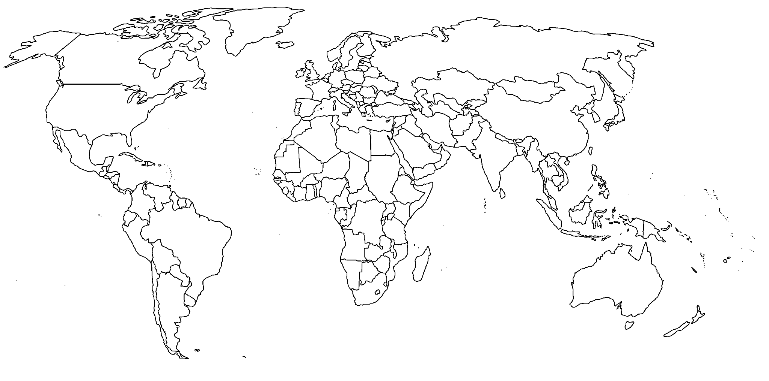
BELLRINGER: Pick one continent, TRY TO NAME EVERY COUNTRY IN THAT CONTINENT

Slide 26
Today’s Inquiry Questions & Learning Targets
Inquiry Questions:
When is the ICS Community Market?
What are the concepts of Scarcity, Globalisation, Sustainability, Trade, & Systems?
Learning Targets (By the end of this lesson…):
I can read the syllabus and understand that I should save the date: January 25 to attend the ICS Community Market.
I can explore the concepts of Scarcity, Globalisation, Sustainability, Trade, and Systems through a Stations Activity.

Slide 27

Word Breakdown: Statement of Inquiry
Systems of trade can affect the sustainability of markets, commodities, and commercialisation.
TABLE TASK:
Discuss, define, give an example:
Commodity: a raw material or primary agricultural product (coffee beans, oil)
Trade:
Sustainability:
Market:
Commercialization:

Slide 28



Trade Web
Systems of trade can affect the sustainability of markets, commodities, and commercialisation.
Identify the people, resources, and actions involved in trading a commodity.
Discuss how changes in the system might affect sustainability
People - Who creates it? Where? How?
Resources - Raw materials? Manufacturing?
Actions - How are the materials moved and gathered?

Slide 29
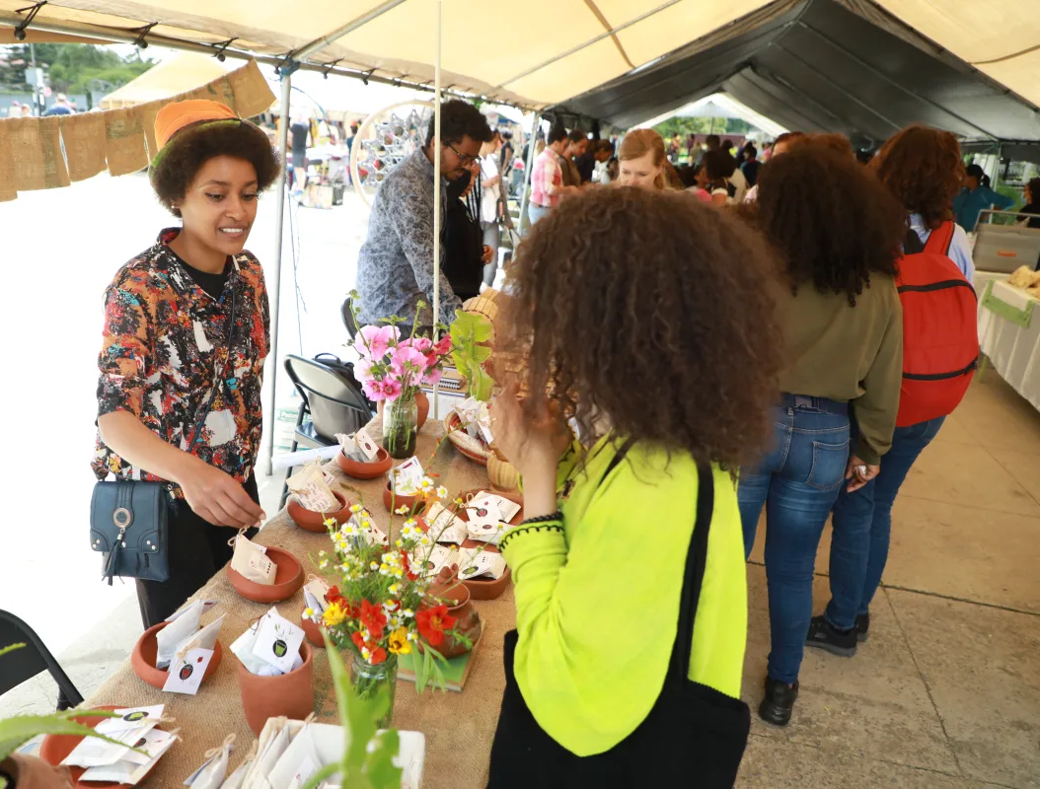
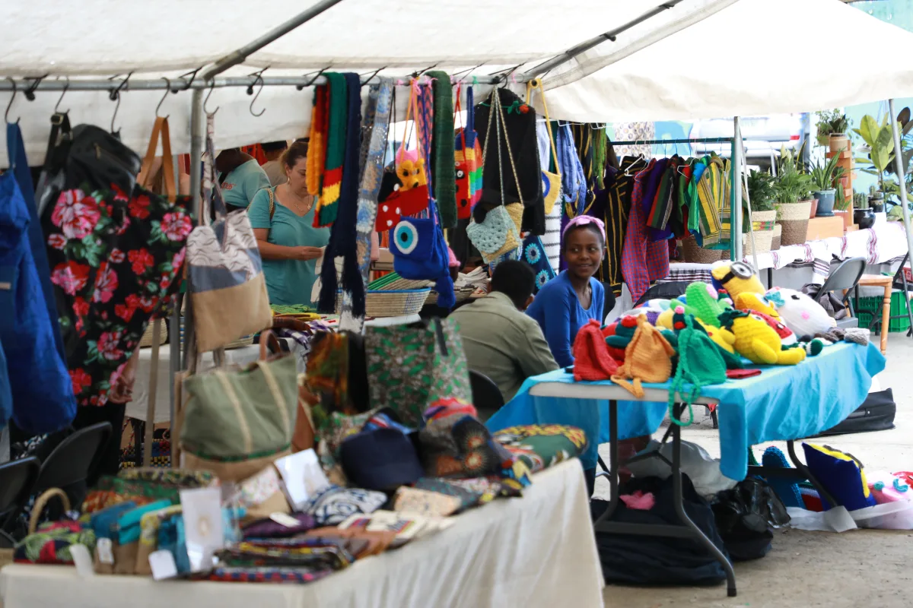
Save the Date: Saturday 25 January
Please write this date down in your agendas and ask your parents or guardians for permission to attend the Community Market at ICS so that you can interview a business for your summative. If you cannot attend, we will provide you with digital resources but the process is far more enjoyable if you attend the Market.

Slide 30
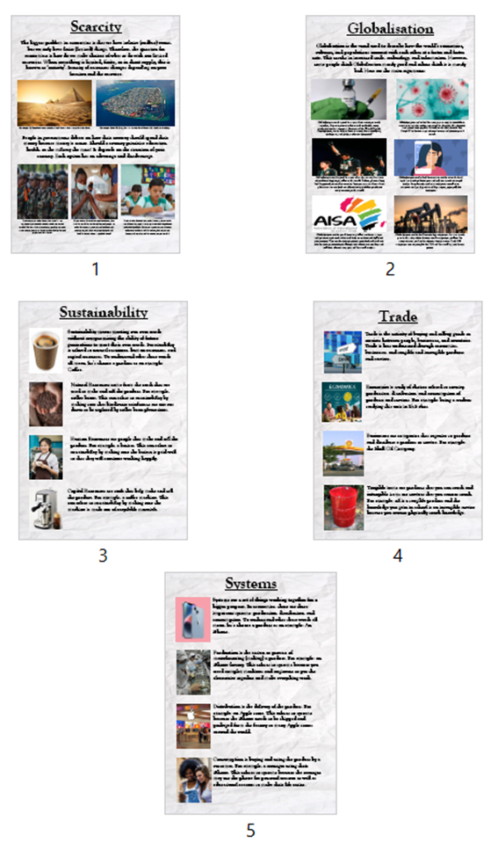
Stations Activity
There are 5 stations in total.
You have 10 minutes per station.
Please read silently for the first 5 minutes.
The questions are on a separate A4 paper on each table.
Please write your answers in your notebook.

Slide 31
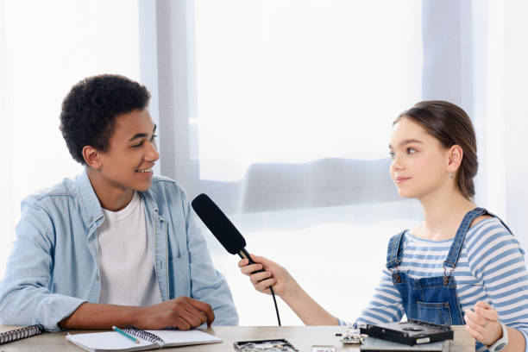
Interview Practice
Date: CD: Mon Jan 20
Unit 3: Local and Global Markets
Grade 6: Individuals & Societies

Slide 32
Today’s Inquiry Questions & Learning Targets
Inquiry Questions:
What makes an interview effective and meaningful?
How can I ask clear and respectful questions to learn about a local business?
Why is listening important during an interview?
Learning Targets (By the end of this lesson…):
I can identify the key elements of a good interview, including preparation and active listening.
I can write and ask clear, respectful, and relevant questions for a local business owner.
I can practice listening carefully and taking notes during a simulated interview.

Slide 33
Interviews: Why?
Purpose of interviews: to learn and share information.
Interview:
A conversation where one person asks questions to gain information.
Active Listening:
Focusing fully on the speaker, understanding their message, and responding thoughtfully.

Slide 34
Interviews: Why?
Open-Ended Questions:
Questions that cannot be answered with a simple “yes" or “no."
Follow-Up Questions:
Additional questions based on the speaker's response.

Slide 35
Interviews: Typical Style - GIPAT
Greeting: Hello, how are you?
Intro: We are here to study local businesses…
Permission: May we interview/record/take a picture?
Ask: What, who, how, where, why…
Thank: Thank you so much, goodbye

Slide 36
Mr. Larson, Structured Interview #1
Hello Mr. Larson, is your day going okay?
Is becoming a teacher difficult?
Do you like being a teacher?
Do you like working with young people?
Are most work days the same?
Is teaching stressful?

Slide 37
Mr. Larson, Structured Interview #2
Hello Mr. Larson, how is your day going?
How does someone become a teacher?
Why did you become a teacher?
What is it like working with younger people?
Can you describe your normal day?
How stressful is it to be a teacher?

Slide 38

Interviews: Scenarios
In Pairs:
Pick 1 business below.
Brainstorm 5 open-ended questions you would ask the business owner
Business #1: Juice Seller
Business #2: Local Baker
Business #3: Blanket Maker
Business #4: Coffee/Cafe Owner
Business #5: Furniture Maker (Chairs, Carpets, Couches)
Business #6: Produce Seller (Cheese, Vegetables, Fruits)

Slide 39
Simulated Interview
Rotate roles, 5 minute each:
The interviewer
The business owner.
Practice active listening and take notes during the interview

Slide 40
Reflection & Tips
What went well during the interviews?
What was challenging?
How did active listening help?
Top tips for interviews?
Saturday January 25th, 9:30am, make a plan with partner(s)

Slide 41

Non-Government Organizations: NGO
Date: CD: Tue Jan 21, Thu Jan 23, AB: Thu Jan 30
Unit 3: Local and Global Markets
Grade 6: Individuals & Societies

Slide 42
Today’s Inquiry Questions & Learning Targets
Inquiry Questions:
What is the role of NGOs in supporting local and global markets?
How do NGOs impact communities economically and socially?
Why might an NGO focus on a specific issue, and how does that connect to economics?
Learning Targets (By the end of this lesson…):
I can explain what an NGO is and its role in local and global markets.
I can analyze how an NGO's mission connects to its impact on communities.
I can evaluate the challenges and benefits of NGOs working within economies.

Slide 43
NGOs
What do you think an NGO does?
Can you think of any examples of organizations that help people?
NGO (Non-Governmental Organization): An organization independent of the government, often focused on social or economic issues.
Mission Statement: A short description of an organization’s purpose.
Impact: The effect or change an organization creates in a community.

Slide 44
NGO Examples
Selam Children’s Village
Focus: Supporting orphaned and vulnerable children by providing housing, education, and vocational training.
Economic Impact: Equips youth with skills to join the workforce and contribute to the local economy.
Ethiopian Women Lawyers Association (EWLA)
Focus: Advocating for women's rights and providing legal aid to women and children.
Economic Impact: Promotes equality and empowers women to participate fully in economic and social life.

Slide 45
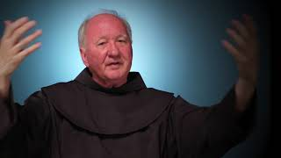
https://www.youtube.com/watch?v=rNcj54d4yyI

Slide 46
NGO Examples
Farm Africa
Focus: Sustainable agricultural practices, forestry, and rural livelihoods.
Economic Impact: Trains farmers and communities in sustainable methods, improving productivity and income.
Hope Enterprises
Focus: Education, skills training, and feeding programs for underprivileged youth.
Economic Impact: Prepares youth for jobs and entrepreneurial opportunities to break cycles of poverty.

Slide 47
NGO Mission Match
Instructions: Match the mission to the organization at your table. Try to look at keywords to make connections

Slide 48
NGO Mission Match
Organization | Mission
Selam Children’s Village | We provide housing, education, and vocational training to empower orphaned and vulnerable children to become self-reliant.
Ethiopian Women Lawyers Association (EWLA) | We advocate for women’s rights and provide free legal aid to marginalized women and children.
Hamlin Fistula Ethiopia | We provide life-changing surgeries and maternal health services to women suffering from childbirth injuries.
Farm Africa | We help farmers adopt sustainable agriculture practices to increase food security and incomes in rural Ethiopia.
Light for the World Ethiopia | We promote inclusive education and development for people with disabilities in Ethiopia.
Doctors Without Borders (Médecins Sans Frontières) | We deliver emergency medical care to people affected by conflict, epidemics, and disasters worldwide.
World Food Programme (WFP) | We provide food assistance and nutrition programs to fight hunger and improve food security globally.
WaterAid | We work to ensure everyone has access to clean water, decent toilets, and good hygiene.
Heifer International | We provide livestock and training to communities around the world to help end hunger and poverty.
Oxfam International | We fight inequality and work to end poverty through sustainable development programs and advocacy.

Slide 49
Design an NGO
Individually or in pairs, design your own NGO.
Name the NGO.
Write a mission statement.
Explain its focus (e.g., education, health, environment).
Describe one way it would impact a local or global market.

Slide 50
Reflection
Discussion Question:
What did you learn about how NGOs work?
How can NGOs make a difference in economies?
Written reflection:
If you could start your own NGO, what issue would you focus on and why?

Slide 51
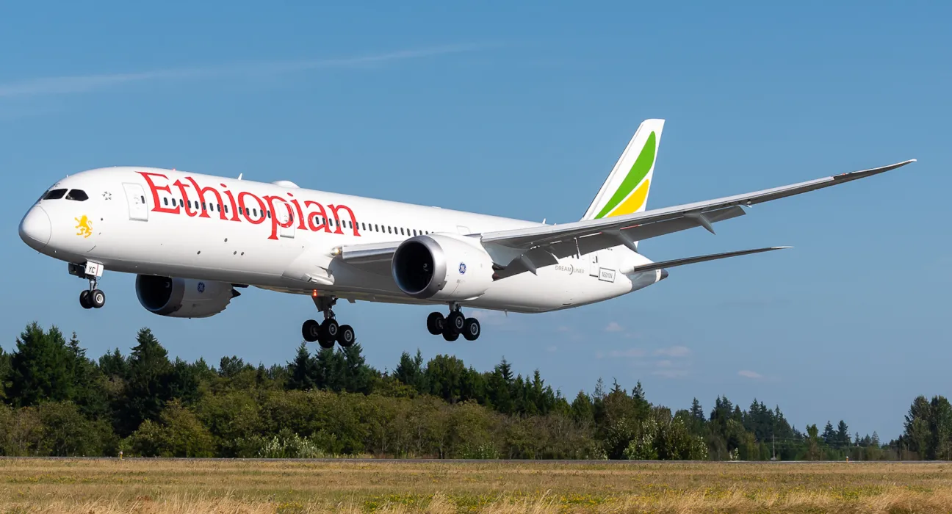
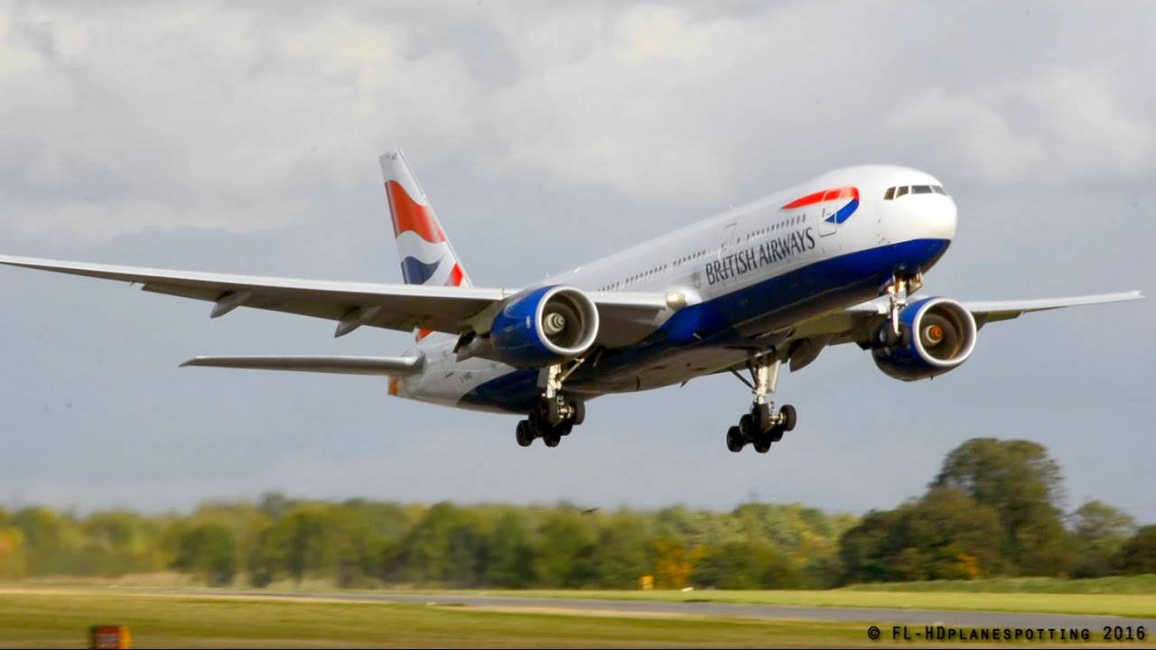
Public & Private Sector
Date: A Mon. Feb 19, B Tues. Feb 20
Unit 3: Local and Global Markets
Grade 6: Individuals & Societies

Slide 52
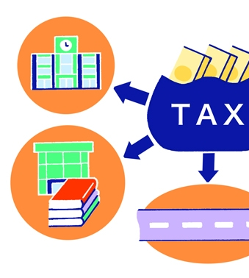
Taxes
Money collected by the government
Many different types
  Income Tax
  Sales Tax
  Tariffs (import tax)
Pay for public projects/services
  Roads, Bridges, Street lights
  Public Schools, Public Libraries
  Police Officers
  Government buildings, government workers, politicians
  Passport applications

Slide 53
Today’s Inquiry Questions & Learning Targets
Inquiry Questions:
What is the Public and Private Sectors?
What are Taxes and Wages?
What are Unions and Strikes?
Why do governments make Health & Safety Regulations?
Learning Targets (By the end of this lesson…):
I can explain the differences and give examples about the Public and Private Sectors.
I can define Taxes, Wages, Unions, and Strikes.
I can list examples of Health & Safety Regulations.

Slide 54
Taxes
Sales Tax: “Sin Tax”
  A “sin tax" is a tax on products that are considered harmful
Singapore
  Alcohol (~$65 tax per bottle)
New York
  Cigarettes (~$5 tax)
  Soda
Should the government tax all unhealthy products?
Taxes

Slide 55
Private & Public
Private:
  Owned by individuals
  Motivated by profit
  Hours vary depending on business/owner
Public:
  Owned by the government
  Hours/holidays made by law
  Motivated for the benefit of all
  Not motivated by profit
  Examples: Environmental protection, public schools, military

Slide 56
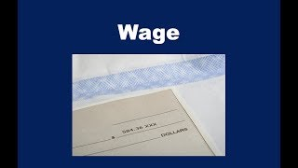
Wage
Amount paid (per hour, per month, per year)
Many different types
  Wage Workers (by hour)
  Salary (by year)
Government Laws
  Minimum wages
    US: $7:25

Slide 57
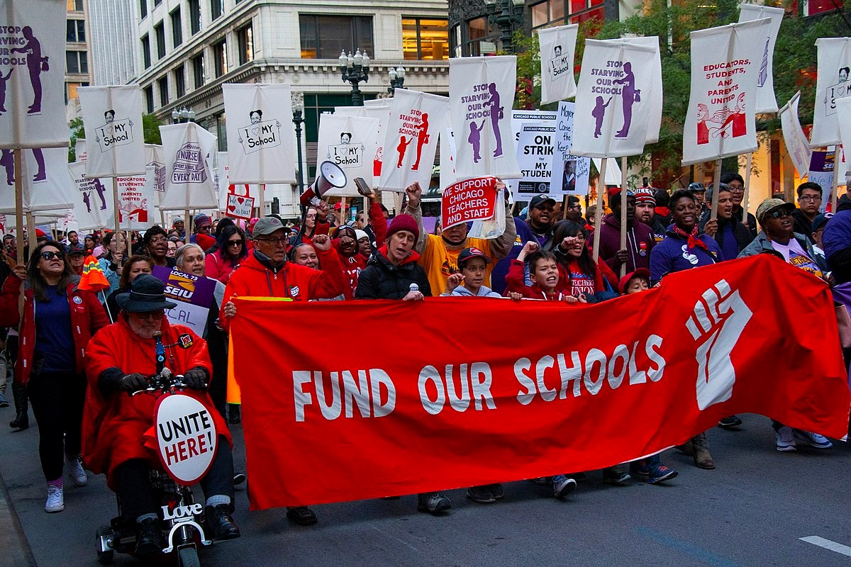
Unions
An organization of workers to demand certain things:
  Higher wages
  Safety rules
  Benefits: Healthcare, Holidays, time off (sick leave, parental leave)
Saturdays and Sundays were created by unions. Countries with more higher minimum wages and family leave, usually have more organized unions.

Slide 58
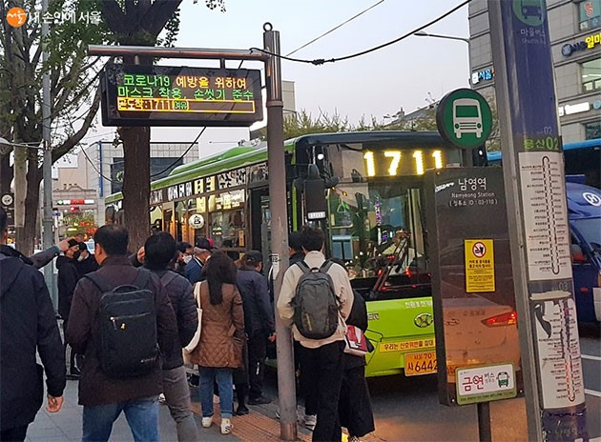
Strikes
A form of protest
One tool used by Unions
Gives power to workers, not CEOs
Can sometimes be disruptive
Two options:
  Give into union demands
  Hire all new workers
  Both options cost money or human resources for the business

Slide 59
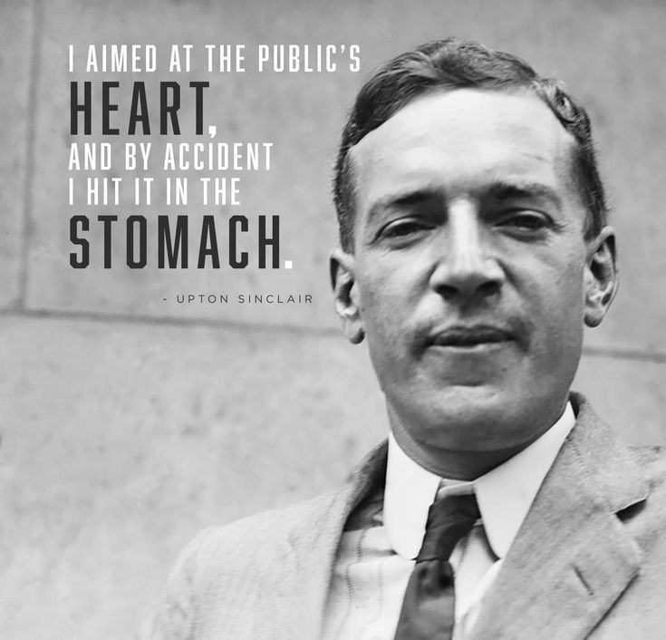
Health & Safety Regulations
Government laws that businesses must follow:
  Risk of fines or closure
  Makes employees safer
Before H&S Laws, many jobs were dangerous and health standards were low
Upton Sinclair

Slide 60
GET LAPTOP, SIT IN ASSIGNED SPOT, TRY BELLRINGER BELOW.
BELLRINGER: Pick one continent, TRY TO NAME EVERY COUNTRY IN THAT CONTINENT

Slide 61
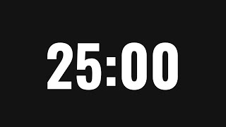
WORK DAY
First 25 minutes:
SILENT work time
Finish Making Presentation
  SMALL PART:
  Shared Summary of interview
  BIGGER PART:
  Individual sections on business idea (Shark tank)
    Use slides document (NOT CANVA). Can customize.
    Transfer your slides to your partner when you finish.
Second 25 minutes:
Work time/practice

Slide 62
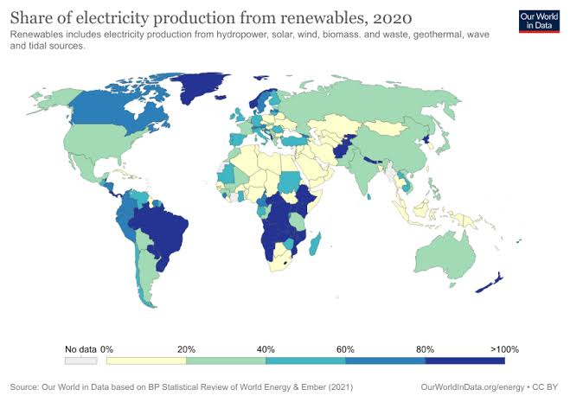

Slide 63
B: Fri 15 Mar A: Mon 18 Mar | L14: Sustainability: Stations Activity & Writing
B: Tue 19 Mar A: Wed 20 Mar | L15: Sustainability: Breaking News & Stock Market
B: Thu 21 Mar A: Fri 22 Mar | L16: Shark Tank Pitch Preparation & Feedback
A: Mon 1 Apr B: Tue 2 Apr | L17: Shark Tank Pitch Presentations
A: Wed 3 Apr B: Thu 4 Apr | L18: Shark Tank Pitch Presentations Larson absent Apr 4
A: Fri 5 Apr B Mon 8 Apr | L19: Reflection Larson absent Apr 5 & 8

Slide 64
Goals Today
Finish slideshow slides
  Summary of interview (together)
  Explain your business (you created individually)
Make sure you have clear examples for A, B, and C sections (Part A document)
  Part D: Sustainability on next lesson.

Slide 65
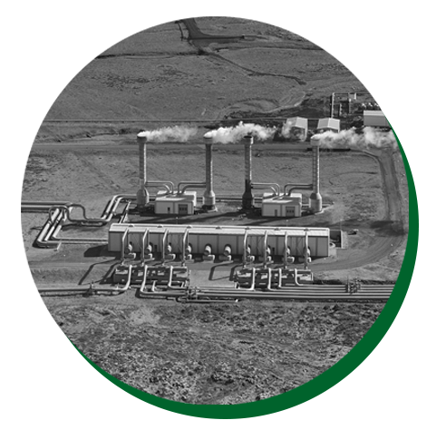



BELLRINGER:
GET NOTEBOOK & PENCIL
What do you see in these images?
How do these images relate to business?

Slide 66

SUSTAINABILITY
Date: A Mon. MAR 18, B FRI. MAR 15
Unit 3: Local and Global Markets
Grade 6: Individuals & Societies

Slide 67
Today’s Inquiry Questions & Learning Targets
Inquiry Questions:
What is Sustainability?
What are the advantages of different distribution systems?
What is sustainable consumption?
What is sustainable production?
Learning Targets (By the end of this lesson…):
I can define sustainability.
I can relate sustainability to business and the economy.
I can list examples of UN sustainable development goals.

Slide 68
What is Sustainability?
Avoid using everything up (completely) to maintain a balance with human needs and environmental use.

Slide 69
TABLE TALK:
What energy do you see? What do you not see?

Slide 70
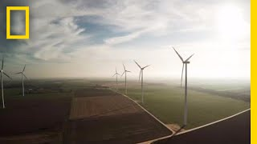

Slide 71
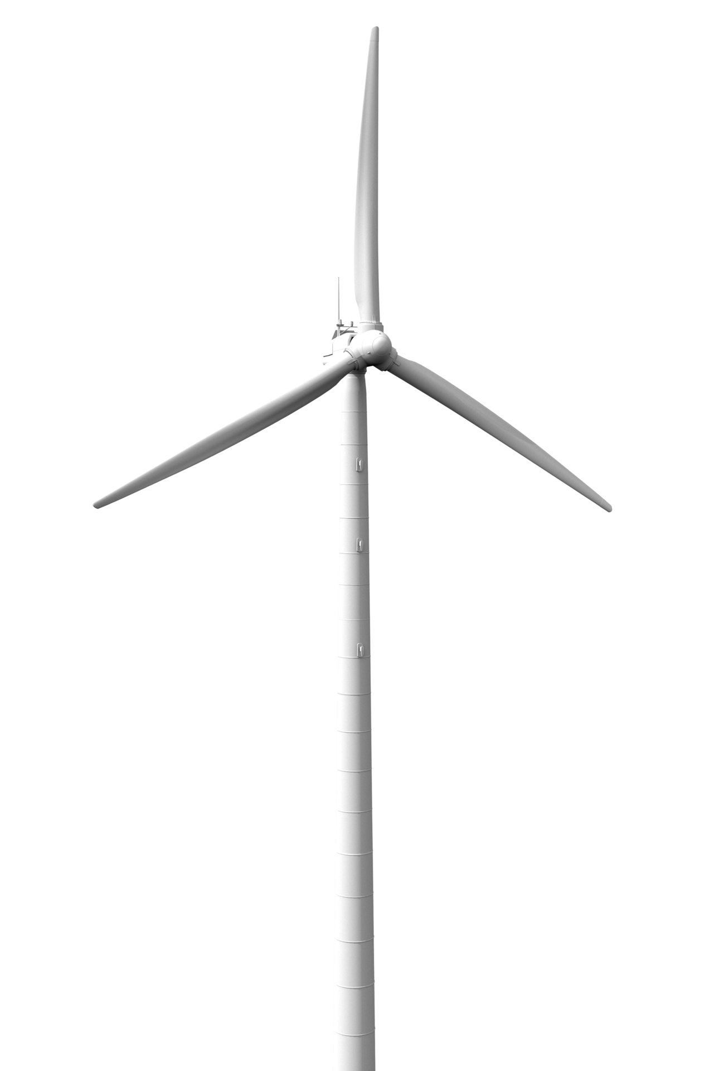
Sustainable Energy Sources?
SOLAR ENERGY - Solar energy is the most abundant of all energy resources and can even be harnessed in cloudy weather.
WIND ENERGY - Energy of moving air by using large wind turbines

Slide 72
Sustainable Energy Sources?
SOLAR ENERGY - Cheap
WIND ENERGY - available everywhere

Slide 73
Sustainable Energy Sources?
GEOTHERMAL ENERGY - Heat is extracted from geothermal wells
HYDROPOWER - harnesses the energy of water moving from higher to lower elevations.

Slide 74
Sustainable Energy Sources?
GEOTHERMAL ENERGY - Reliable, safe, expensive to build
HYDROPOWER - Relies on rainfall, largest source

Slide 75
TABLE TALK:
What energy will your business use? Why?

Slide 76
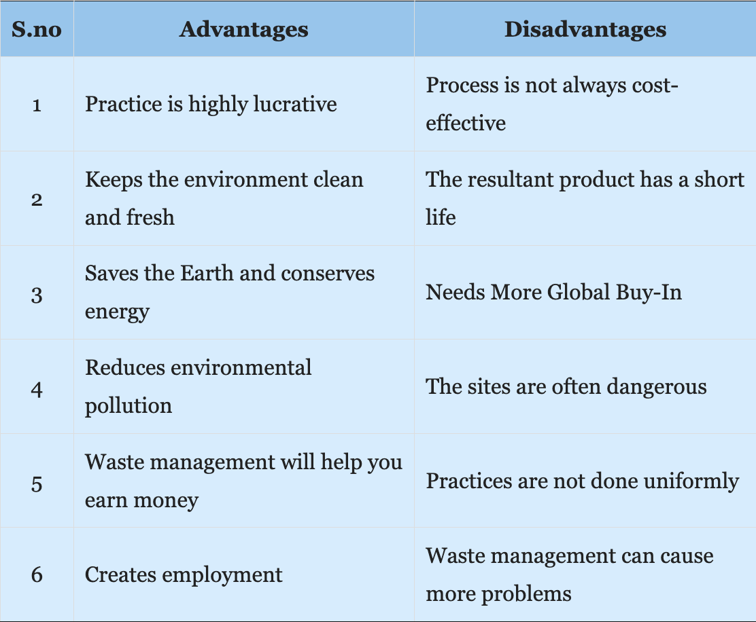
Sustainable
Waste
Disposal
How will your business adapt to have sustainable waste disposal?

Slide 77
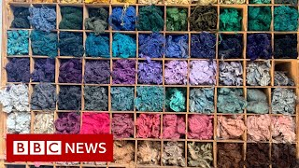
Sustainable Recyclable Materials
How will your business adapt to use recyclable materials?
Advantages: Alternatives materials might target new customers
Disadvantages: The cost to produce your product/service might increase

Slide 78
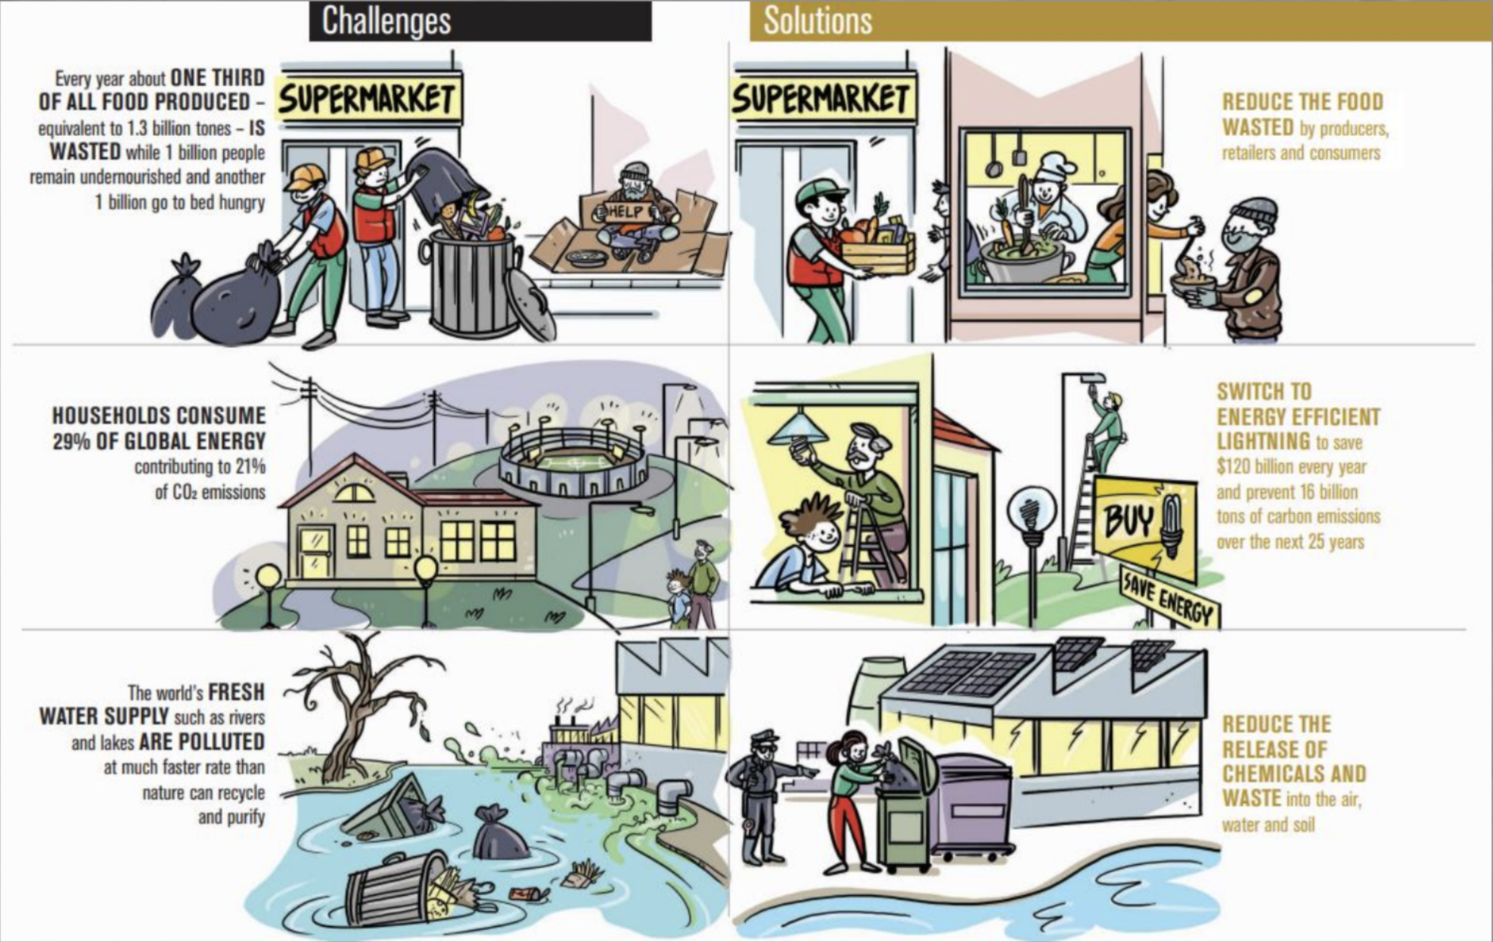

Slide 79
TABLE TALK: Minimize Pollution
How can your business pollute less?
What are Advantages to polluting less?
What are Disadvantages to polluting less?

Slide 80
UN SDGs
Sustainable Development Goals
All United Nations Member States agreed in 2015 to a shared plan for peace and prosperity for people and the planet, now and into the future.
Which UN SDG will your business contribute towards?

Slide 81


Slide 82


Slide 83
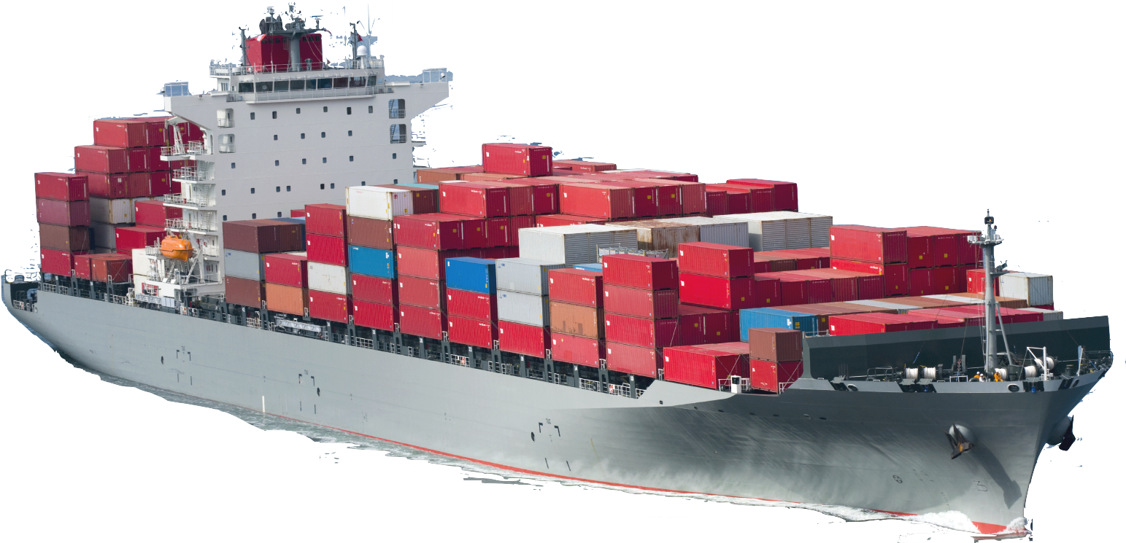
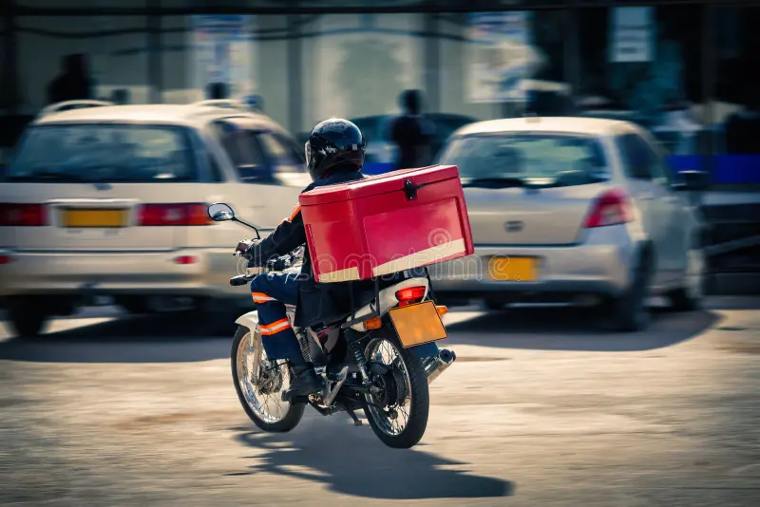
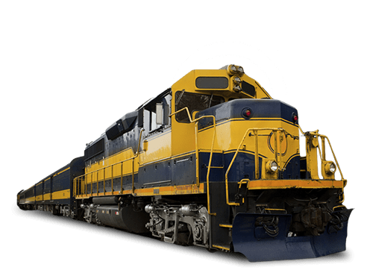
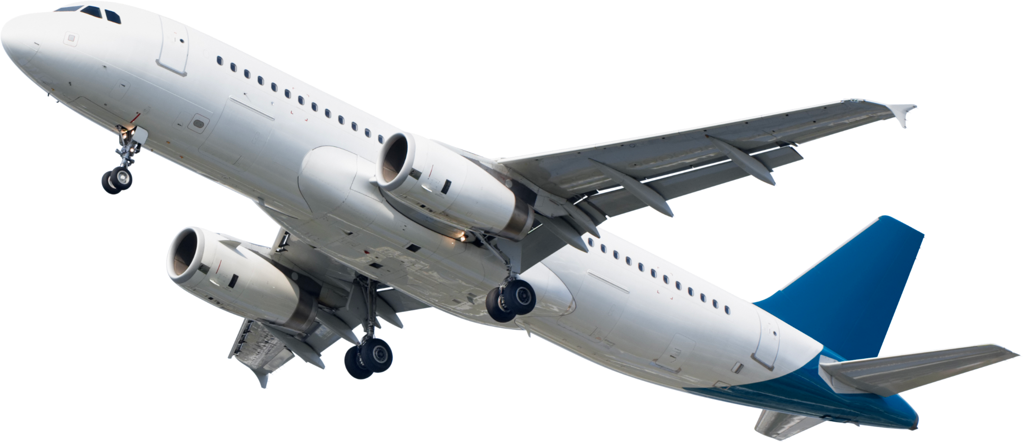
Sustainable Distribution
What types of distribution do you SEE?
Which is most sustainable? Why?

Slide 84
Sustainable Distribution
Distribution via Shipping
  Pros: Cheapest cost, rent a small amount of space on a huge cargo ship.
  Cons: Fossil fuels & Transit tariffs in canals.
Distribution via Air
  Pros: Fastest option, luxury customers or emergency aid
  Cons: Most expensive, most damaging to environment

Slide 85
Sustainable Distribution
Distribution via Rail
  Pros: New bullet trains or cargo-rails use smallest amount of fossil fuels, very fast.
  Cons: restrict to same continent
Distribution via Car/Motorbike
  Pros: Motorbikes helpful to rural places. Low/No emission (electric)
  Cons: Can’t be used long distance, fossil fuel use high (old)

Slide 86
BELLRINGER:
What is going on in our world?
What news have you heard about recently?

Slide 87
What does it mean for a business to have sustainable waste disposal? How will your business adapt to have sustainable waste disposal? What are the advantages and disadvantages?
What does it mean for a business to have sustainable recyclable materials? How will your business adapt to have recyclable materials? What are the advantages and disadvantages?
What does it mean for a business to minimize pollution? How will your business adapt to minimize pollution? What are the advantages and disadvantages?
What is the purpose of the United Nations Sustainable Development Goals (UNSDG)? Which UNSDG will your business contribute towards? What are the advantages and disadvantages?

Slide 88
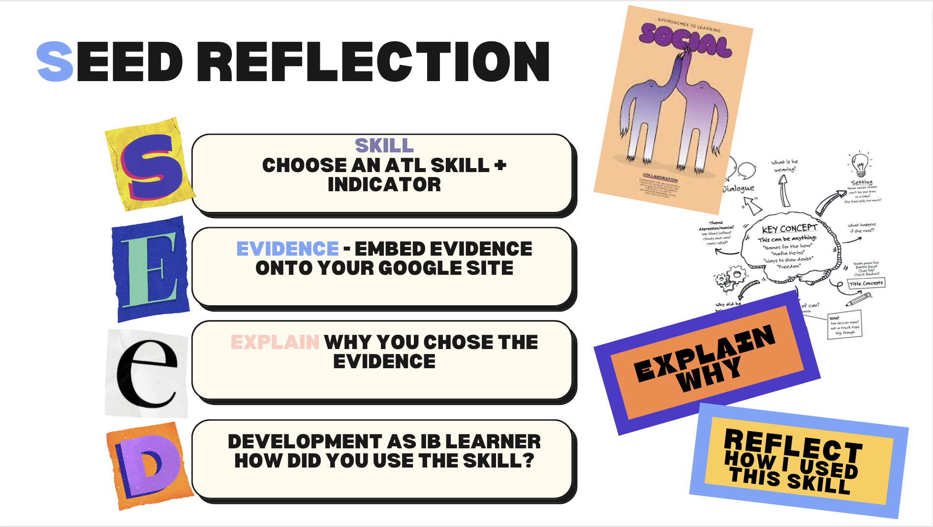
Reflection
Today’s Expectations:
If you have not presented yet, please go to the breakout room with Ms. Smith.
If you have not responded to Mr. Larson’s feedback on Toddle, please do that now.
Once you are finished responding to feedback, please complete the SEED Reflection in your Student Portfolio, the same way you have done for previous reflections.
Today is the last day for this unit.

Slide 90
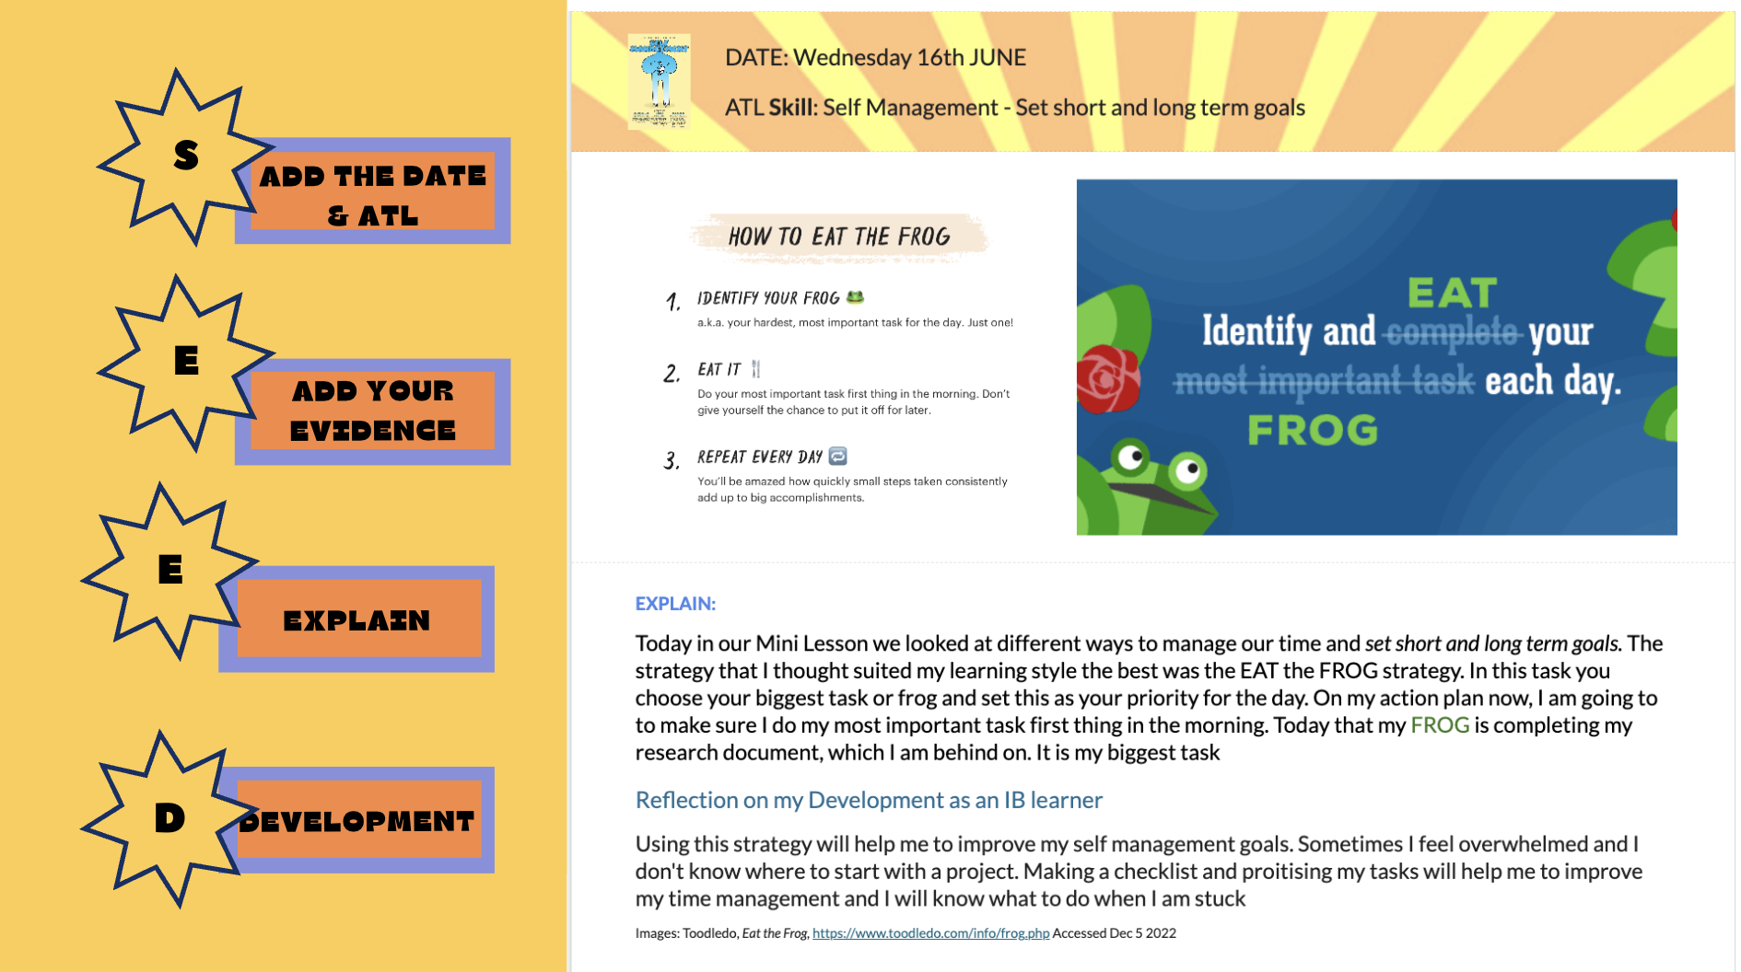
Notes:
RILEY SLIDE

Slide 91

Step 4:
The Student Led conference.
Follow the same process Steps 1 - 3 as for your video
Tips for success
Make sure you have EVIDENCE of your task and reflection on your portfolio.
Embed pictures, task sheet or a video to show your parents what you have been doing.
Can you read your evidence?
Be confident - You are an amazing learner and have grown so much. Be proud of yourself and explain who you are as a learner for your parents.
You have already written clear summary of your task - use this to guide what you are saying.

Slide 92
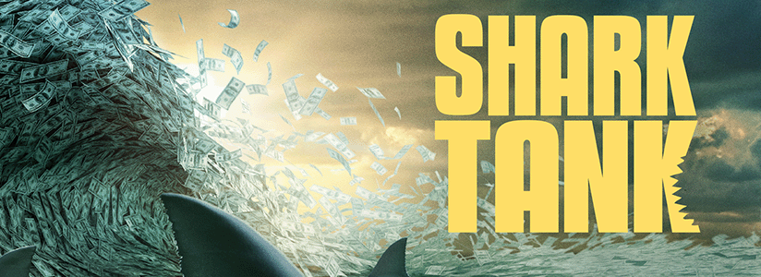
Summative 2: Creating Your Own Business
Theme: Creating your own Business
Unit 3: Local and Global Markets
Grade 6: Individuals & Societies

Slide 93
Today’s Inquiry Questions & Learning Targets
Inquiry Questions:
How can I become inspired to create my own fictional business?
How can I begin to create my own fictional business?
Learning Targets (By the end of this lesson…):
I can watch a clip of Shark Tank to gain inspiration for my own fictional business.
I can fill in part “A: Starting Your Business” section on my graphic organiser.

Slide 94
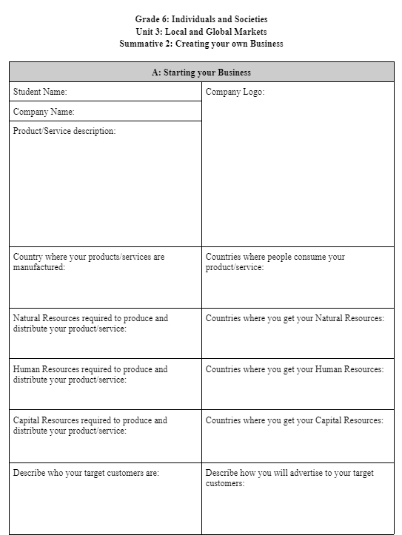
Today’s Inquiry Questions & Learning Targets
Let’s watch these real Shark Tank pitches made by people around your age:
Video 1
Video 2
Fill out part “A: Starting Your Business” on your graphic organiser in Toddle. You can make up your product and decide how local or global your business is.

Slide 97
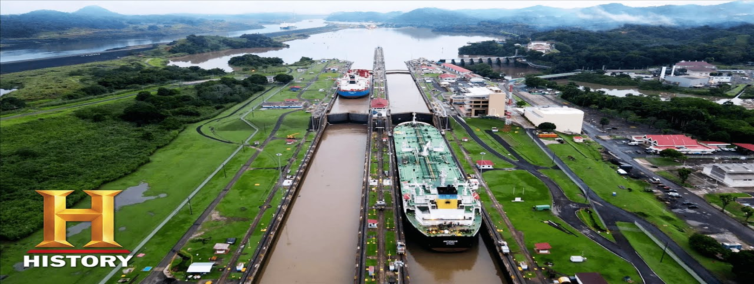
Supply & Demand
Theme: Creating your own Business
Unit 3: Local and Global Markets
Grade 6: Individuals & Societies

Slide 98
Today’s Inquiry Questions & Learning Targets
Inquiry Questions:
How can I understand Supply and Demand, Shortages, Surpluses, and Tariffs?
Can I finish Part A of my own fictional business?
Learning Targets (By the end of this lesson…):
I can understand Supply and Demand, Shortages, Surpluses, and Tariffs.
I can finish everything in Part A of my own fictional business.

Slide 99
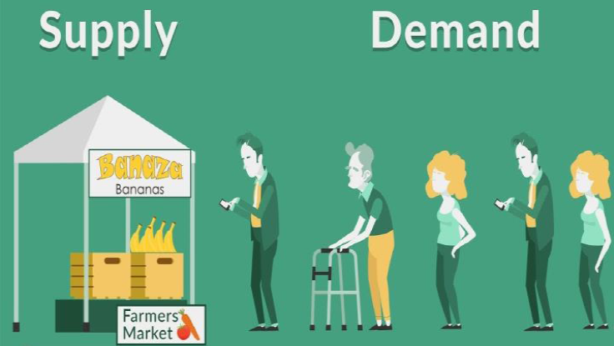

Supply and Demand
Please write down the definition of Supply and Demand:
Supply is the amount of something.
Demand is how much people want it.
When there’s more supply than demand, prices go down.
When there’s more demand than supply, prices go up.
For example, the demand for roses increases on special occasions like Valentine’s Day or Mother’s Day, and the price of roses increases significantly at that time. Similarly, after the holidays the demand for holiday decorations reduces drastically, so they are available at a deep discount.
Can you think of another example of a product or service where Supply and Demand changes throughout the year?

Slide 100
SUPPLY
DEMAND
PRICES

Slide 101
DEMAND
PRICES
SUPPLY

Slide 102

Shortage
Please write down the definition of a shortage:
A shortage results when there is more demand than supply (there is too little of something).
When there is a shortage of something, the price will probably increase.
A shortage can happen if the supply of a product is drastically reduced. For example, there is a shortage of wheat because Ukraine is no longer able to sell wheat due to the Russian invasion.
A shortage can happen if the demand for a product is drastically increased. For example, there was a shortage of toilet paper in the US during Covid because everybody panicked due to the lockdown.
Can you think of another example of a product that has a shortage?

Slide 103


Surplus
Please write down the definition of a surplus:
A surplus occurs when there is more supply than demand (there is too much of something).
When there is a surplus of something, the price will probably decrease.
A surplus can happen due to a massive increase ins supply. For example, in 1956, two Americans bought so many onion companies and sold more far more onions that people needed that the onions in the bag were worth less than the bag itself.
A surplus can also happen due to a massive decrease in demand. For example, in some parts of rural Italy, people are leaving because of a lack of jobs. Some houses are selling for only 1 Euro (60 Birr).
Can you think of another example of a product that has a surplus?

Slide 104
SUPPLY
DEMAND
PRICES

Slide 105


Slide 106


Slide 107
Tariff
Please write down the definition of a tariff:
A tariff is a tax (making something more expensive by giving the government some money) on products that go in and out of a country.
For example, the Suez Canal in Egypt and Panama Canal in Panama, charge a tariff for all ships that pass through their waters. Panama Canal Video. Suez Canal Video.

Slide 108
Please use the remaining time to finish Part A!
Fill out part “Starting Your Business” on your graphic organiser. You can make up your product and decide how local or global your business is.
You have 20 minutes to finish this! If you don’t, then you will miss out on some of the Stock Market and Breaking News activities next class!

Slide 109
Please sit in your assigned seat with a pen or a pencil.
Video (0:00, 18:01, 24:46, 35:54)
Do you think they made a good pitch or would you change their methods?
Which offers would you have taken?
After we finish watching, please finish the entire back side of your summative paper.

Slide 110

Supply & Demand: Breaking News & Stock Market (part B)
Date: Thursday February 15 (B) & Friday February 16 (A)
Theme: Creating your own Business
Unit 3: Local and Global Markets
Grade 6: Individuals & Societies

Slide 111
Today’s Inquiry Questions & Learning Targets
Inquiry Questions:
How can I participate in the Stock Market?
How can I respond to Breaking News?
Learning Targets (By the end of this lesson…):
I can participate in the Stock Market and record my earnings and/or losses on my Toddle log.
I can respond to Breaking News in my Toddle log.

Slide 112

Stock Market
Definitions:
The Stock Market is where people buy and sell shares of other companies. A share is a piece of the company you own. So if the company makes a lot of money, so do you! But if the company loses money, then so do you.
1. Everyone starts off with 1,000 USD.
2. Choose how many stocks you would like to buy and record it in the ‘Stock Market Tracker’ and ‘Profits/Loses Tracker’ sections. You don’t have to use all your money. For example:
Stock Market Cost of Shares as of February 15 and 16:
Amazon: 1 share = 200 USD.
Apple: 1 share = 160 USD.
China Petroleum: 1 share = 120 USD.
CVS Health: 1 share = 100 USD.
Volkswagen: 1 share = 50 USD.
Tesla: 1 share = 20 USD.

Slide 113

Stock Market
Stock Market Cost of Shares as of February 15 and 16:
Amazon: 1 share = 200 USD.
Apple: 1 share = 160 USD.
China Petroleum: 1 share = 120 USD.
CVS Health: 1 share = 100 USD.
Volkswagen: 1 share = 50 USD.
Tesla: 1 share = 20 USD.
Stock Market Performance on February 15 and 16:
For every share purchased of Amazon, you get 210 USD.
For every share purchased of Apple, you get 180 USD.
For every share purchased of China Petroleum, you get 120 USD.
For every share purchased of CVS Health, you get 80 USD.
For every share purchased of Volkswagen, you get 20 USD.
For every share purchased of Tesla, you lose 10 USD.
Now write down how much you gained or lost in your profits/losses tracker →

Slide 114

Breaking News
1. Demand for all food products in the world increased. All food related businesses gain 1000 USD.
2. Supply of fabric in the world decreased. All fashion related businesses lose 200 USD.
3. Due to Amazon Forest Fires, there is a shortage of wood. All businesses that use wood as a natural resource lose 50 USD.
4. Due the discovery of new precious stones in Mozambique, there is a surplus of precious stones. All businesses that use precious stones as a natural resource gain 300 USD.
5. Egypt has increased tariffs for all goods passing through the Suez Canal. If you import or export to Asia, Oceana, Africa, or Europe, you lose 200 USD.
Fill out your log for today in this section in the bottom of section B. Now add any additional profits/losses that you encountered from your Breaking News. This is an example what it should look like →

Slide 115

Complete the rest of Part B
Refer to your notes to answer these questions.

Slide 116

Rubric for Summative 2
For Part Two, students will create their own fictional business, go through multiple simulations, and apply the concepts and vocabulary to their businesses. This way, students will not only learn vocabulary in isolation but also how it would operate in this theoretical simulation. Students will be assessed on Criteria A (Knowing and Understanding). The due date for part two is April 19 for B Days and April 22 for A Days.

Slide 117




BELLRINGER ACTIVITY:
READ:
Bags in back
Sit down in Assigned Spot, START BELLRINGER ACTIVITY BEFORE CLASS BEGINS
Write title “Public VS Private” as today’s title.
DESCRIBE AS MANY COUNTRIES PICTURED AS POSSIBLE
Name of Country
Continent
Main Religion(s)
Other countries nearby

Slide 118




BELLRINGER ACTIVITY:
READ:
Bags in back
Sit down in Assigned Spot, START BELLRINGER ACTIVITY BEFORE CLASS BEGINS
DESCRIBE AS MANY PICTURES AS POSSIBLE
Name of Religion
Name the type of building
What country is this?

Slide 119
Public & Private Sector
Date: A Mon. Feb 19, B Tues. Feb 20
Unit 3: Local and Global Markets
Grade 6: Individuals & Societies

Slide 120
Today’s Inquiry Questions & Learning Targets
Inquiry Questions:
What is the Public and Private Sectors?
What are Taxes and Wages?
What are Unions and Strikes?
Why do governments make Health & Safety Regulations?
Learning Targets (By the end of this lesson…):
I can explain the differences and give examples about the Public and Private Sectors.
I can define Taxes, Wages, Unions, and Strikes.
I can list examples of Health & Safety Regulations.

Slide 121





Stations Rotations
You have 8 minutes for each of the five stations:

Slide 122
Taxes
Money collected by the government
Many different types
  Income Tax
  Sales Tax
  Tariffs (import tax)
Pay for public projects/services
  Roads, Bridges, Street lights
  Public Schools, Public Libraries
  Police Officers
  Government buildings, government workers, politicians
  Passport applications

Slide 123
Taxes
567 × 378
Sales Tax: “Sin Tax”
  A “sin tax" is a tax on products that are considered harmful
Singapore
  Alcohol (~$65 tax per bottle)
New York
  Cigarettes (~$5 tax)
  Soda
Should the government tax all unhealthy products?

Slide 124
TABLE TALK
SHOULD THE GOVERNMENT MAKE A SIN-TAX FOR POPCORN?

Slide 125
TABLE TALK
SHOULD THE GOVERNMENT MAKE A SIN-TAX FOR PLASTIC BAGS?

Slide 126
Private & Public
Private:
  Owned by individuals
  Motivated by profit
  Hours vary depending on business/owner
Public:
  Owned by the government
  Hours/holidays made by law
  Motivated for the benefit of all
  Not motivated by profit
  Examples: Environmental protection, public schools, military

Slide 127



Slide 128


Slide 129


Slide 130


Slide 131


Slide 132
TABLE TALK
Is the private sector or public sector better at providing education for all?

Slide 133
Wage
Amount paid (per hour, per month, per year)
Many different types
  Wage Workers (by hour)
  Salary (by year)
Government Laws
  Minimum wages
    US: $7:25

Slide 134
TABLE TALK
Should government make a maximum wage for owners of businesses?
Which country do you think has the highest minimum wage? Why do you think so?

Slide 135


Slide 136
Unions
An organization of workers to demand certain things:
  Higher wages
  Safety rules
  Benefits: Healthcare, Holidays, time off (sick leave, parental leave)
Saturdays and Sundays were created by unions. Countries with more higher minimum wages and family leave, usually have more organized unions.

Slide 137
TABLE TALK
Do students need a union? Why/why not?

Slide 138
Strikes
A form of protest
One tool used by Unions
Gives power to workers, not CEOs
Can sometimes be disruptive
Two options:
  Give into union demands
  Hire all new workers
  Both options cost money or human resources for the business

Slide 139
TABLE TALK
What is your opinion of the Korean Bus Driver Strike? Is it wrong for the drivers to refuse money?

Slide 140
Health & Safety Regulations
Government laws that businesses must follow:
  Risk of fines or closure
  Makes employees safer
Before H&S Laws, many jobs were dangerous and health standards were low
Upton Sinclair

Slide 141
TABLE TALK
Should children under 16 be banned from working? Why/why not?

Slide 142


Slide 143


Slide 144
TABLE TALK
Should children be allowed to work part-time while going to school part-time?

Slide 145


Slide 146
TABLE TALK
What is your reaction to the last video?
Talk again: Should children under 16 be banned from working? Why/why not?

Slide 147
Public VS Private: Breaking News & Stock Market (part C)
Date: Thursday February 22 (A) & Friday February 23 (B)
Theme: Creating your own Business
Unit 3: Local and Global Markets
Grade 6: Individuals & Societies

Slide 148
Today’s Inquiry Questions & Learning Targets
Inquiry Questions:
How can I participate in the Stock Market?
How can I respond to Breaking News?
Learning Targets (By the end of this lesson…):
I can participate in the Stock Market and record my earnings and/or losses on my Toddle log.
I can respond to Breaking News in my Toddle log.

Slide 149
Stock Market
Definitions:
The Stock Market is where people buy and sell shares of other companies. A share is a piece of the company you own. So if the company makes a lot of money, so do you! But if the company loses money, then so do you.
Everyone can be new stocks or sell their existing stocks. Record it in the ‘Stock Market Tracker’ and ‘Profits/Loses Tracker’ sections. You don’t have to use all your money. For example:
Stock Market Cost of Shares as of February 22 and 23 are:
Amazon: 1 share = 300 USD (it was worth 250 USD last class).
Apple: 1 share = 200 USD (it was worth 180 USD last class).
China Petroleum: 1 share = 140 USD (it was worth 120 USD last class).
CVS Health: 1 share = 90 USD (it was worth 90 USD last class).
Volkswagen: 1 share = 30 USD (it was worth 40 USD last class).
Tesla: 1 share = 5 USD (it was worth 5 USD last class).

Slide 150
Stock Market
Stock Market Cost of Shares as of February 22 and 23 are:
Amazon: 1 share = 300 USD (it was worth 250 USD last class).
Apple: 1 share = 200 USD (it was worth 180 USD last class).
China Petroleum: 1 share = 140 USD (it was worth 120 USD last class).
CVS Health: 1 share = 90 USD (it was worth 90 USD last class).
Volkswagen: 1 share = 30 USD (it was worth 40 USD last class).
Tesla: 1 share = 5 USD (it was worth 5 USD last class).
Stock Market Performance on February 22 and 23:
For every share purchased of Amazon, you lose 1000 USD.
For every share purchased of Apple, you get 3000 USD.
For every share purchased of China Petroleum, you lose 500 USD.
For every share purchased of CVS Health, you get 5000 USD.
For every share purchased of Volkswagen, you get 1000 USD.For every share purchased of Tesla, you lose 10 USD.
Now write down how much you gained or lost in your profits/losses tracker →

Slide 151
Breaking News
1. China, Ethiopia, Germany, and the UAE have added a sales tax to all Natural Resources sold from the country. If you get your natural resources from these countries, you lose 200 USD.
2. Rwanda, Japan, the Netherlands, Brazil, USA, Germany, France, Poland, Egypt, and Turkey have added a new safety regulation: It is now mandatory for all businesses to pay for dental care. If you have human resources from these countries, you must pay 500 USD to abide by the new health regulation. However, you can choose to hire human resources in a new country and fire all your current workers.
3. Every country in North America, South America, and Europe has made it mandatory to join a union. You must choose now if you want to keep your human resources in these countries, or fire all your workers and hire human resources in another country.
4. Workers in Ethiopia, China, and South Africa have all demanded to double the minimum wage. You can choose to pay 1000 USD to increase the minimum wage or relocate to another country and fire all your current human resources.
5. All workers in Europe have gone on strike unless you let them have a three day weekend. If you have human resources in Europe you cannot fire them because they are in a union. You must pay 600 USD since you will lose all business on the third weekend.
Fill out your log for today in this section in the bottom of section B. Now add any additional profits/losses that you encountered from your Breaking News. This is an example what it should look like →

Slide 152

Complete the rest of Part C
Refer to your notes to answer these questions.

Slide 153
Public VS Private: Breaking News & Stock Market (part D)
Date: Tuesday March 19 (B) & Wednesday March 20 (A)
Theme: Creating your own Business
Unit 3: Local and Global Markets
Grade 6: Individuals & Societies

Slide 154
Today’s Inquiry Questions & Learning Targets
Inquiry Questions:
How can I participate in the Stock Market?
How can I respond to Breaking News?
Learning Targets (By the end of this lesson…):
I can participate in the Stock Market and record my earnings and/or losses on my Toddle log.
I can respond to Breaking News in my Toddle log.

Slide 155

Complete the rest of Part D
Refer to your notes to answer these questions.

Slide 156
Stock Market
Definitions:
The Stock Market is where people buy and sell shares of other companies. A share is a piece of the company you own. So if the company makes a lot of money, so do you! But if the company loses money, then so do you.
Everyone can be new stocks or sell their existing stocks. Record it in the ‘Stock Market Tracker’ and ‘Profits/Loses Tracker’ sections. You don’t have to use all your money. For example:
Stock Market Cost of Shares as of March 19 and 20 are:
Amazon: 1 share = 400 USD (it was worth 300 USD last class).
Apple: 1 share = 300 USD (it was worth 200 USD last class).
China Petroleum: 1 share = 200 USD (it was worth 140 USD last class).
CVS Health: 1 share = 90 USD (it was worth 90 USD last class).
Volkswagen: 1 share = 10 USD (it was worth 30 USD last class).
Tesla: 1 share = 1 USD (it was worth 5 USD last class).

Slide 157
Stock Market
Stock Market Cost of Shares as of March 19 and 20 are:
Amazon: 1 share = 400 USD (it was worth 300 USD last class).
Apple: 1 share = 300 USD (it was worth 200 USD last class).
China Petroleum: 1 share = 200 USD (it was worth 140 USD last class).
CVS Health: 1 share = 90 USD (it was worth 90 USD last class).
Volkswagen: 1 share = 10 USD (it was worth 30 USD last class).
Tesla: 1 share = 1 USD (it was worth 5 USD last class).
Stock Market Performance on February 22 and 23:
For every share purchased of Amazon, you get 3000 USD.
For every share purchased of Apple, you get 2000 USD.
For every share purchased of China Petroleum, you get 1500 USD.
For every share purchased of CVS Health, you get 1000 USD.
For every share purchased of Volkswagen, you get 500 USD.For every share purchased of Tesla, you get 400 USD.
Now write down how much you gained or lost in your profits/losses tracker →

Slide 158
Breaking News
OPEC (an organisation of the countries that produce the most oil in the world) decide to cut off all fossil fuels to countries in Europe and North America due to a political fight. If you use fossil fuels for production, distribution, or consumption, you lose 1000 USD.
The World Bank is giving a loan to all businesses that use recyclable materials in their production and/or electric cars in their distribution. If you have one of these then you earn 2000 USD.
Hyperinflation has impacted China, South Korea, and Japan. If you export to any of these nations, you lose 500 USD for each country.
The AQI is so poor in the UAE, Saudi-Arabia, and Turkey, that factories have to shut down for a few days. If you manufacture in any of these countries you lose 500 USD.
The United Nations is giving a loan for every UNSDG you support. You gain 800 USD for every UNSDG that you support.
Fill out your log for today in this section in the bottom of section B. Now add any additional profits/losses that you encountered from your Breaking News. This is an example what it should look like →

Slide 159


Welcome Back!
We hope you had a wonderful spring break! Please spend the first few minutes catching up with your friends at your table.
If you have not presented your Shark Tank pitch yet, please get ready on your computers.

Slide 160
Substitute Plan: 18 March
1. Please spend the first 30 minutes finishing your Shark Tank presentations to the students on your table groups.
2. After all Shark Tank presentations are complete on your tables, you may make any final alterations to your papers located on the desk in front of the projector in the hub.
3. After everything is complete, please finish your reflections located in Toddle.

