Slide 1
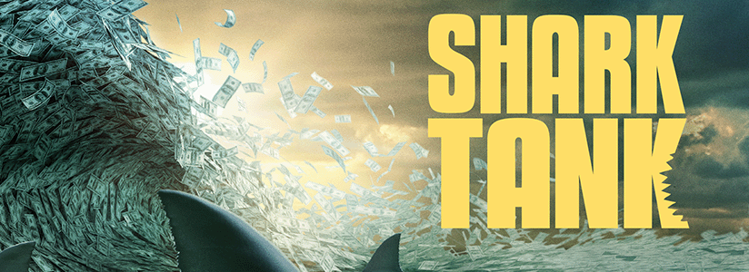
Summative 2: Creating Your Own Business
Theme: Creating your own Business
Unit 3: Local and Global Markets
Grade 6: Individuals & Societies

Slide 2

Today’s Inquiry Questions & Learning Targets
Inquiry Questions:
How can I become inspired to create my own fictional business?
How can I begin to create my own fictional business?
Learning Targets (By the end of this lesson…):
I can watch a clip of Shark Tank to gain inspiration for my own fictional business.
I can fill in part “Starting Your Business” section on my graphic organiser.

Slide 3
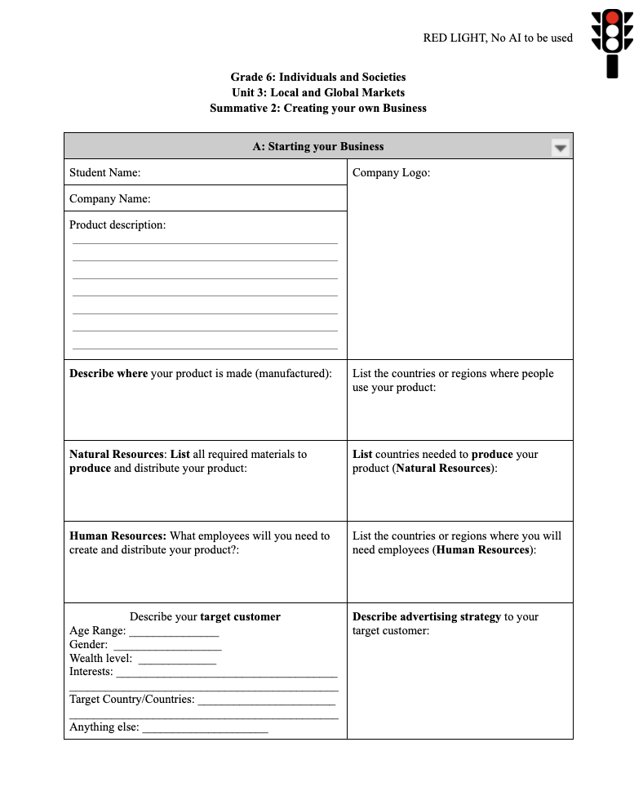
Today’s Inquiry Questions & Learning Targets
Let’s watch these real Shark Tank pitches made by people around your age:
Video 1
Video 2
Fill out part “Starting Your Business” on your graphic organiser.
First read product/industry options
Then decide your type of business

Slide 4
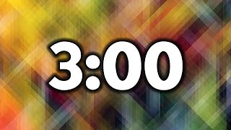

Slide 5


Slide 6
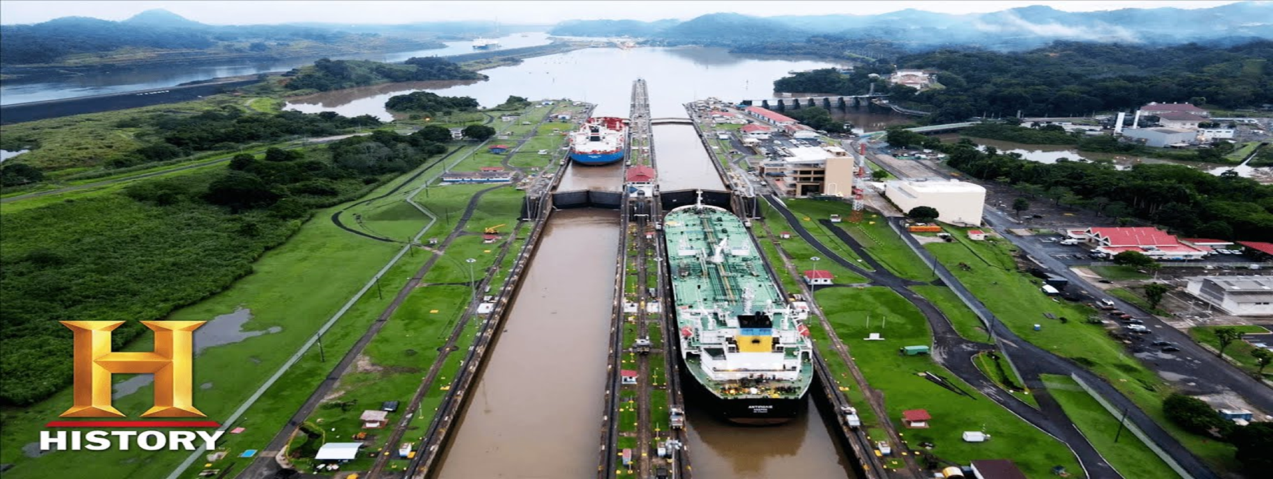
Supply & Demand
Theme: Creating your own Business
Unit 3: Local and Global Markets
Grade 6: Individuals & Societies

Slide 7
Today’s Inquiry Questions & Learning Targets
Inquiry Questions:
How can I understand Supply and Demand, Shortages, Surpluses, and Tariffs?
Can I finish Part A of my own fictional business?
Learning Targets (By the end of this lesson…):
I can understand Supply and Demand, Shortages, Surpluses, and Tariffs.
I can finish everything in Part A of my own fictional business.

Slide 8
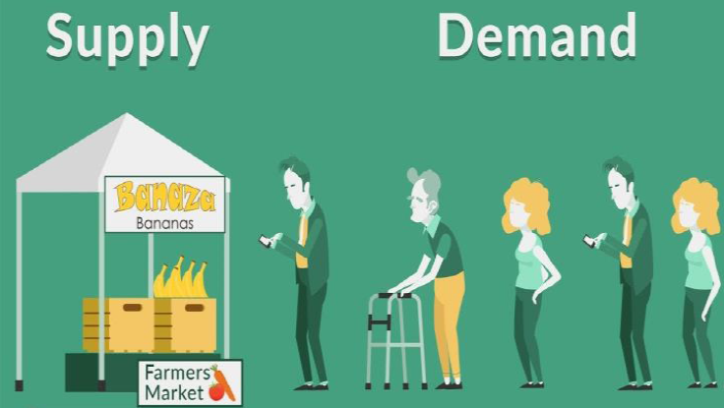
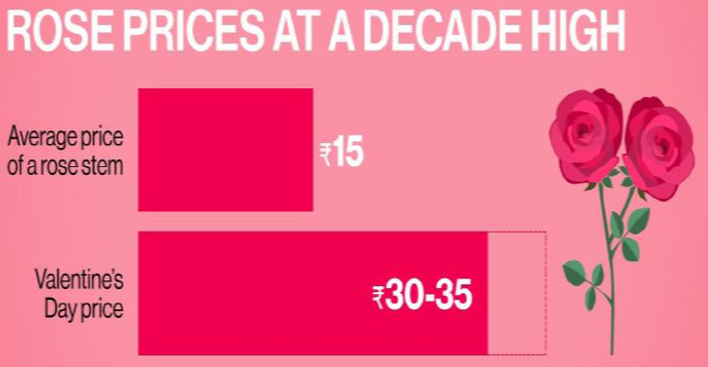
Supply and Demand
Please write down the definition of Supply and Demand:
Supply is the amount of something.
Demand is how much people want it.
When there’s more supply than demand, prices go down.
When there’s more demand than supply, prices go up.
For example, the demand for roses increases on special occasions like Valentine’s Day or Mother’s Day, and the price of roses increases significantly at that time. Similarly, after the holidays the demand for holiday decorations reduces drastically, so they are available at a deep discount.
Can you think of another example of a product or service where Supply and Demand changes throughout the year?

Slide 9
SUPPLY
DEMAND
PRICES

Slide 10
DEMAND
PRICES
SUPPLY

Slide 11
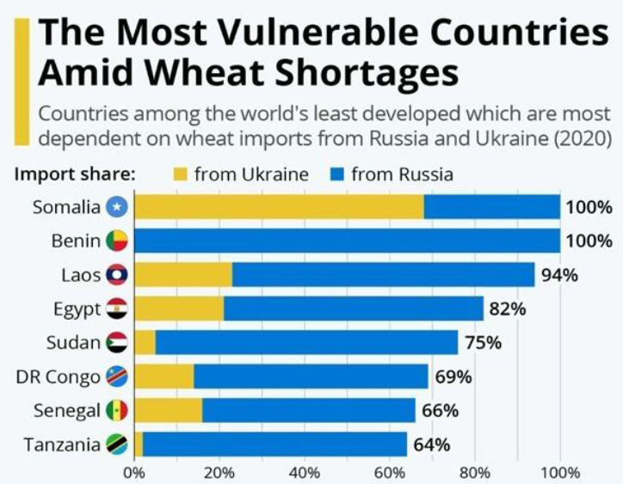
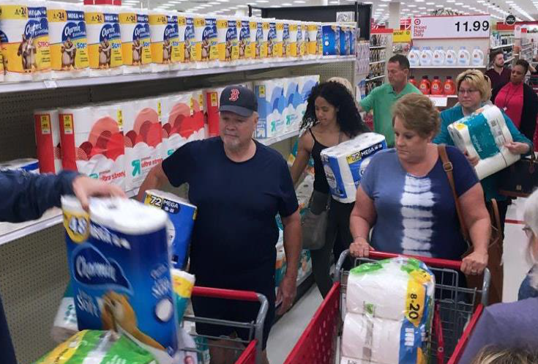
Shortage
Please write down the definition of a shortage:
A shortage results when there is more demand than supply (there is too little of something).
When there is a shortage of something, the price will probably increase.
A shortage can happen if the supply of a product is drastically reduced. For example, there is a shortage of wheat because Ukraine is no longer able to sell wheat due to the Russian invasion.
A shortage can happen if the demand for a product is drastically increased. For example, there was a shortage of toilet paper in the US during Covid because everybody panicked due to the lockdown.
Can you think of another example of a product that has a shortage?

Slide 12
DEMAND
PRICES
SUPPLY
SHORTAGE!

Slide 13
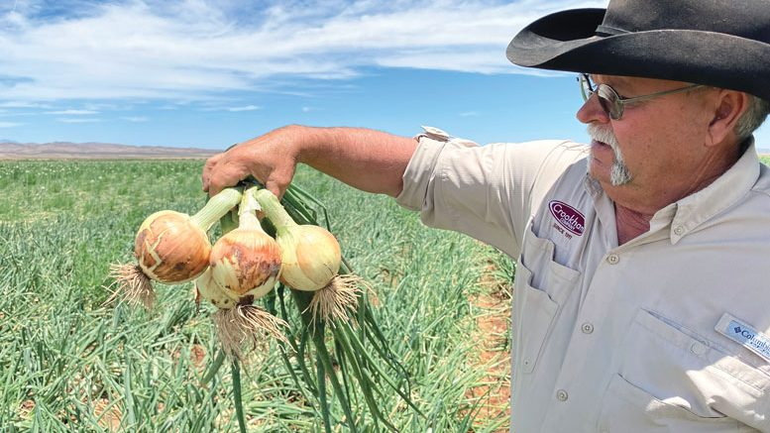

Surplus
Please write down the definition of a surplus:
A surplus occurs when there is more supply than demand (there is too much of something).
When there is a surplus of something, the price will probably decrease.
A surplus can happen due to a massive increase ins supply. For example, in 1956, two Americans bought so many onion companies and sold more far more onions that people needed that the onions in the bag were worth less than the bag itself.
A surplus can also happen due to a massive decrease in demand. For example, in some parts of rural Italy, people are leaving because of a lack of jobs. Some houses are selling for only 1 Euro (60 Birr).
Can you think of another example of a product that has a surplus?

Slide 14
SUPPLY
SURPLUS!
DEMAND
PRICES

Slide 15
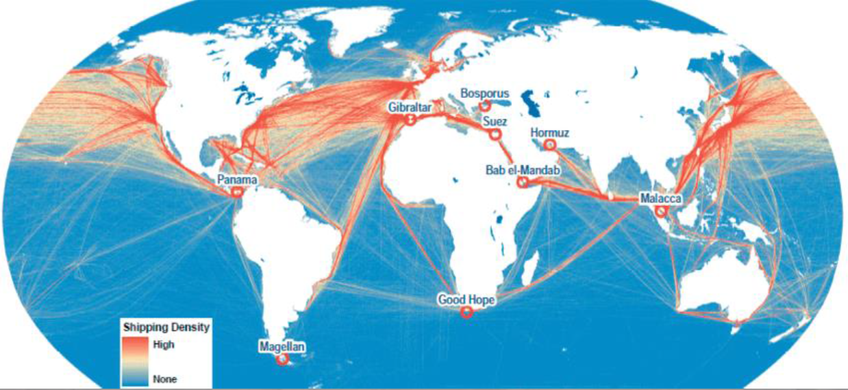

Slide 16
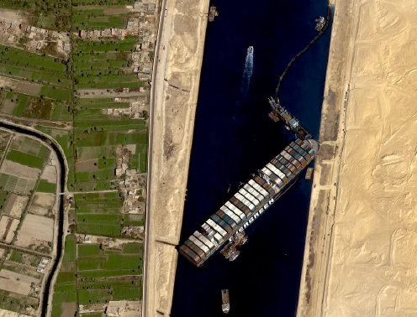

Slide 17
Tariff
Please write down the definition of a tariff:
A tariff is a tax (making something more expensive by giving the government some money) on products that go in and out of a country.
For example, the Suez Canal in Egypt and Panama Canal in Panama, charge a tariff for all ships that pass through their waters. Panama Canal Video. Suez Canal Video.

Slide 18
Please use the remaining time to finish Part A!
Fill out part “A: Starting Your Business” on your graphic organiser in Toddle. You can make up your product and decide how local or global your business is.
You have 20 minutes to finish this! If you don’t, then you will miss out on some of the Stock Market activities next class!

Slide 19
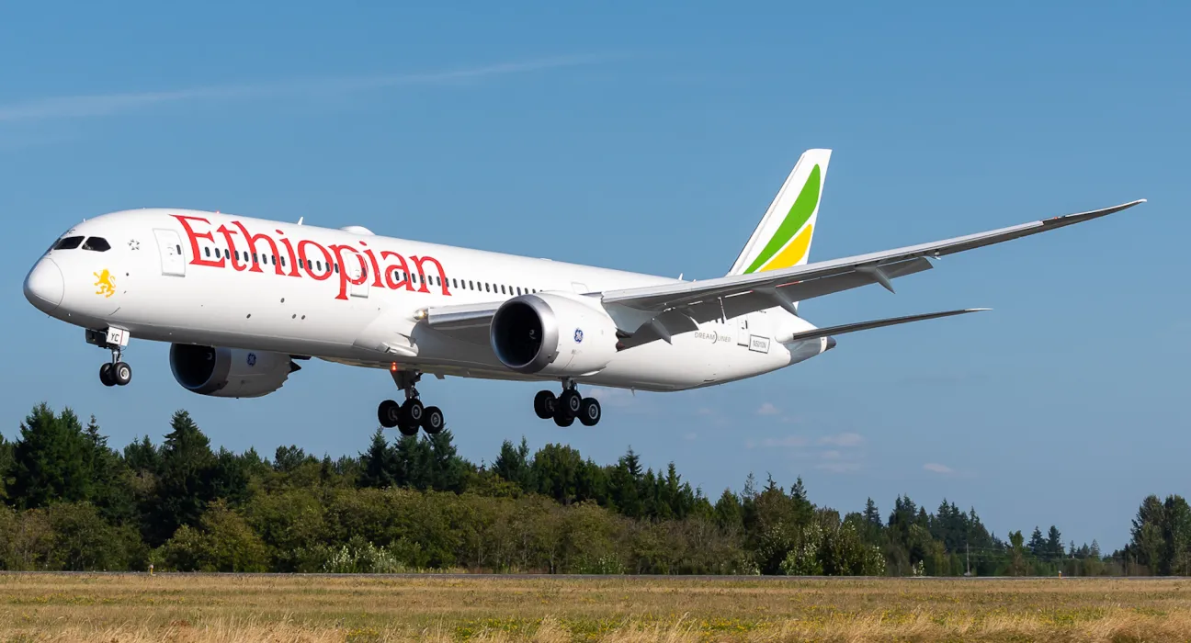
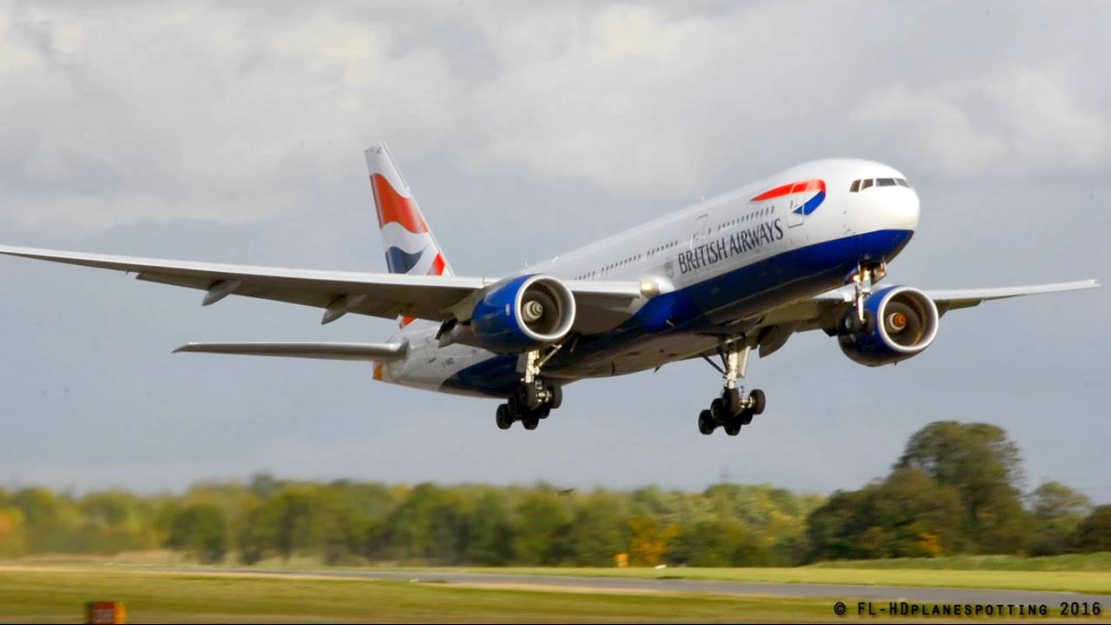
Public & Private Sector
Date: A Mon. Feb 19, B Tues. Feb 20
Unit 3: Local and Global Markets
Grade 6: Individuals & Societies

Slide 20
Today’s Inquiry Questions & Learning Targets
Inquiry Questions:
What is the Public and Private Sectors?
What are Taxes and Wages?
What are Unions and Strikes?
Why do governments make Health & Safety Regulations?
Learning Targets (By the end of this lesson…):
I can explain the differences and give examples about the Public and Private Sectors.
I can define Taxes, Wages, Unions, and Strikes.
I can list examples of Health & Safety Regulations.

Slide 21
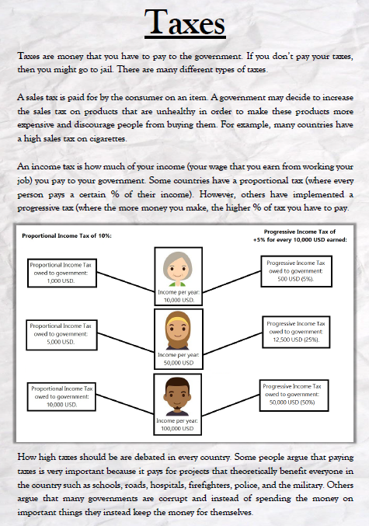
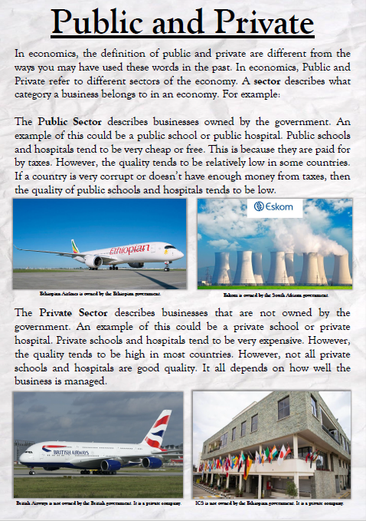
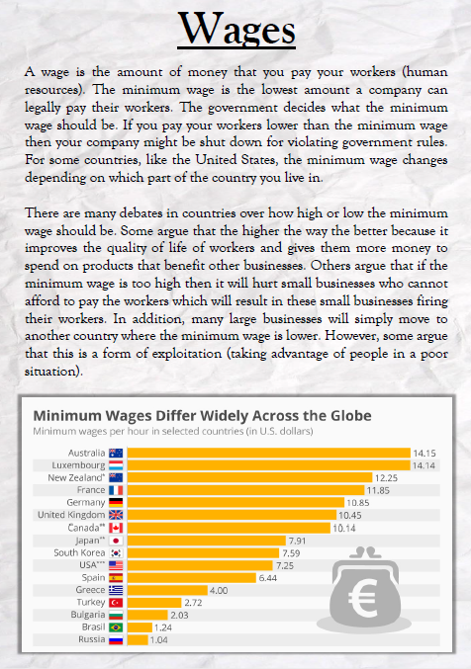
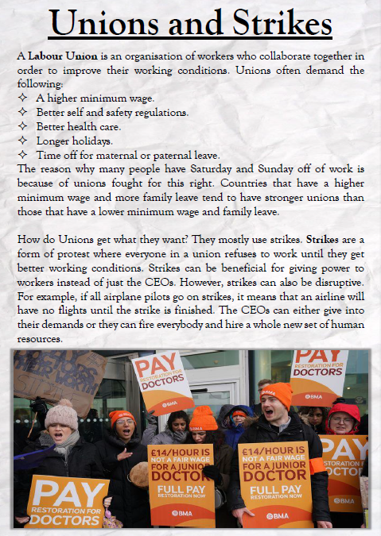
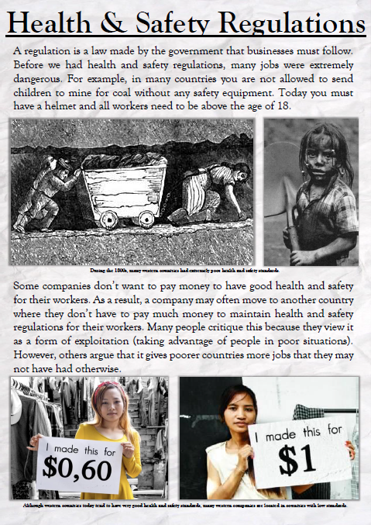
Stations Rotations
You have 8 minutes for each of the five stations:

Slide 22
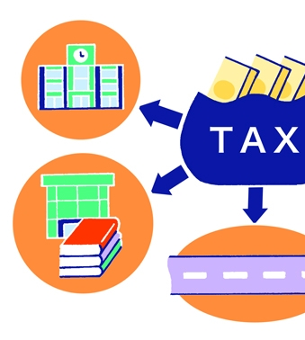
Taxes
Money collected by the government
Many different types
  Income Tax
  Sales Tax
  Tariffs (import tax)
Pay for public projects/services
  Roads, Bridges, Street lights
  Public Schools, Public Libraries
  Police Officers
  Government buildings, government workers, politicians
  Passport applications

Slide 23
Taxes
Sales Tax: “Sin Tax”
  A “sin tax" is a tax on products that are considered harmful
Singapore
  Alcohol (~$65 tax per bottle)
New York
  Cigarettes (~$5 tax)
  Soda
Should the government tax all unhealthy products?

Slide 24
TABLE TALK
SHOULD THE GOVERNMENT MAKE A SIN-TAX FOR POPCORN?

Slide 25
TABLE TALK
SHOULD THE GOVERNMENT MAKE A SIN-TAX FOR PLASTIC BAGS?

Slide 26
Private & Public
Private:
  Owned by individuals
  Motivated by profit
  Hours vary depending on business/owner
Public:
  Owned by the government
  Hours/holidays made by law
  Motivated for the benefit of all
  Not motivated by profit
  Examples: Environmental protection, public schools, military

Slide 27
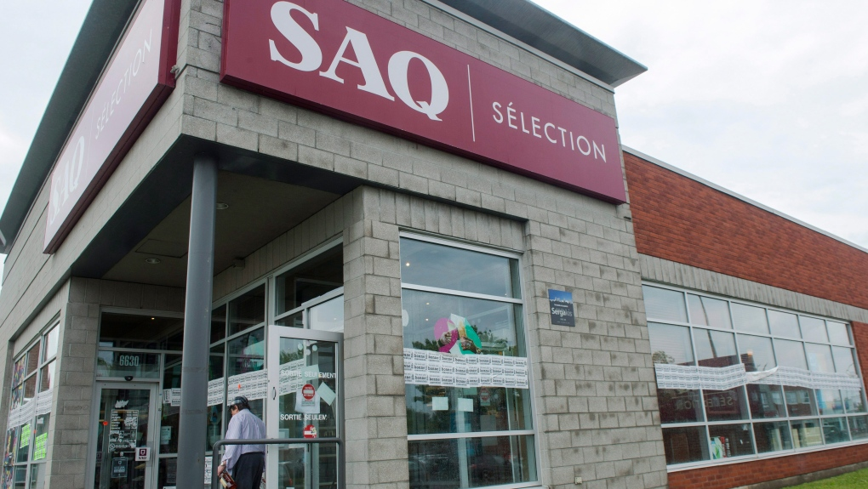
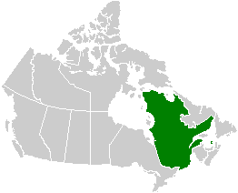

Slide 28
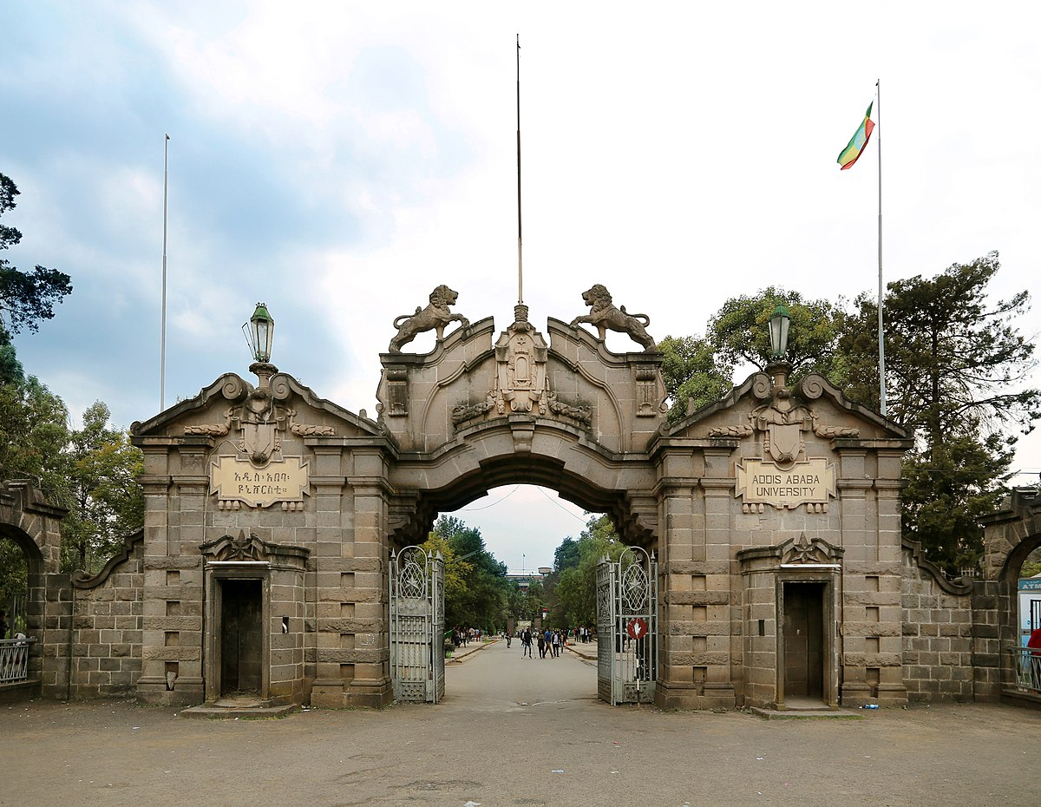

Slide 29
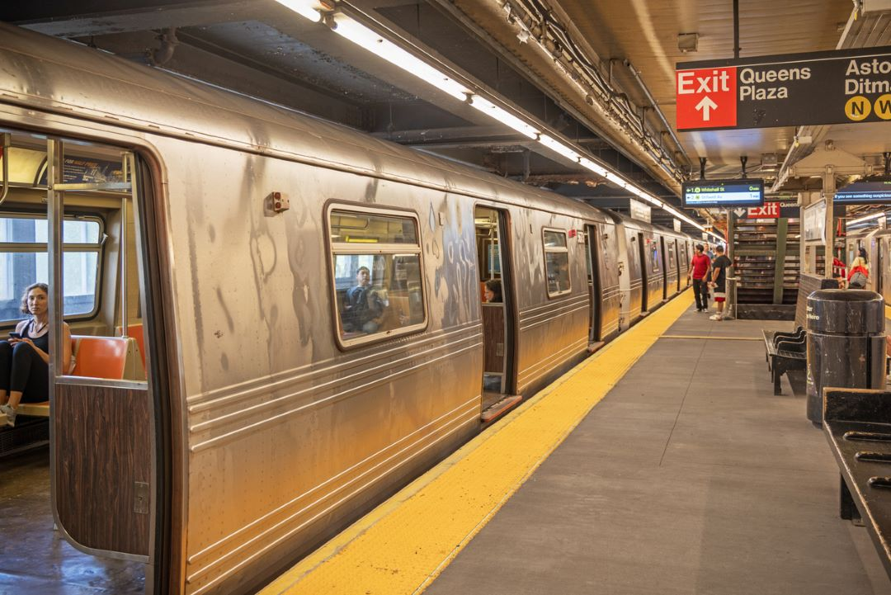

Slide 30
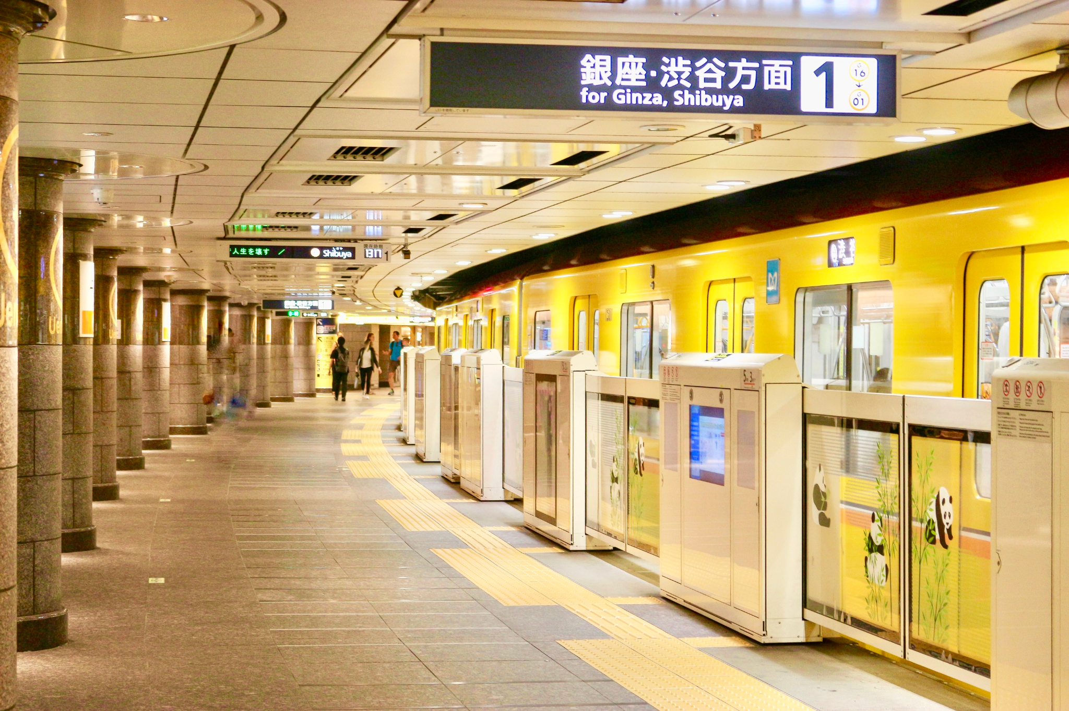

Slide 31
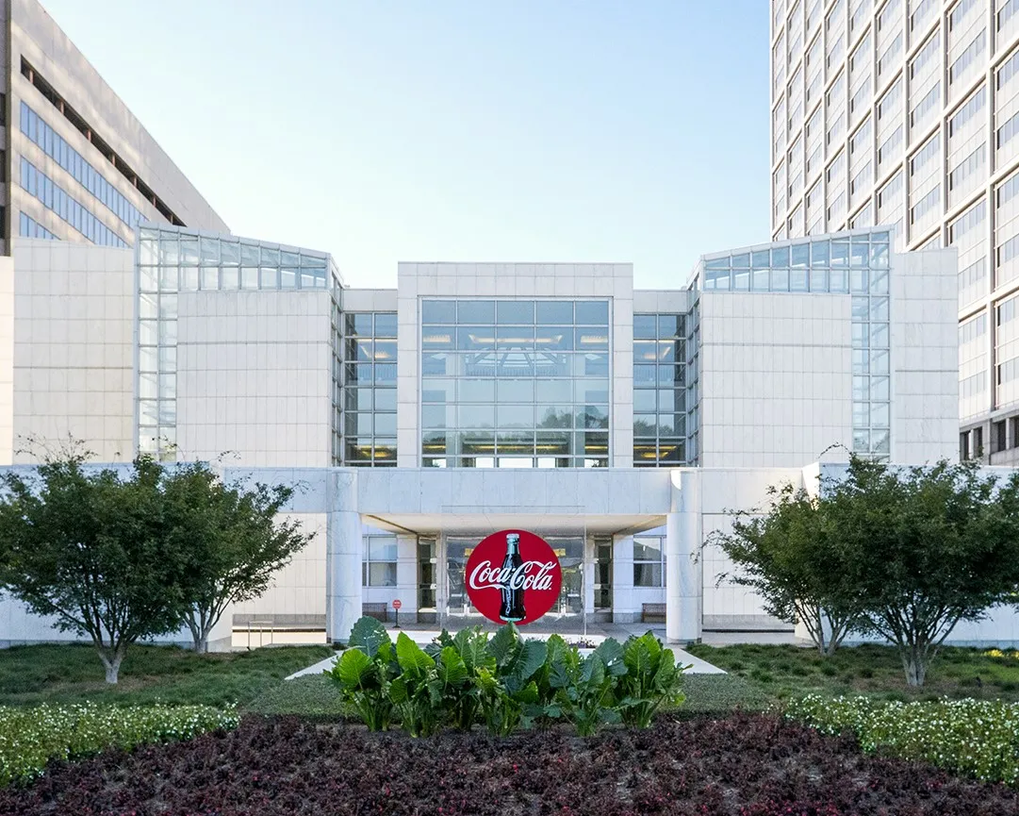

Slide 32
TABLE TALK
Is the private sector or public sector better at providing education for all?

Slide 33
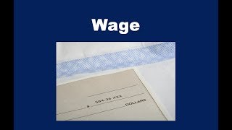
Wage
Amount paid (per hour, per month, per year)
Many different types
  Wage Workers (by hour)
  Salary (by year)
LIVING WAGE:
  Minimum amount to survive: rent, food, etc.
Government Laws
  Minimum wages
    Lowest you can legally pay someone
    US: $7:25

Slide 34
TABLE TALK
Which country do you think has the highest minimum wage? Why do you think so?

Slide 35
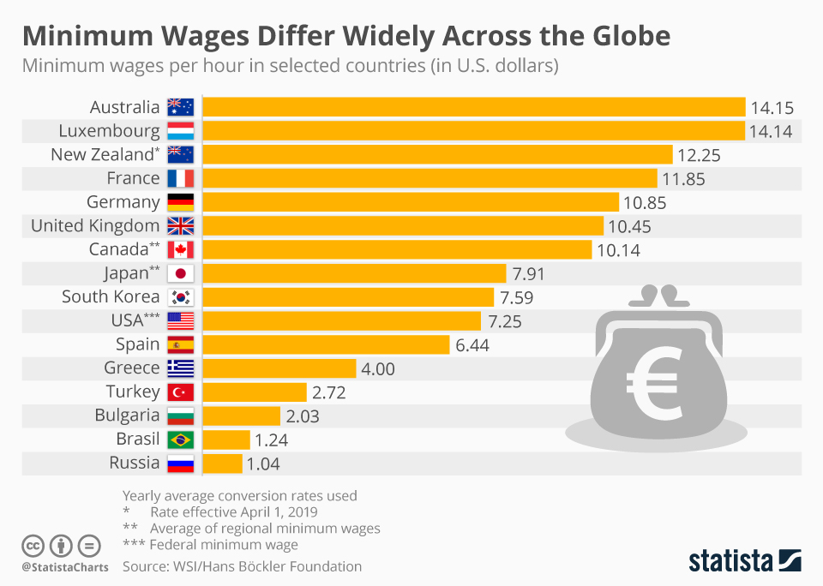

Slide 36
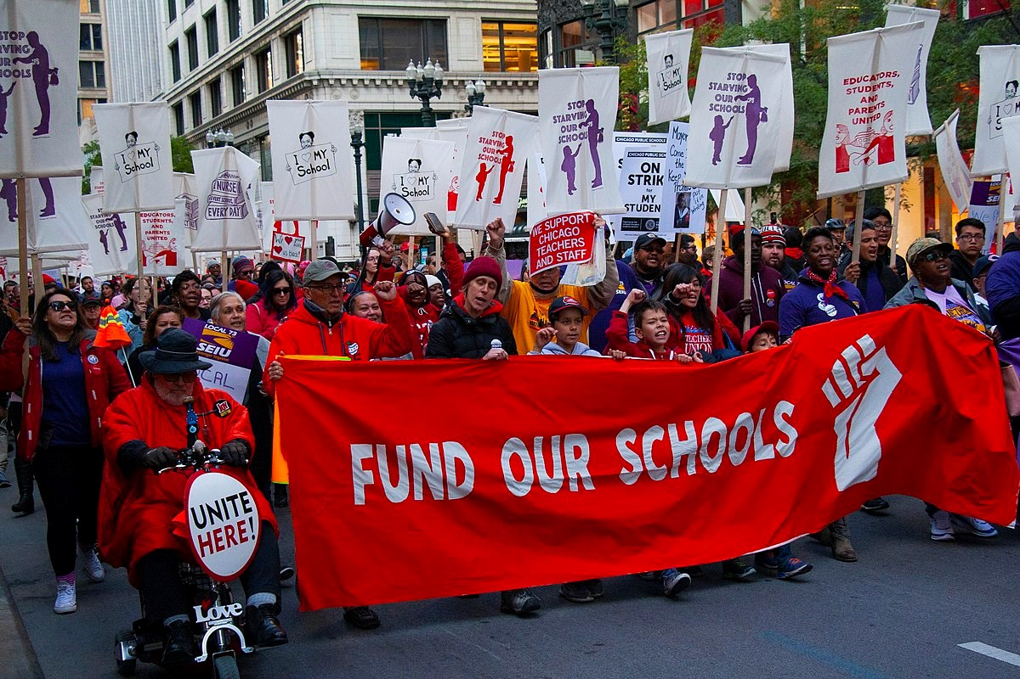
Unions
An organization of workers to demand certain things:
  Higher wages
  Safety rules
  Benefits: Healthcare, Holidays, time off (sick leave, parental leave)
Saturdays and Sundays were created by unions. Countries with more higher minimum wages and family leave, usually have more organized unions.

Slide 37
TABLE TALK
Do students need a union? Why/why not?

Slide 38
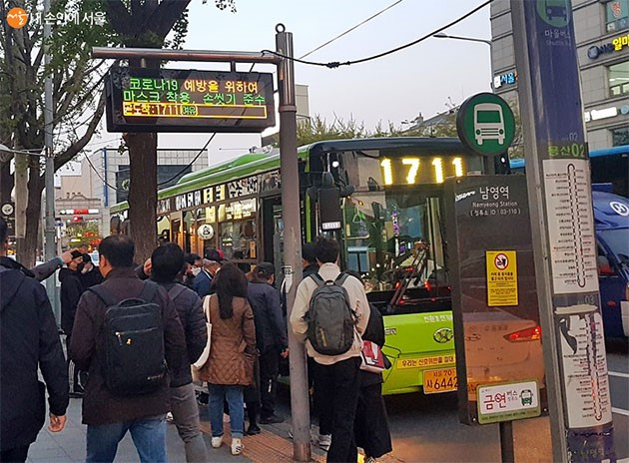
Strikes
A form of protest
One tool used by Unions
Gives power to workers, not CEOs
Can sometimes be disruptive
Two options:
  Give into union demands
  Hire all new workers
  Both options cost money or human resources for the business

Slide 39
TABLE TALK
What is your opinion of the Korean Bus Driver Strike? Is it wrong for the drivers to refuse money?

Slide 40
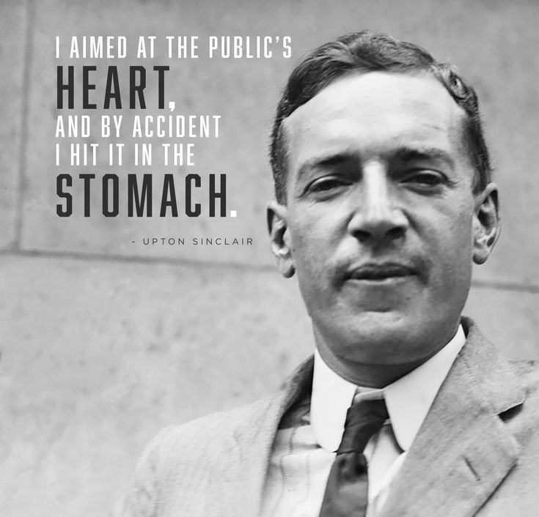
Health & Safety Regulations
Government laws that businesses must follow:
  Risk of fines or closure
  Makes employees safer
Before H&S Laws, many jobs were dangerous and health standards were low
Upton Sinclair

Slide 42
TABLE TALK
Should children under 16 be banned from working? Why/why not?

Slide 43
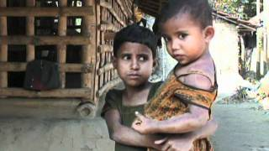

Slide 44
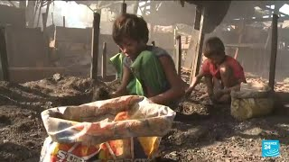

Slide 45
TABLE TALK
Should children be allowed to work part-time while going to school part-time?

Slide 46
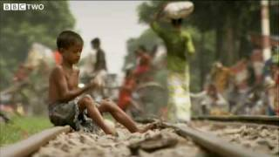

Slide 47
TABLE TALK
What is your reaction to the last video?
Talk again: Should children under 16 be banned from working? Why/why not?

Slide 48
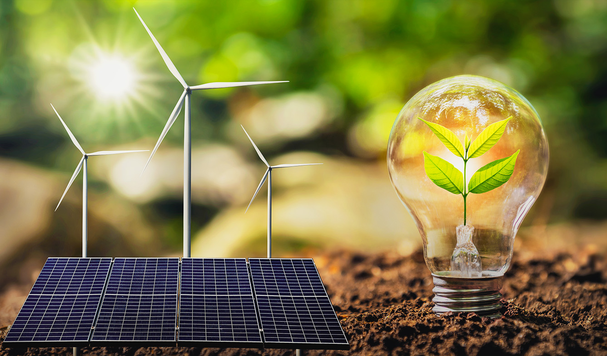
Sustainability & Business
Unit 3: Local and Global Markets
Grade 6: Individuals & Societies

Slide 49
Today’s Inquiry Questions & Learning Targets
Inquiry Questions:
What is sustainability?
What is sustainable energy?
What is sustainable waste disposal?
What are recyclable materials?
What are SDGs?
Learning Targets (By the end of this lesson…):
I can explain sustainability and relate it to business.
I can define sustainability, sustainable energy, recyclable materials.
I can list some examples of UN SDGs
I can explain the purpose of the UN SDGs

Slide 50
Sustainability
the ability to be maintained at a certain rate or level
Advantages:
✅ Reduces pollution and greenhouse gas emissions
✅ Lowers long-term energy costs after initial setup
✅ Improves the company’s reputation for being environmentally friendly
✅ Can make businesses eligible for government incentives or tax benefits
Disadvantages:
❌ High upfront costs to install renewable energy systems
❌ Some sources (solar and wind) depend on weather conditions
❌ Requires space (e.g., solar panels need large areas)
❌ May not be available everywhere

Slide 51

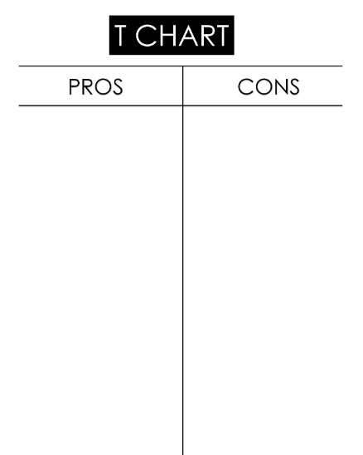
Nuclear Energy
While watching the videos, make a T charts of pros and cons
  Nuclear 1
  Nuclear 2
  Nuclear 3
  Nuclear 4

Slide 52
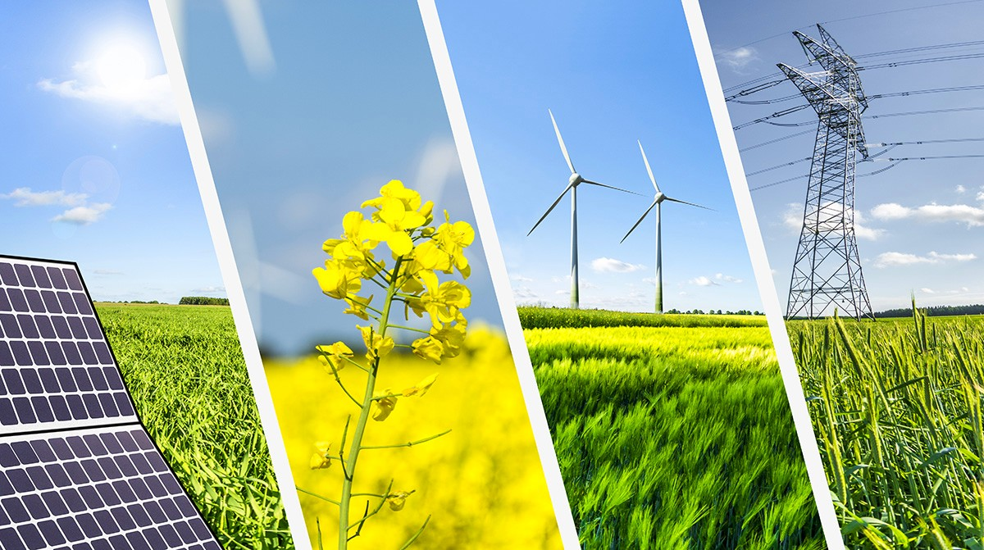
Sustainable Energy
Non-renewables:
  Coal
  Oil/Petroleum
Renewables:
  Solar
  Wind
  Maybe: Hydro?
  Maybe: Nuclear?

Slide 53
Nuclear Energy
Discuss at table:
  Nuclear power plants create radioactive waste that must be stored safely. Do you think the benefits of nuclear energy outweigh the risks of waste disposal?
  Some scientists believe that in the future, we will have better technology to make nuclear energy safer and cleaner. Should we continue using nuclear power while waiting for these improvements?

Slide 54
Sustainable Waste Disposal
Keep materials in use for as long as possible and minimize the amount of solid waste that is disposed of in landfill or through incineration
Advantages:
  ✅ Reduces landfill waste and pollution
  ✅ Saves money by reusing materials instead of buying new ones
  ✅ Helps protect wildlife and ecosystems from harmful waste
  ✅ Improves the company’s environmental image and attracts eco-conscious customers
Disadvantages:
  ❌ Requires time and effort to set up and manage properly
  ❌ Some sustainable waste disposal methods (e.g., recycling programs) can be expensive
  ❌ Not all waste can be easily recycled or composted
  ❌ Requires employee training and cooperation

Slide 56
Sustainable Recyclable Materials
reusable materials
Advantages:
  ✅ Reduces waste and lowers pollution
  ✅ Saves natural resources by reusing materials
  ✅ Improves the company’s image and attracts environmentally conscious customers
  ✅ Can lead to cost savings in the long run
Disadvantages:
  ❌ Recyclable materials can sometimes be more expensive than non-recyclable alternatives
  ❌ Not all customers recycle, so some materials still end up in landfills
  ❌ Recycling requires proper facilities and infrastructure
  ❌ Some materials degrade in quality after multiple recycling processes

Slide 57
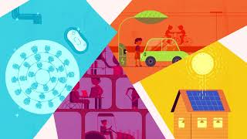
UN SDGs
UN SDGs –
  The United Nations Sustainable Development Goals (UN SDGs) are 17 global goals created to improve the world by 2030. They focus on ending poverty, protecting the planet, and ensuring peace and prosperity for everyone. The goals cover areas like clean energy, responsible consumption, climate action, and economic growth.
  Advantages:
    ✅ Provides a clear global framework for solving major world problems
    ✅ Encourages countries and businesses to take action for a sustainable future
    ✅ Helps create a fairer, healthier, and more prosperous world

Slide 58
UN SDGs
Disadvantages:
    ❌ Some countries or businesses may not fully commit to the goals
    ❌ Achieving all 17 goals requires large amounts of funding and cooperation
    ❌ Progress can be slow, especially in poorer or war-affected regions

Slide 59
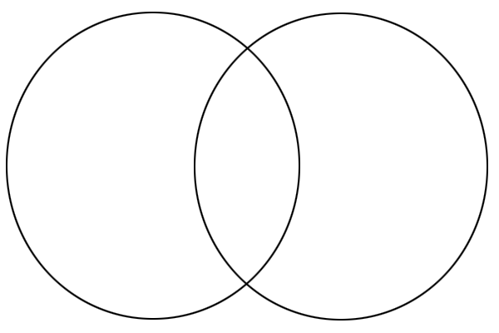
Solar & Hydro Energy
While watching the videos, make a compare and contrast
  HYDRO (Egypt)
  SOLAR (Sahara)
What type of renewable energy will your business use?

Slide 60
Sustainability
Using Renewable Energy – A store that powers its lights with solar panels instead of coal is making a sustainable choice.
Reducing Waste – A company that uses recycled paper for packaging instead of plastic helps the environment.
Fair Treatment of Workers – A business that pays workers fairly and provides safe working conditions is being sustainable because it helps people live well.
Reusable Products – A coffee shop that gives discounts to customers who bring their own reusable cups reduces waste.
Eco-Friendly Materials – A clothing brand that makes shirts from organic cotton instead of plastic-based fabrics is choosing sustainable materials.

Slide 61

Corporate Social Responsibility

Slide 62

Supply & Demand: Breaking News & Stock Market (1)
Theme: Creating your own Business
Unit 3: Local and Global Markets
Grade 6: Individuals & Societies

Slide 63
Today’s Inquiry Questions & Learning Targets
Inquiry Questions:
What is the stock market?
What is the key vocabulary of the stock market?
How do stocks rise and fall?
Learning Targets (By the end of this lesson…):
I can define stock market
I can explain the stock market to another person
I can understand some key vocabulary related to the stock market

Slide 64
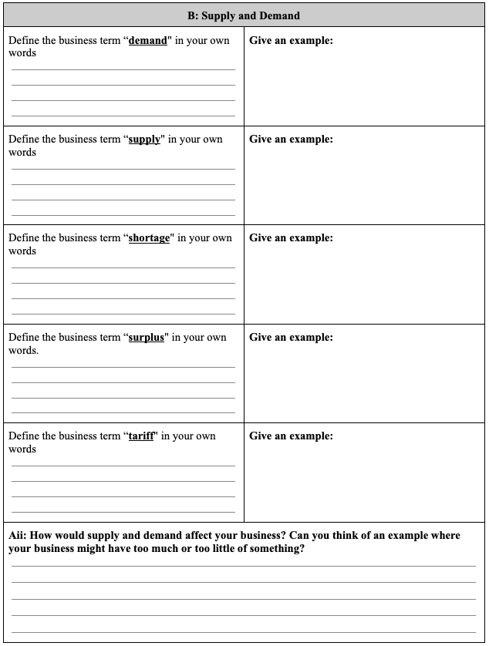
Entrance Ticket
To join the advanced class on the stock market, the Supply and Demand page must be fully and ACCURATELY filled out.

Slide 65
Discussion
Have you ever heard of the stock market? What do you think it is?
Why do you think companies sell shares (pieces of their business) to the public?
What does it mean to “invest" in something?
  Have you ever invested in something (time, money, effort)?

Slide 66
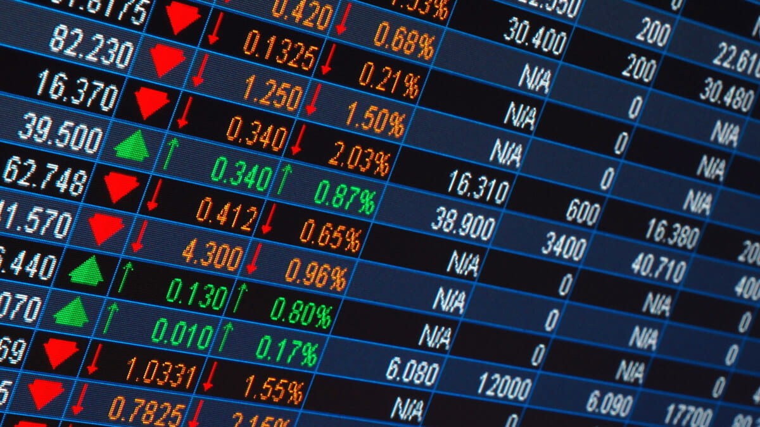
Stock Market
The stock market is like a big market where people buy and sell parts of companies (called stocks or shares).
Companies sell stocks to raise money, and when you buy a stock, you own a small part of that company.
Stock prices can go up and down based on how well the company is doing.

Slide 67
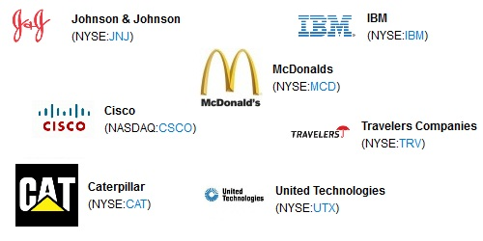
Key Vocabulary
Stock
  A share of ownership in a company.
  Example: If you buy one share of Apple stock, you own a tiny piece of Apple.
Shareholder
  Someone who owns shares (or stock) in a company.
  Example: If you own 10 shares of Disney, you are a Disney shareholder.
Ticker Symbol
  A short code that represents a company’s stock.
  Example: Apple’s ticker symbol is AAPL, and Tesla’s is TSLA.

Slide 68
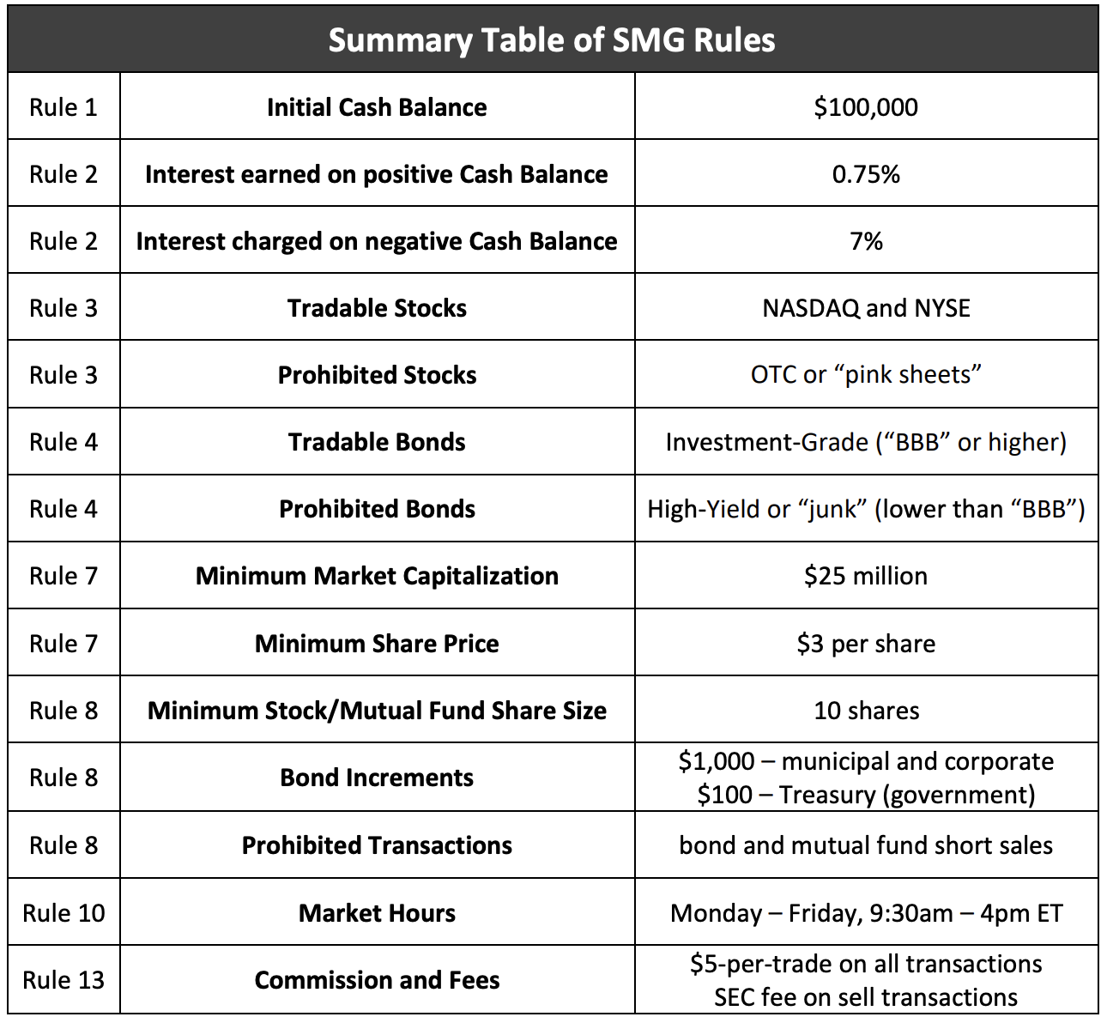
Apple – AAPL
Microsoft – MSFT
Amazon – AMZN
Alphabet (Google) – GOOG / GOOGL
Tesla – TSLA
Meta (Facebook) – META
Netflix – NFLX
NVIDIA – NVDA
Disney – DIS
McDonald’s – MCD
Coca-Cola – KO
PepsiCo – PEP
Nike – NKE
Adidas – ADDYY
Walmart – WMT
Costco – COST
Target – TGT
Starbucks – SBUX
Boeing – BA
Ford – F
General Motors (GM) – GM
Berkshire Hathaway – BRK.A / BRK.B
JPMorgan Chase – JPM
Bank of America – BAC
Visa – V
Mastercard – MA
Intel – INTC
AMD – AMD
ExxonMobil – XOM
Procter & Gamble – PG
Too complicated, High School Level
Too complicated, High School Level

Slide 69
Stock Market Game CD
Login Username: DD_2_ZZ1280
  Login Password: 8ZHDQ9ZF
Login Username: DD_2_ZZ1281
  Login Password: WTUJRC5G
Login Username: DD_2_ZZ1282
  Login Password: 3BTWP7KV
Login Username: DD_2_ZZ1283
  Login Password: PKDDWR8M
Login Username: DD_2_ZZ1284
  Login Password: 1ZWCXBOA
www.stockmarketgame.org

Slide 70
Stock Market Game AB
5 Login Username: DD_2_ZZ1285
  Login Password: TJBTVZTL
6 Login Username: DD_2_ZZ1286
  Login Password: OFNMSOP9
7 Login Username: DD_2_ZZ1287
  Login Password: 5Z1ZDUDY
8 Login Username: DD_2_ZZ1288
  Login Password: QEAWHSJU
9 Login Username: DD_2_ZZ1289
  Login Password: JWFIN8W4
www.stockmarketgame.org

Slide 71
Private & Public: Breaking News & Stock Market (2)
Theme: Creating your own Business
Unit 3: Local and Global Markets
Grade 6: Individuals & Societies

Slide 72
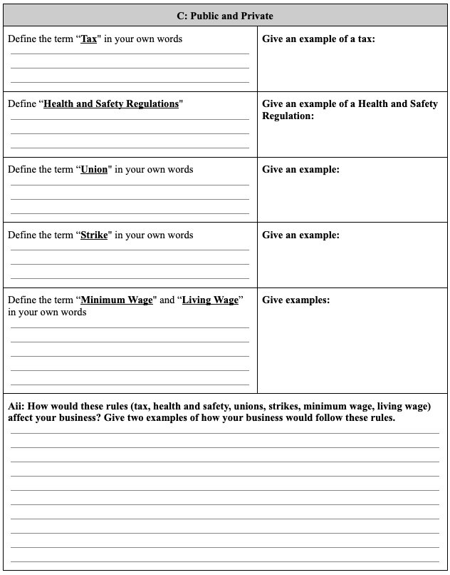
Complete the rest →
To join the advanced class on the stock market, the Private and Public page must be fully and ACCURATELY filled out.

Slide 73
Today’s Inquiry Questions & Learning Targets
Inquiry Questions:
How do stock prices change?
What determines if a company is doing well or doing bad?
Learning Targets (By the end of this lesson…):
I can define diversification, bull market, bear market, and day trading.
I can understand how stock prices rise and fall

Slide 74
How do Stock Prices Change?
Why do they go up?
Why do they go down?
If a company is doing well (making lots of money, creating new products, or becoming more popular), more people want to buy its stock.
When many people want to buy a stock, the price goes up because it becomes more valuable.
If a company is not doing well (losing money, having problems, or if people stop buying its products), fewer people want to buy its stock.
When more people sell their stock instead of buying it, the price goes down because it becomes less valuable.

Slide 75
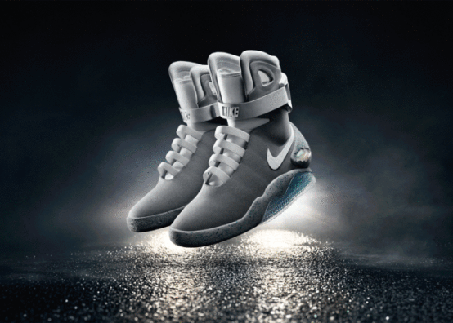
Example: NIKE
Imagine Nike releases a cool new shoe, and everyone loves it. Many people want to buy the company’s stock because they think the company will make a lot of money. The stock price of NIKE goes up!
But if later, the shoes turn out to be uncomfortable and people stop buying them, investors sell their NIKE stock, and the price goes down.

Slide 76
Other Things That Change Stock Prices:
News – If something big happens, like a company inventing a new phone or facing a problem, stock prices change.
Supply & Demand – If many people want a stock, the price goes up. If many people sell it, the price goes down.
The Economy – If the country’s economy is doing well, people buy more stocks. If it’s struggling, people sell stocks.

Slide 77
Discussion
Imagine you have extra money—would you rather save it in a piggy bank, put it in a bank, or invest it in a company? Why?
What do you think happens when more people want to buy a company’s stock? What about when fewer people want to buy it?
Can you think of a famous company you’d want to own a piece of? Why?

Slide 78
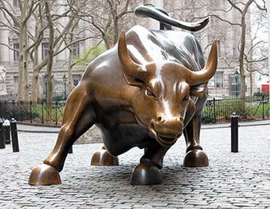
Key Vocabulary
Bull Market
  When stock prices are going up over time.
Bear Market
  When stock prices are going down over time.
  Example: If the stock market drops 20% or more, it’s called a bear market.

Slide 79

Key Vocabulary
Diversification
  Spreading your money across different investments to reduce risk.
  Example: Instead of buying only tech stocks, you buy stocks in healthcare, energy, and retail too.

Slide 80

Stock Market Game Updates
Who is doing best?
Who is doing worst?
Write your Team Name (T1, T2, etc..) on the board and your losses/gains

Slide 81
Discuss with Team
Make an honest assessment of your first stock purchases.
Do you regret buying anything?
Are you happy with a particular purchase?
THEN, less or buy any new stocks (make changes)

Slide 82
Apple – AAPL
Microsoft – MSFT
Amazon – AMZN
Alphabet (Google) – GOOG / GOOGL
Tesla – TSLA
Meta (Facebook) – META
Netflix – NFLX
NVIDIA – NVDA
Disney – DIS
McDonald’s – MCD
Coca-Cola – KO
PepsiCo – PEP
Nike – NKE
Adidas – ADDYY
Walmart – WMT
Costco – COST
Target – TGT
Starbucks – SBUX
Boeing – BA
Ford – F
General Motors (GM) – GM
Berkshire Hathaway – BRK.A / BRK.B
JPMorgan Chase – JPM
Bank of America – BAC
Visa – V
Mastercard – MA
Intel – INTC
AMD – AMD
ExxonMobil – XOM
Procter & Gamble – PG
Too complicated, High School Level
Too complicated, High School Level

Slide 83
Stock Market Game CD
Login Username: DD_2_ZZ1280
  Login Password: 8ZHDQ9ZF
Login Username: DD_2_ZZ1281
  Login Password: WTUJRC5G
Login Username: DD_2_ZZ1282
  Login Password: 3BTWP7KV
Login Username: DD_2_ZZ1283
  Login Password: PKDDWR8M
Login Username: DD_2_ZZ1284
  Login Password: 1ZWCXBOA
www.stockmarketgame.org

Slide 84
Stock Market Game AB
Login Username: DD_2_ZZ1285
  Login Password: TJBTVZTL
Login Username: DD_2_ZZ1286
  Login Password: OFNMSOP9
Login Username: DD_2_ZZ1287
  Login Password: 5Z1ZDUDY
Login Username: DD_2_ZZ1288
  Login Password: QEAWHSJU
Login Username: DD_2_ZZ1289
  Login Password: JWFIN8W4
www.stockmarketgame.org

Slide 85
Sustainability: Breaking News & Stock Market (3)
Theme: Creating your own Business
Unit 3: Local and Global Markets
Grade 6: Individuals & Societies

Slide 86
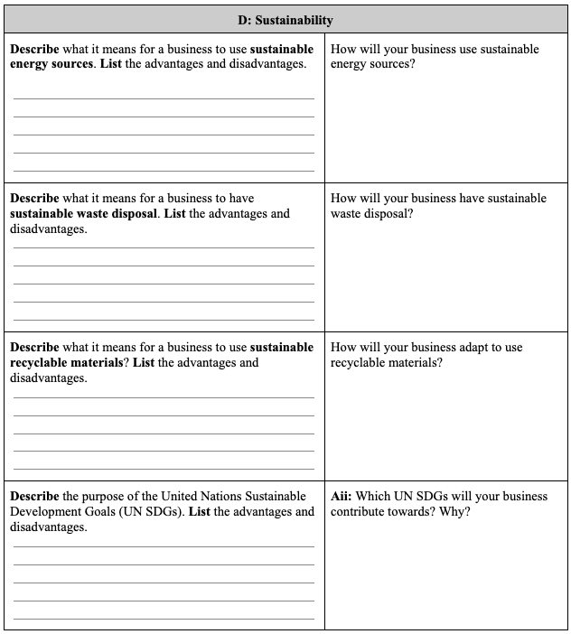
Complete the rest →
To join the advanced class on the stock market, the Sustainability page must be fully and ACCURATELY filled out.

Slide 87
Today’s Inquiry Questions & Learning Targets
Inquiry Questions:
Do companies try to be sustainable?
  Is that good for their stock price?
What determines if a company is being sustainable?
Learning Targets (By the end of this lesson…):
I can define Corporate Social Responsibility.
I can understand how stock might be impacted by sustainability.

Slide 88
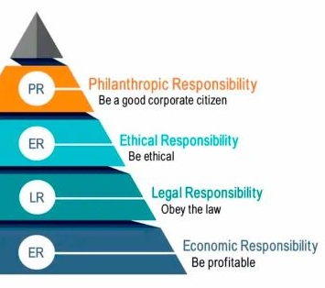
Key Vocabulary
CSR (Corporate Social Responsibility
  A business helping society and the environment while still making money.
  Instead of only focusing on profits, businesses also think about people, the planet, and doing the right thing.
Examples:
  Use recycled materials to make their shoes (helping the environment 🌍).
  Donate free shoes to children in need (helping people 👟).
  Make sure their workers are paid fairly and treated well (being responsible 💼).

Slide 89
Stock Market Game Updates
Who is doing best?
Who is doing worst?
Write your Team Name (T1, T2, etc..) on the board and your losses/gains

