Slide 1
Sample Debate Demonstration
The teachers will pretend to be 7 grade students and provide a sample debate demonstration.
This will allow you to understand the debate procedures that you will all follow.
Remember that what we are arguing does not necessarily indicate our personal beliefs. It may even be against our personal moral values. You must understand that many students will also be arguing against their own beliefs and values. The purpose of the debate is to understand different perspectives, NOT to argue your personal beliefs.
Please fill out your audience forms. You won’t be graded on these forms during the sample debate but you will be graded during the actual debate.
We will refer to each other, not with names, but as the ‘opposition’ or ‘the team in favour of war or diplomacy’.
Respect must be upheld throughout the entire debate. This includes when you are in the audience. There is no clapping or booing or any sounds from the audience. Your Criteria C will be affected by this behaviour.
Notes:
Insert full text of main argument here.

Slide 2
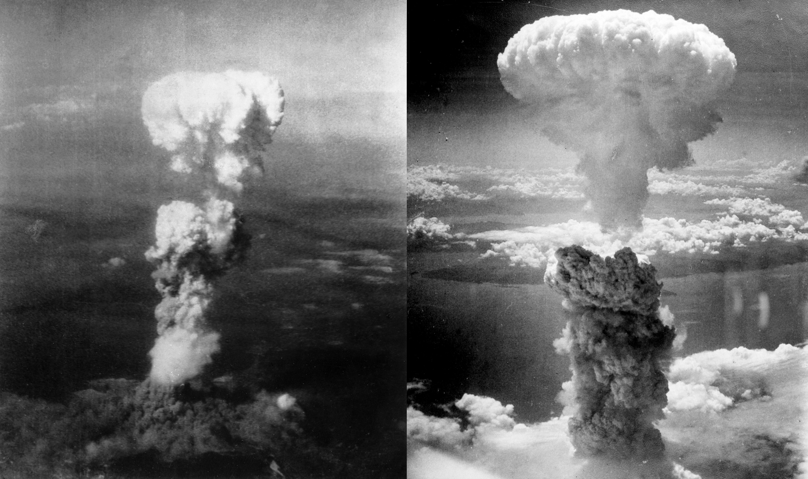
Pre Debate Vote:
Should War or Diplomacy been used to solve the conflict between Japan & the USA?

Slide 3

War was the best way to solve the conflict between Japan and the United States
Put country flag here.
Presented by: United States of America. Represented by: Ms. Smith

Slide 4
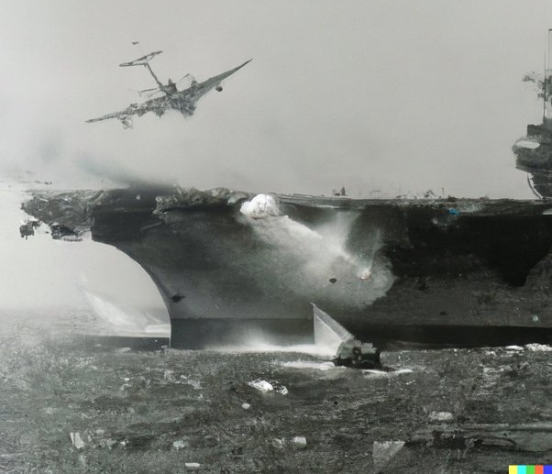
Main Argument 1 by Ms. Smith
War and the Atomic Bombs was the only way to defeat Japan because they would never have surrendered or negotiated.
Japanese soldiers followed the Bushido Code which meant it was very dishonourable to surrender. They would rather commit suicide as evident by the Kamikaze Planes.
In the Battle of Saipan (one of the last battles fought on a Pacific Island during the end of WWII) Japan killed over 25,000 of their own soldiers and civilians than let them surrender.
Notes:
Insert full text of main argument here.

Slide 5
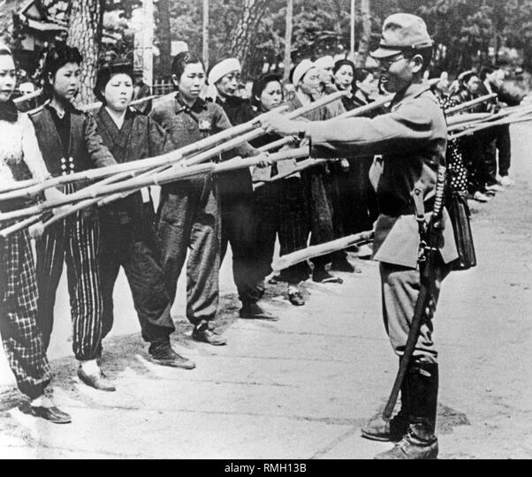
Main Argument 2 by Ms. Smith
War, and specifically the use of Atom Bombs, was the only way to scare the Japanese Emperor into surrendering because an actual invasion of Japan would have killed far more people.
The US military estimated that 5 to 10 million Japanese people would have died if the US invaded. This is far more than the 0.25 million that died from the Atom Bomb.
Japan was even preparing children to defend against invading American troops.
Notes:
Insert full text of main argument here.

Slide 6
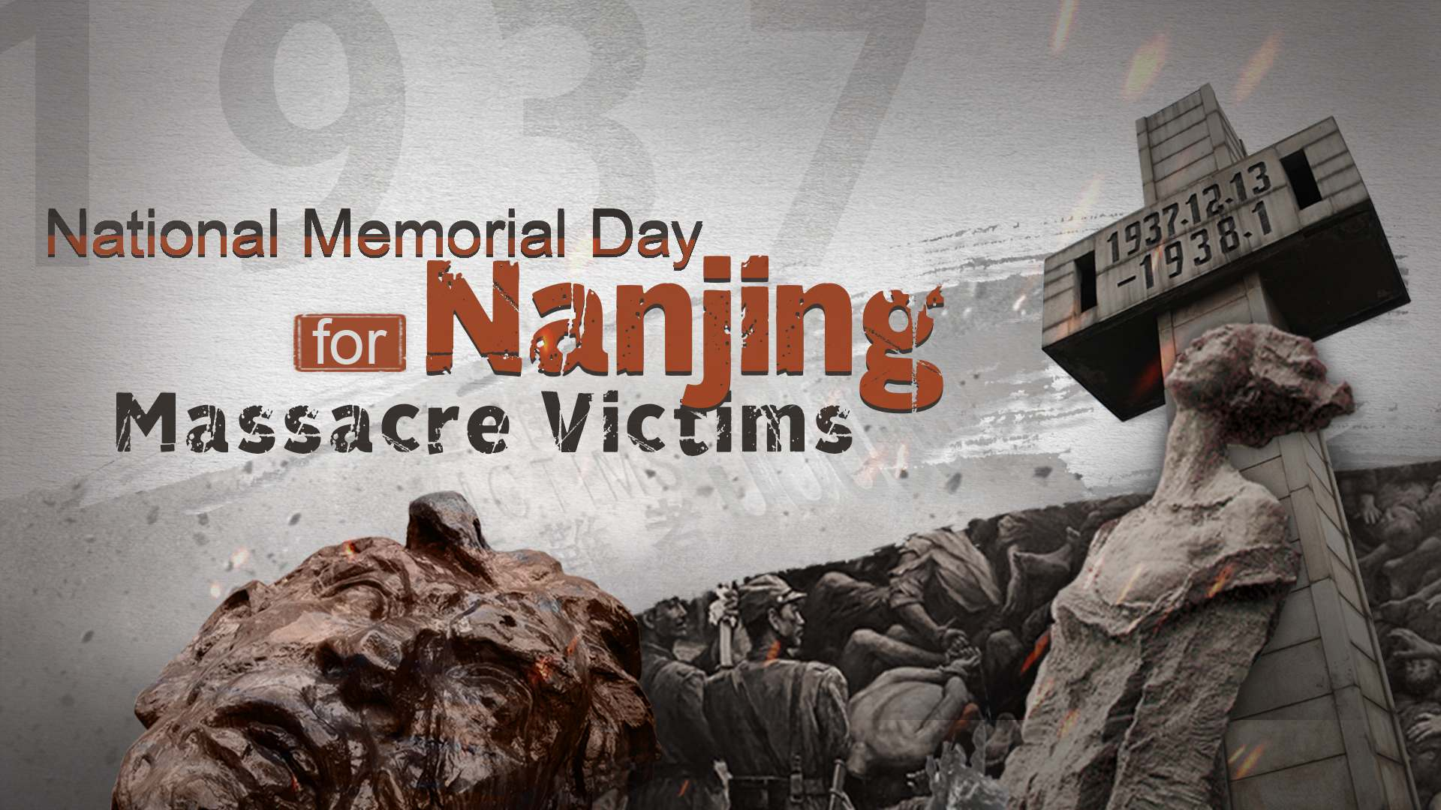
Main Argument 3 by Ms. Smith
Japan started this war. Therefore, if bombs were used to end this war, it is their fault. If Japan believes diplomacy should have been used, then they should never have started the war.
The Japanese government was controlled by an extremist fascist government that is not rational. They only understand force.
Japan committed horrific war crimes and killed millions of people all over Asia. They killed so many more than the Atom Bomb did. They are not the victim.
Notes:
Insert full text of main argument here.

Slide 7

Diplomacy was the best way to solve the conflict between Japan and the United States
Put country flag here.
Presented by: Japan. Represented by: Mr. Larson

Slide 8
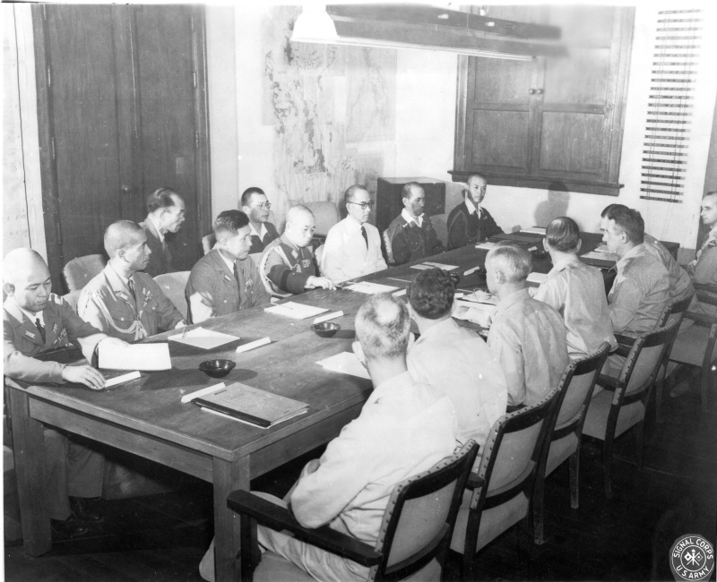
Main Argument 1 by Mr. Larson
Japan was already in the process of negotiating. They were already interested in surrendering, they just wanted to ensure that their Emperor was not tried as a war criminal.
US Supreme Commander and later President Dwight D Eisenhower said “First, the Japanese were ready to surrender, and it wasn’t necessary to hit them with that awful thing. Second, I hated to see our country be the first to use such a weapon.”
Notes:
Insert full text of main argument here.

Slide 9
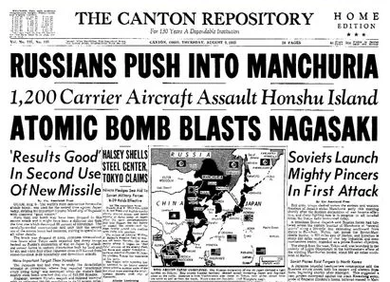
Main Argument 2 by Mr. Larson
Since we already established that the US knew that Japan was on the verge of surrendering, why did they use the bombs? It was only to scare the Soviet Union to show them how much power they have. This is what happens when we only think of war as the answer, not diplomacy.
In addition, the US could have simply bombed a military post to demonstrate their power to boost the diplomatic talks. Killing 250,000 innocent civilians was for nothing.
Notes:
Insert full text of main argument here.

Slide 10
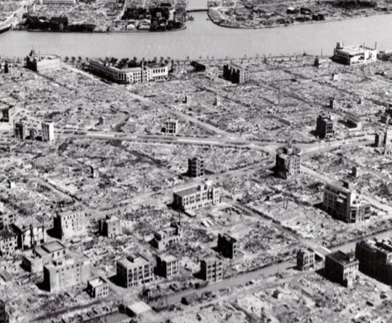
Main Argument 3 by Mr. Larson
The Japanese military was on the verge of defeat and had lost most of their territory by August 1945. There was no way Japan could have won. Most of Japan was already completely destroyed by regular bombing even before the atom bombs. This is was Tokyo looked like.
When people only think about war before diplomacy, they needlessly extend suffering. Not only did people die from the atom bomb lasts themselves, they also died of radiation poisoning and cancers in the years afterwards.
Notes:
Insert full text of main argument here.

Slide 11
Rebuttals:
You have 10min to prepare

Slide 12
Quickfire Rebuttals

Slide 13
Questions from Audience

Slide 14
Post Debate Vote

