Slide 1
Sample Debate Demonstration
The teachers will pretend to be grade 6 students and provide a sample debate demonstration.
This will allow you to understand the debate procedures that you will all follow.
Remember that what we are arguing does not necessarily indicate our personal beliefs. It may even be against our personal moral values. You must understand that many students will also be arguing against their own beliefs and values. The purpose of the debate is to understand different perspectives, NOT to argue your personal beliefs.
Please fill out your audience forms. You won’t be graded on these forms during the sample debate but you will be graded during the actual debate.
We will refer to each other, not with names, but as the ‘opposition’ or ‘the team in favour of war or diplomacy’.
Respect must be upheld throughout the entire debate. This includes when you are in the audience. There is no clapping or booing or any sounds from the audience. Your Criteria C will be affected by this behaviour.
Notes:
Insert full text of main argument here.

Slide 2
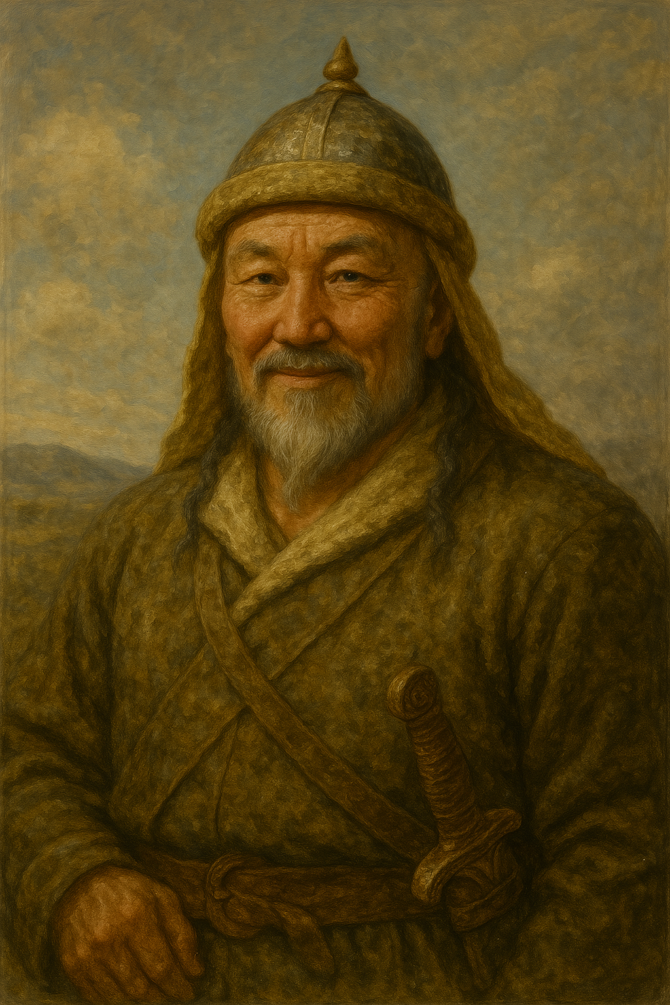
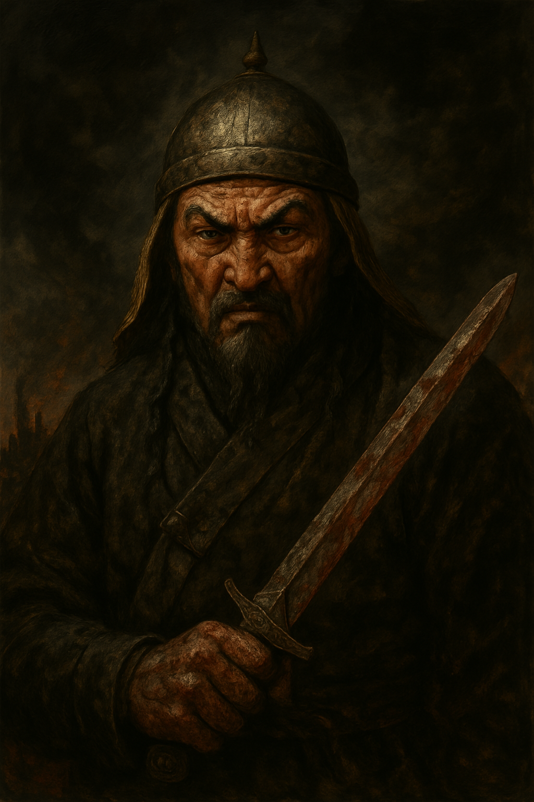
Pre Debate Vote:
Was Genghis Khan mostly a hero or villain?

Slide 3
Genghis Khan was mostly a Hero
Represented by: Ms. Smith

Slide 4
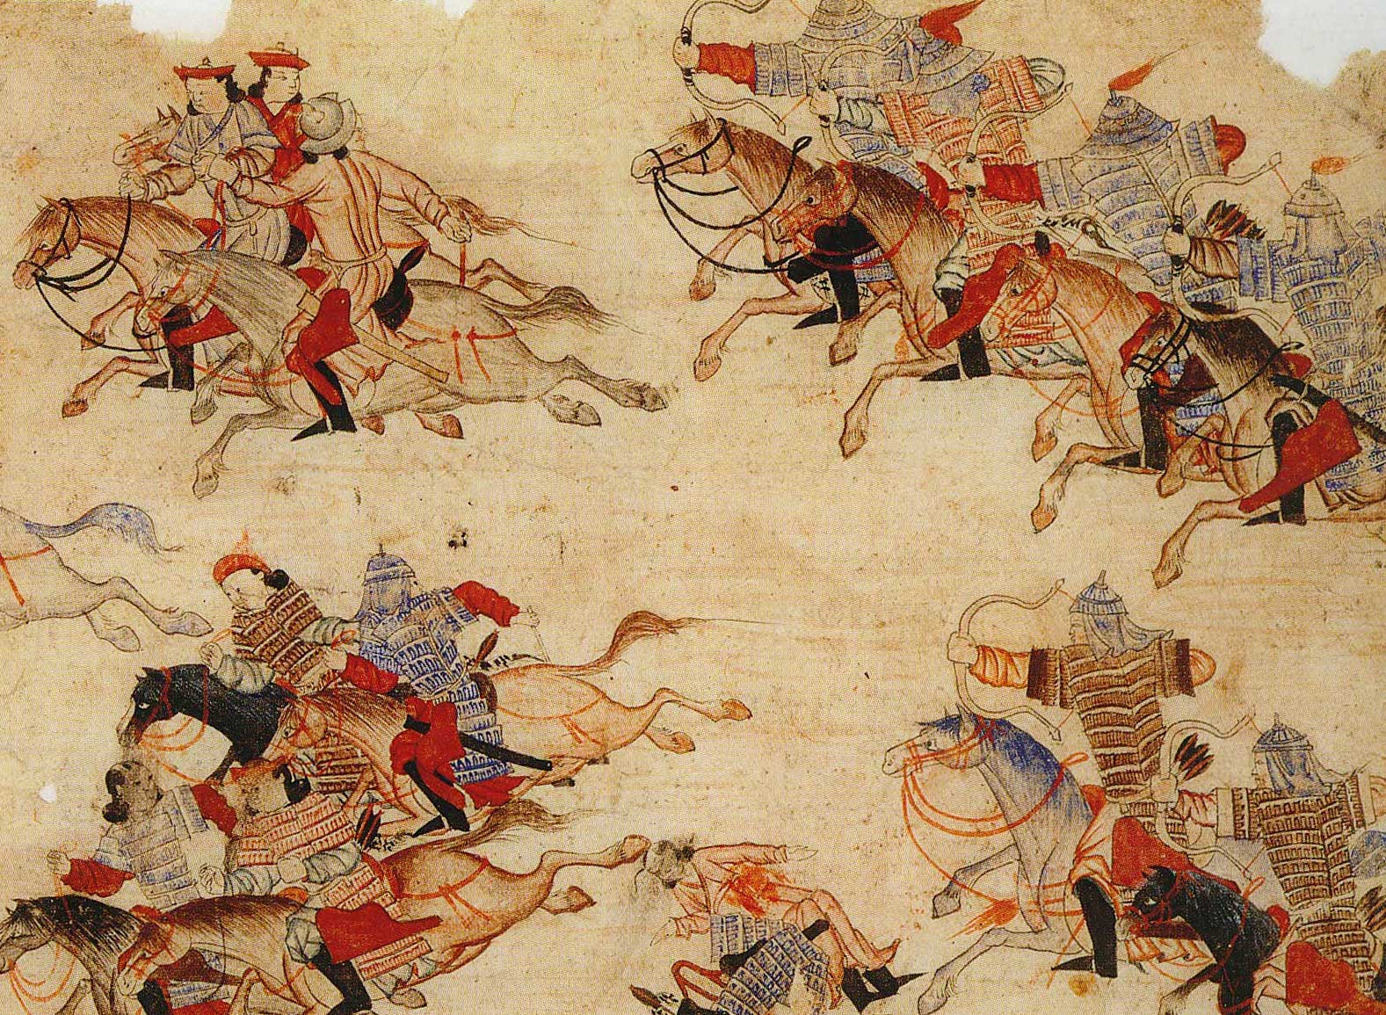
Main Argument 1 by Ms. Smith
Although Genghis Khan’s armies were brutal at times, much of the horror stories are exaggerated by scholars writing about him over a 100 years later or were due to poor census keeping.
Genghis Khan’s armies were not really any more brutal than other armies at the time. We should not judge him using our standards of today. We should be less harsh with people from the past, especially 800 years ago.
Notes:
Insert full text of main argument here.

Slide 5
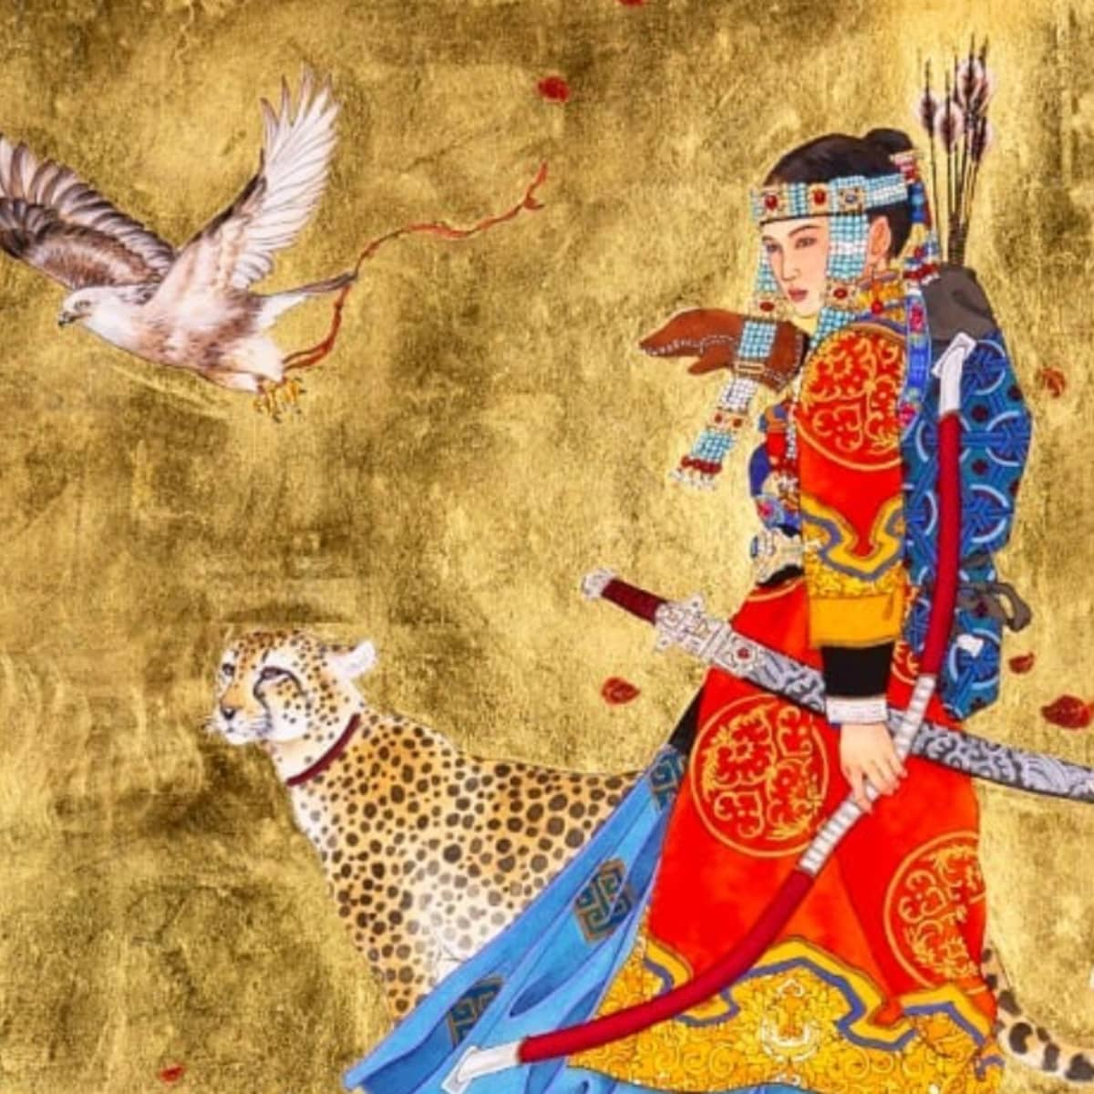
Main Argument 2 by Ms. Smith
Once Genghis Khan conquered an area, the land flourished economically because he remade the silk road. He also respected religious freedom and women’s rights.
Genghis Khan needed to have power first before making good human rights. Having strength is more important than human rights because if you are not strong, you can’t enforce laws that protect people.
Notes:
Insert full text of main argument here.

Slide 6
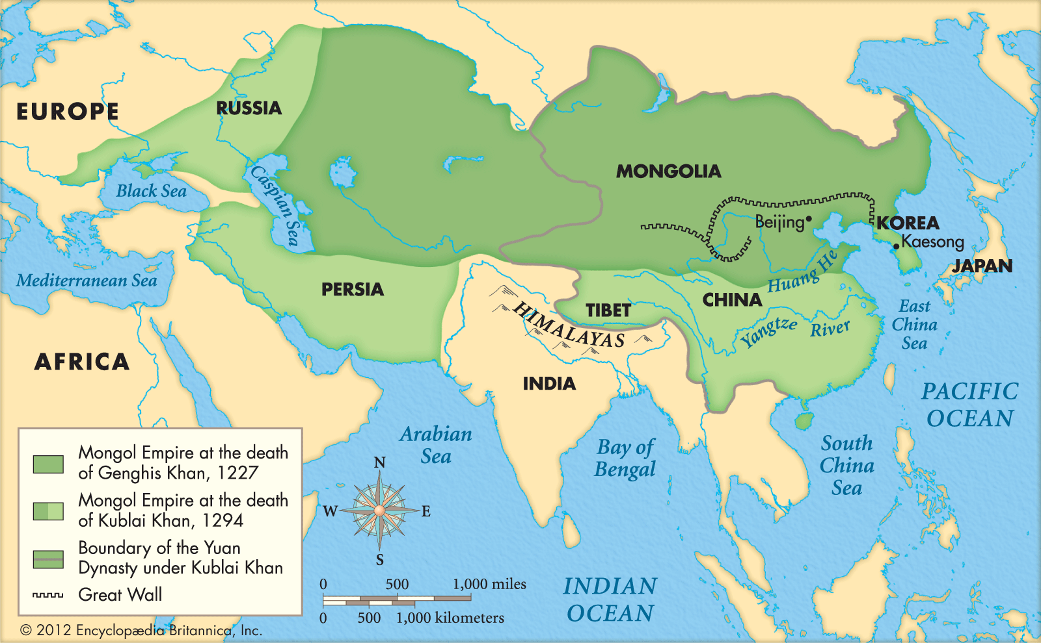
Main Argument 3 by Ms. Smith
After the Mongol Empire fell apart, it gave birth to new countries such as Russia, the Mughal Empire in India, and many strong civilisations.
Violence can be justified at times, because violence was normal at that time. If Mongolia did not use violence to make an empire, it would have been taken over by another country.
Notes:
Insert full text of main argument here.

Slide 7
Genghis Khan was mostly a Villain
Put country flag here.
Represented by: Mr. Larson

Slide 8
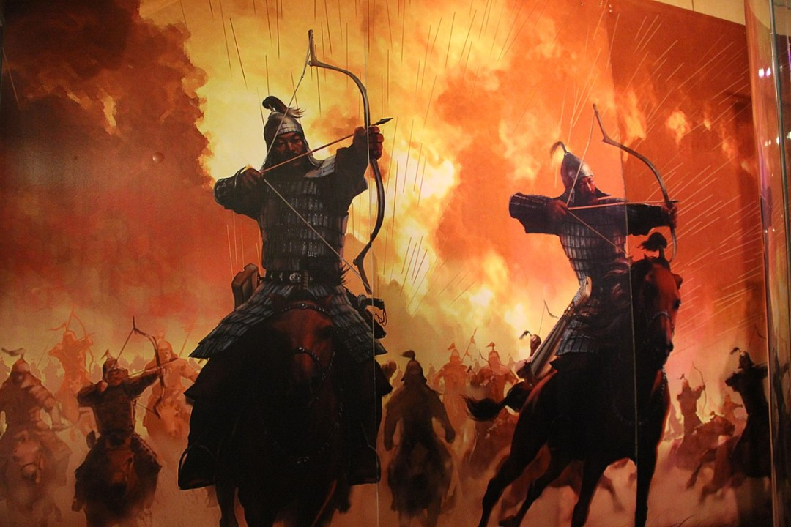
Main Argument 1 by Mr. Larson
Genghis Khan was responsible for killing 40 million people, 10% of the world’s population.
Killing millions of people is wrong, no matter what time period we are in. We should not forgive people for these crimes just because of time. We all know Hitler was a terrible person, and Genghis Khan killed more people than Hitler.
Notes:
Insert full text of main argument here.

Slide 9
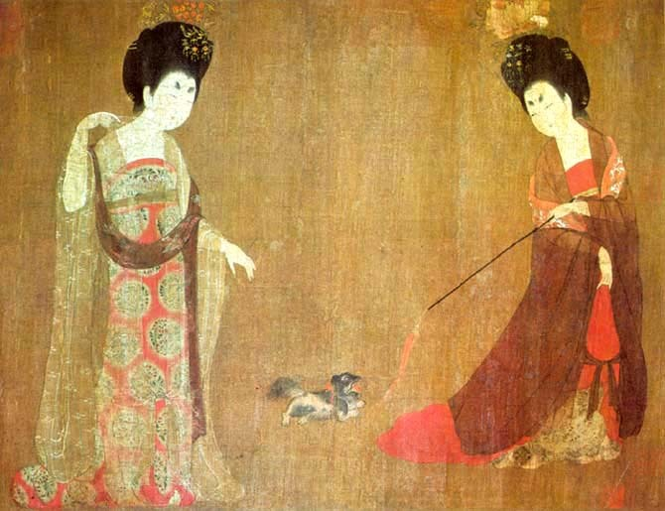
Main Argument 2 by Mr. Larson
It’s possible to create a good economy and respect for religious rights and women's rights without mass murder. For example, the Tang Dynasty in China was one of the most prosperous in Chinese history and they did it without mass violence.
Human Rights are more important than strength and power because Human Rights is what makes people’s standard of living better.
Notes:
Insert full text of main argument here.

Slide 10
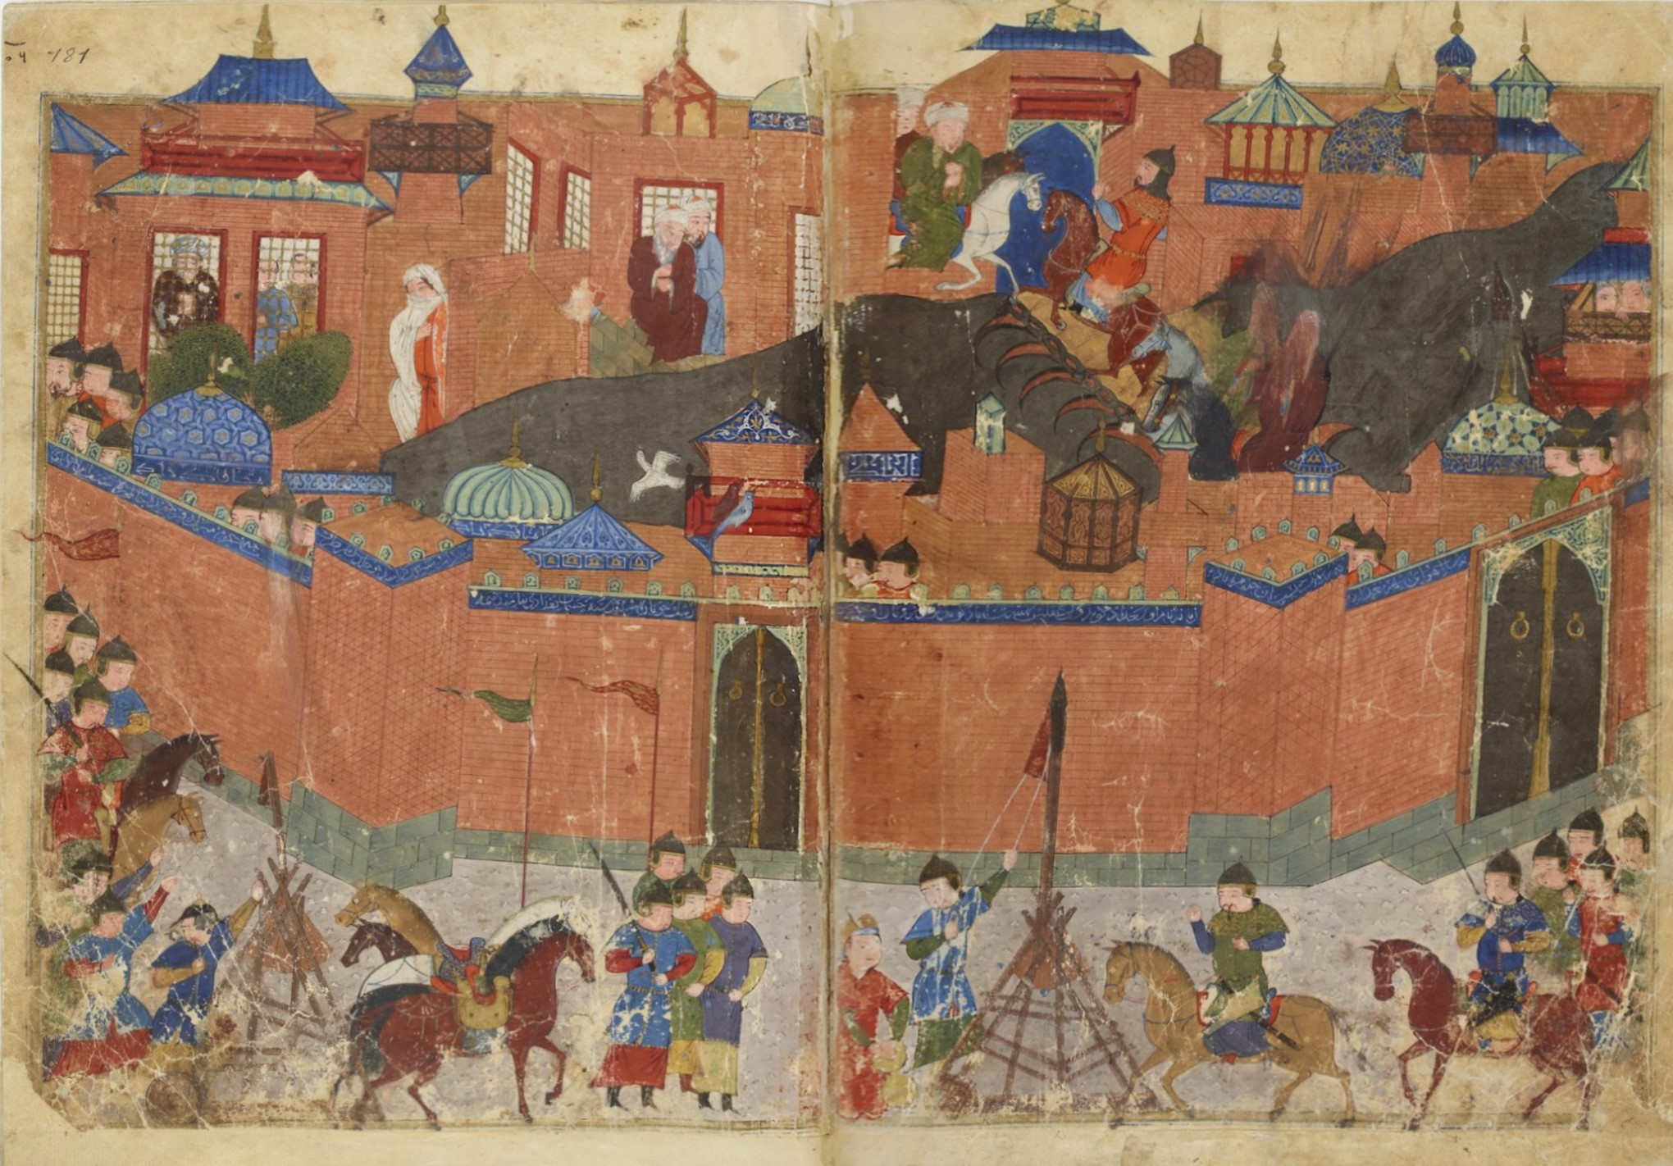
Main Argument 3 by Mr. Larson
The Mongol Empire was responsible for destroying many cultures. For example, the largest library on earth at the time was in Baghdad. The Mongol Army destroyed the library and so much knowledge was lost. Who knows what amazing technology we could have today if this library wasn’t destroyed?
Violence should only ever be used in self defence. In the case of Mongolia, it was only ever used offensively.
Notes:
Insert full text of main argument here.

Slide 11
Rebuttals:
You have 10min to prepare

Slide 12
Quickfire Rebuttals

Slide 13
Questions from Audience

Slide 14
Post Debate Vote:
Was Genghis Khan mostly a hero or villain?

