Slide 1
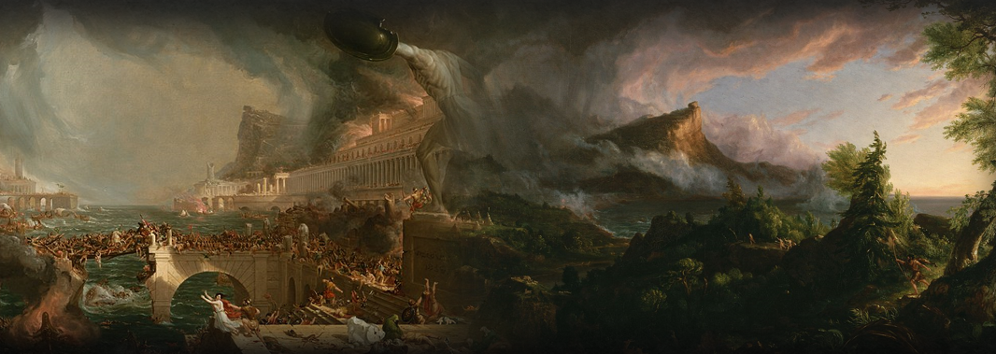
Lesson 1: Introduction to Concepts
Date: Mon Jan 13 (AB) & Fri Jan 10 (CD)
Theme: Case Studies
Unit 3: Unnatural Disasters
Grade 8: Individuals & Societies

Slide 2

Today’s Inquiry Questions & Learning Targets
Inquiry Questions:
What will unit three be about?
What is the Statement of Inquiry for this unit?
What is the difference between facts, context, spectrums, nuance, and taboos?
Learning Targets: By the end of this lesson, I can…
Read the syllabus to understand what we will study for unit three.
Deconstruct the statement of inquiry and differentiate between facts, context, spectrums, nuance, and taboos through a Spectrum Sort activity.

Slide 3
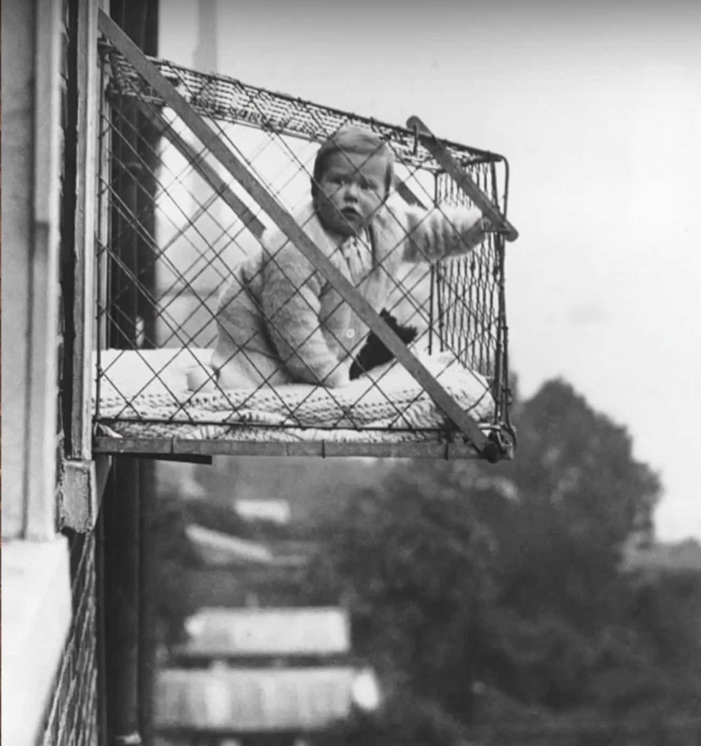
Facts and Context: You need both to have a well-informed opinion
Here is a photo with no context. What is your reaction?
Here is some context. How has your opinion changed?
How many times have you heard someone say “well I am just stating facts?” in order to make their opinion sound more valid?
Let’s say PERSON A hit PERSON B. Someone said, “Person A hit Person B, therefore, Person A is bad. I am just stating a fact!” Which part of this is a fact, and which part of it is an opinion?
What missing context in this scenario could make you change your opinion that Person A is NOT bad?

Slide 4

To what extent do you agree with this statement?
This is a binary statement. But is it too simple to say there are only two options for most debatable questions?
“There are always two sides to a story…”
This has more nuance (differences) but there are still only three options. Is this enough?
“Don’t just think in black and white, there is also grey in the middle.”
This has the most nuances because it puts no limitation to the amount of possible opinions. Therefore, it’s represented as a spectrum.
“The diversity of thought is infinite.”

Slide 5
Nuance and Taboos
Definition of Taboo:
A behaviour or belief that a part of society considers either forbidden or highly undesired.
Some taboos are minor and can result in awkwardness if brought up in conversation and some taboos can result in social ostracization (being completely expelled and cut off from a community) or even legal consequences.
Taboos range greatly across cultures and political affiliations. What might be a major taboo for one community may be a non-issue for another community.
Definition of a Nuanced Opinion:
A complex opinion that takes into account multiple perspectives.
What are examples of taboos?
In what ways, if any, can taboos prevent Nuanced Opinions?

Slide 6
Spectrum Sort Activity
Spectrum Sort Rules:
1. Read the prompt, and put yourself in the room in a spectrum somewhere between 0% agree to 100% agree.
2. Try not to be influenced by your peers (Hawthorne Effect).
3. Do not be disrespectful to other people’s opinions but you are allowed to disagree with them.
“Most natural disasters are made by humans and are therefore, unnatural.”
“Economic Development cannot coexist with Environmental Sustainability.”
“Critiquing your government should not be a taboo.”
“Social media makes us have less nuanced opinions and more extreme opinions.”

Slide 7
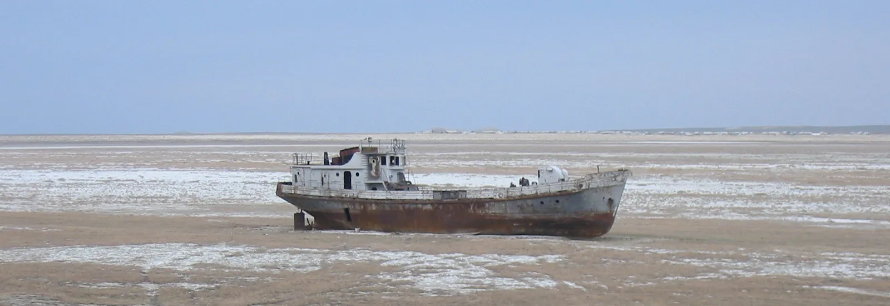
Lesson 2: Draining of the Aral Sea
Date: Wed Jan 15 (AB), Mon Jan 20 (CD)
Theme: Case Studies
Unit 3: Unnatural Disasters
Grade 8: Individuals & Societies

Slide 8
Today’s Inquiry Questions & Learning Targets
Inquiry Questions:
What facts, context, taboos can help us gain a spectrum of nuanced opinions that explain the draining of the Aral Sea?
Learning Targets: By the end of this lesson, I can…
Provide facts, context, and taboos that can help create a spectrum of nuanced opinions that explain the draining of the Aral Sea.

Slide 9
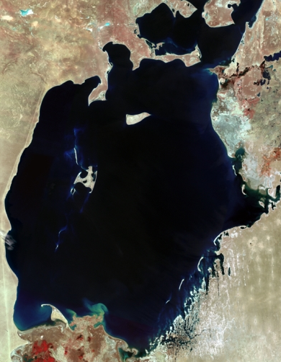
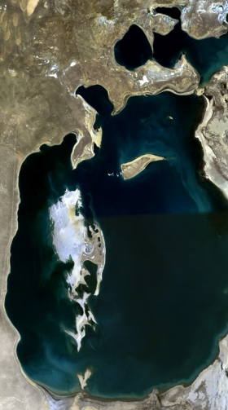
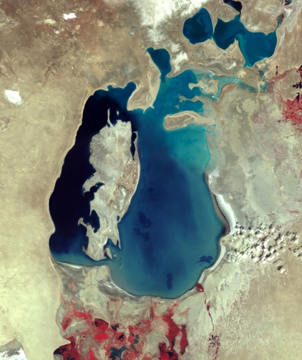
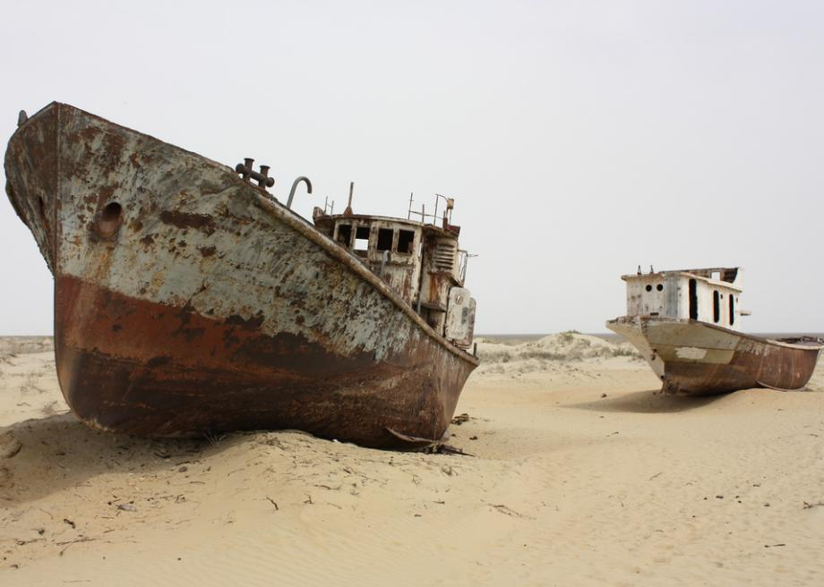
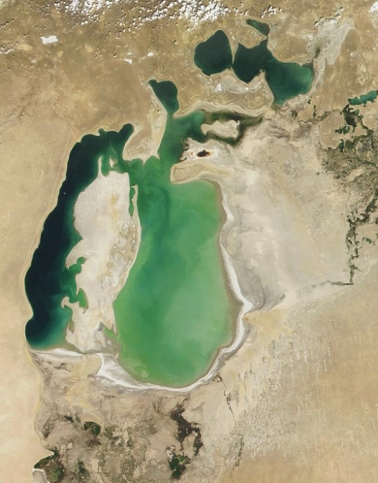
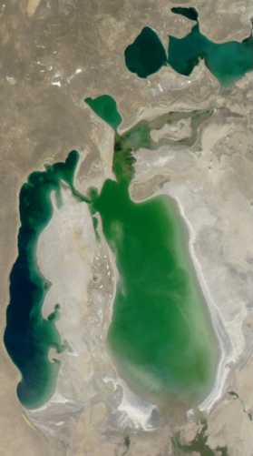
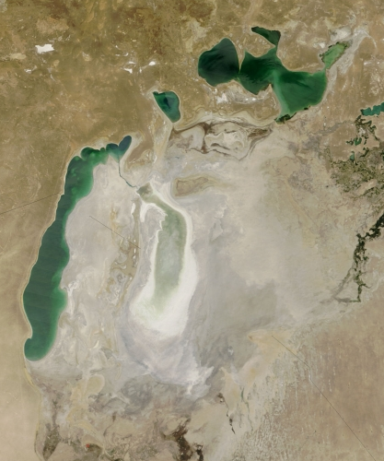
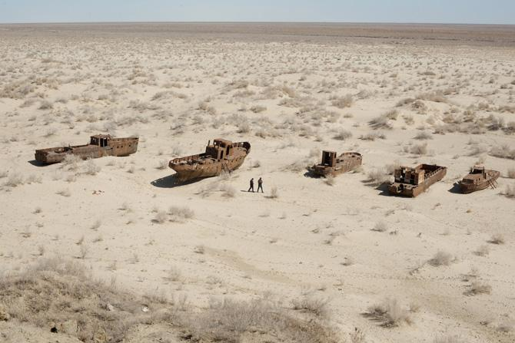
Draining of the Aral Sea: Facts
1964
1974
1984
1994
2004
2014

Slide 10
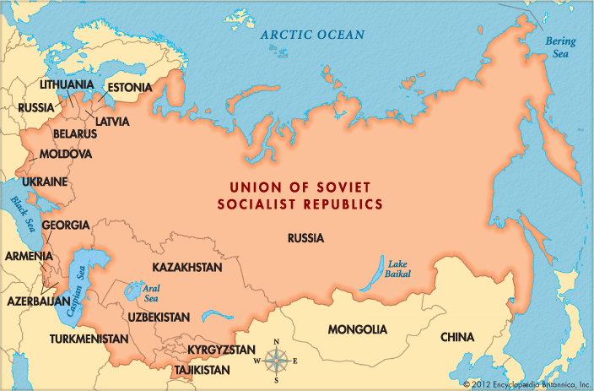
Draining of the Aral Sea: Context
The Aral Sea is located between Kazakhstan and Uzbekistan. It used to be the 4th largest lake in the world.
The Aral Sea began to be drained when these countries were under control of Russia in what was then called the Soviet Union.
The decision to drain the Aral Sea was made by Russia, not by Kazakhstan or Uzbekistan.

Slide 11
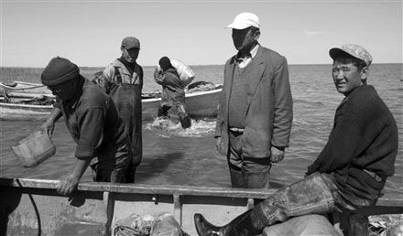
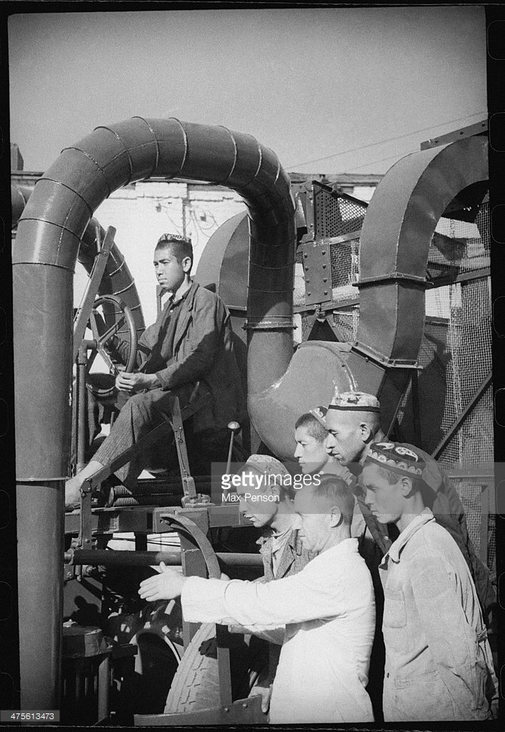

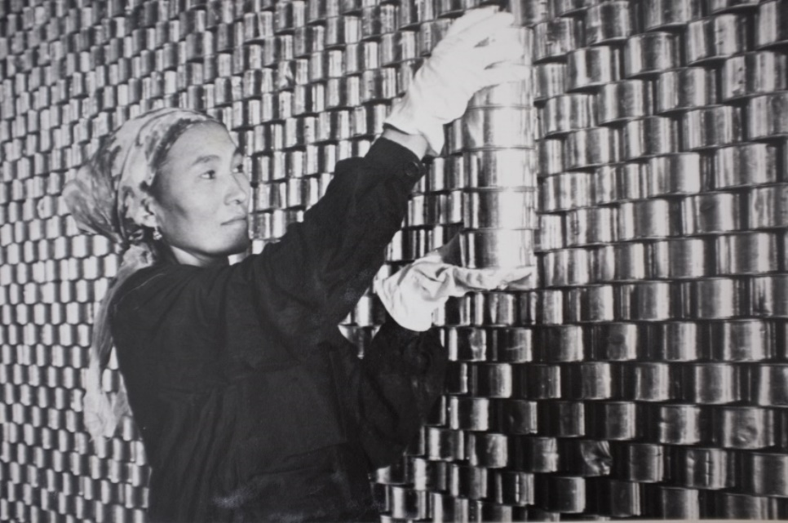
Draining of the Aral Sea: Context
The Soviet Union wanted to turn these small fishing villages into a massive producer of cotton. Growing cotton requires a lot of water and so the Aral Sea was drained to grow cotton.

Slide 12

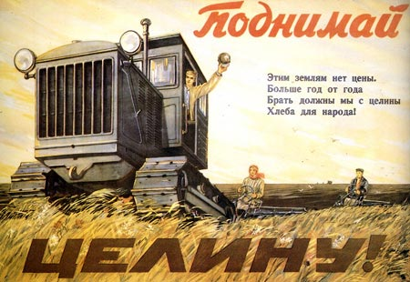
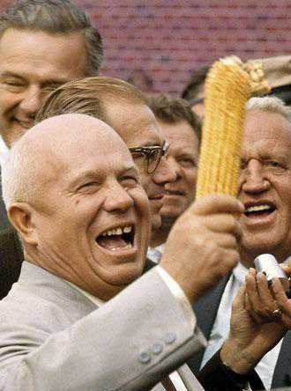
Draining of the Aral Sea: Context
The Soviet Union also wanted to turn much of the dry deserts surrounding the Aral Sea into a massive producer of corn. This also required water that came from the Aral Sea.

Slide 13



Draining of the Aral Sea: Taboo
People realised early on that too much water was being taken from the Aral Sea and that it was not sustainable. However, many people did not feel like they were able to critique the policy to prevent the Aral Sea from being drained. This was because critiquing your government was a taboo:
“You are criticising our country? Does that mean you support our enemy the USA who does nothing but critique our country? Are you a traitor who hates our country? The USSR was poor but is now the second most powerful country in the world? Do you want to destroy our prosperity?”
“It is illegal to critique our great nation. You might be arrested and tortured by the secret police: the KGB.”

Slide 14
Draining of the Aral Sea: Spectrum of Nuanced Opinions
100% Natural:
Physical Geography is to blame.
0% Natural:
Human Geography is to blame.
Nuanced Opinion:
To what extent was the draining of the Aral Sea a natural or unnatural disaster? Provide your percentage with an explanation that uses facts, context, and taboos. You also must define natural, unnatural, and disaster in your opinion.
Video (-5:00)

Slide 15
Statement of Inquiry
Please write this down:
Human choices to develop natural landscapes and resources are frequently unsustainable.
What do you think this means?
Write 2-3 sentences unpacking the Statement of Inquiry.
Key Concept
Related Concepts
Global Context

Slide 16
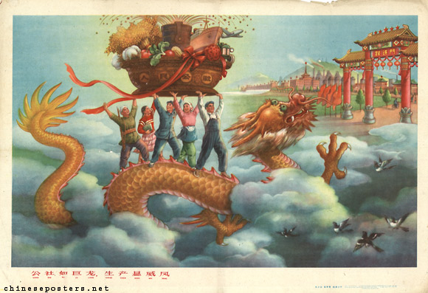
Lesson 3: China’s Great Leap Forward Famine
Date: Thu Jan 16 (AB), Thu Jan 23 (CD)
Theme: Case Studies
Unit 3: Unnatural Disasters
Grade 8: Individuals & Societies

Slide 17
Today’s Inquiry Questions & Learning Targets
Inquiry Questions:
What facts, context, taboos can help us gain a spectrum of nuanced opinions that explain the famine during China’s Great Leap Forward?
Learning Targets: By the end of this lesson, I can…
Provide facts, context, and taboos that can help create a spectrum of nuanced opinions that explain the famine during China’s Great Leap Forward.

Slide 18
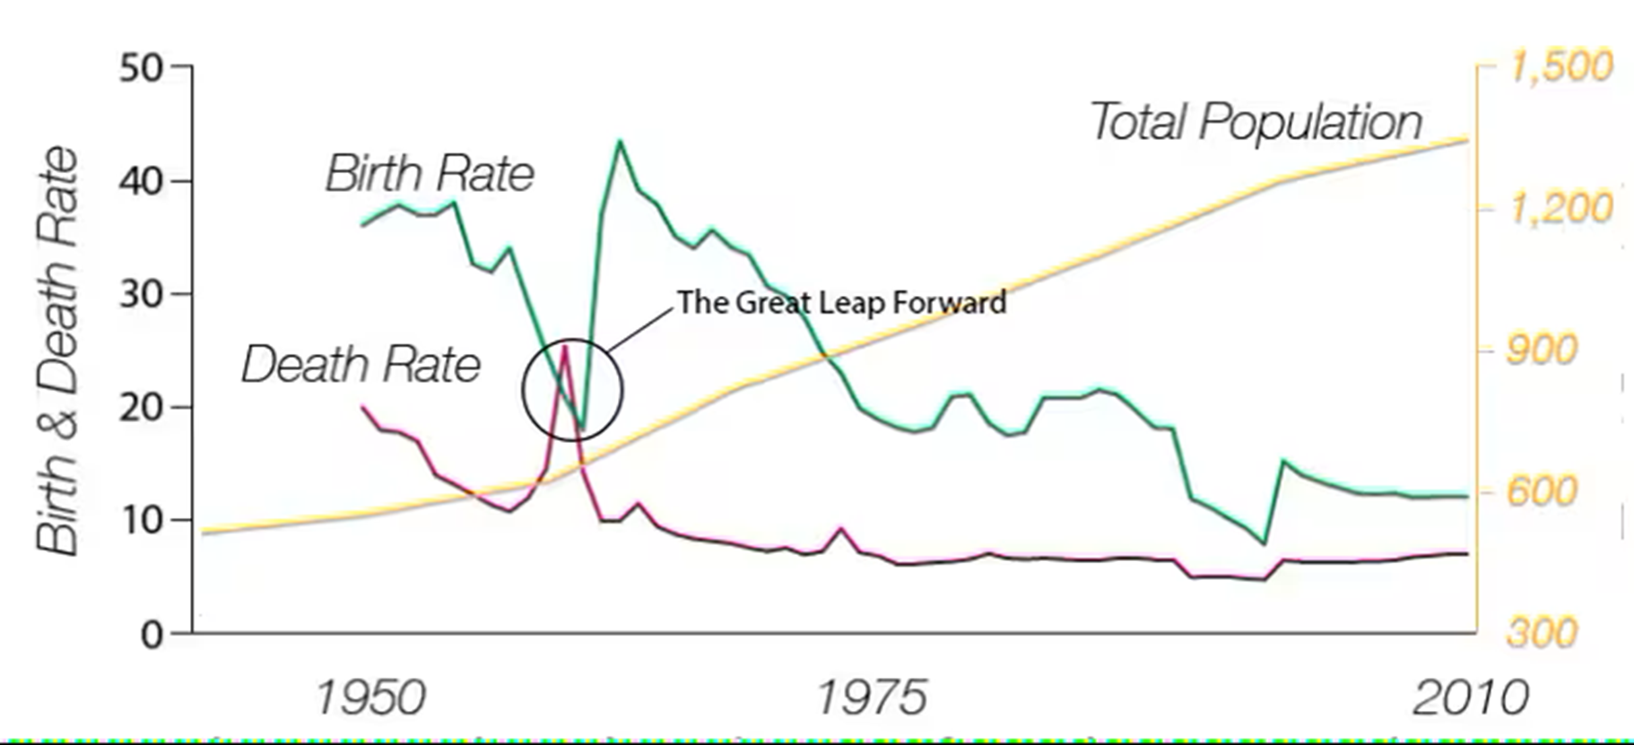
China’s Great Leap Forward: Facts
The Great Leap Forward killed somewhere between 15-55 million people, making it the largest famine in human history.

Slide 19
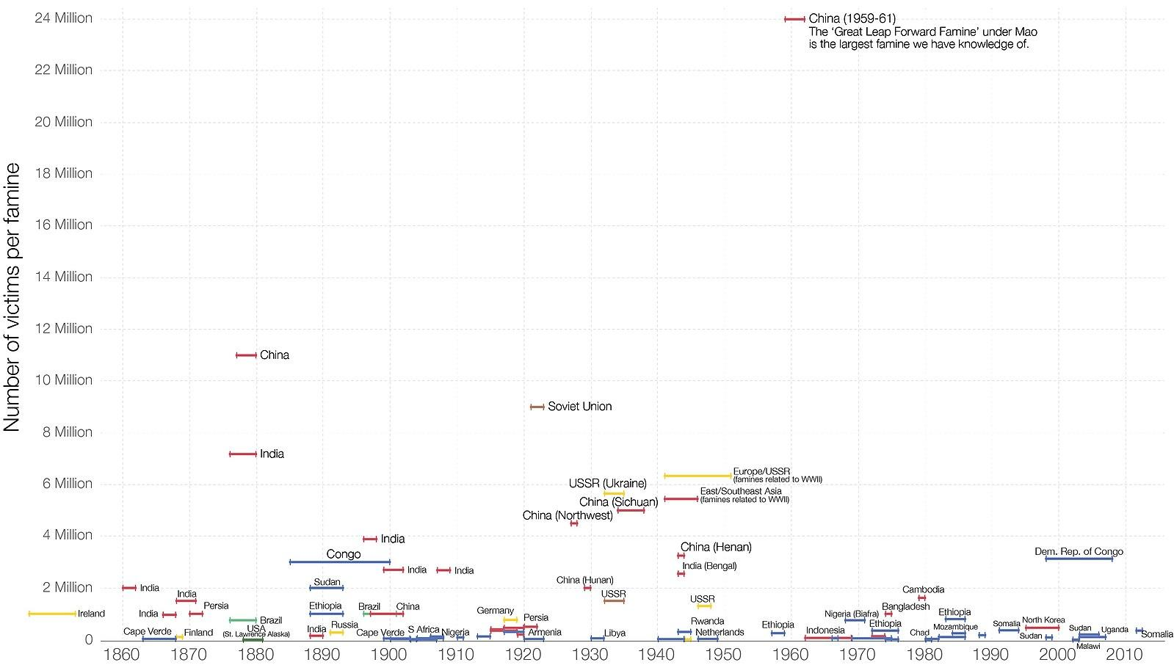

Slide 20
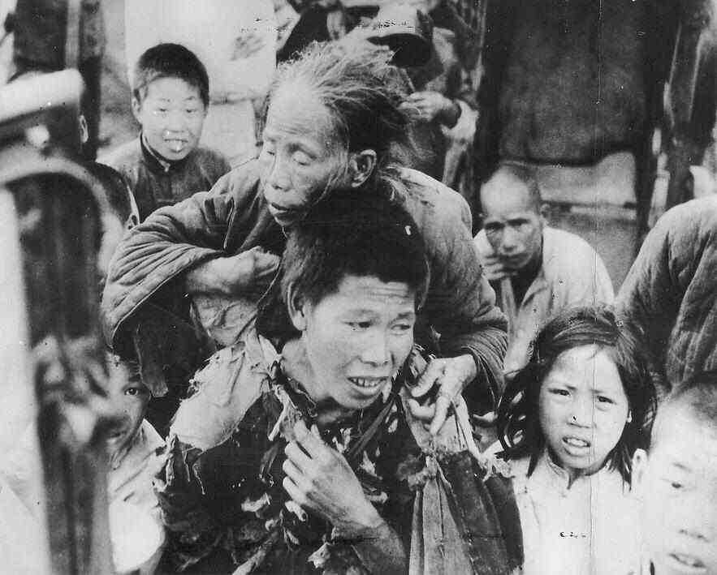
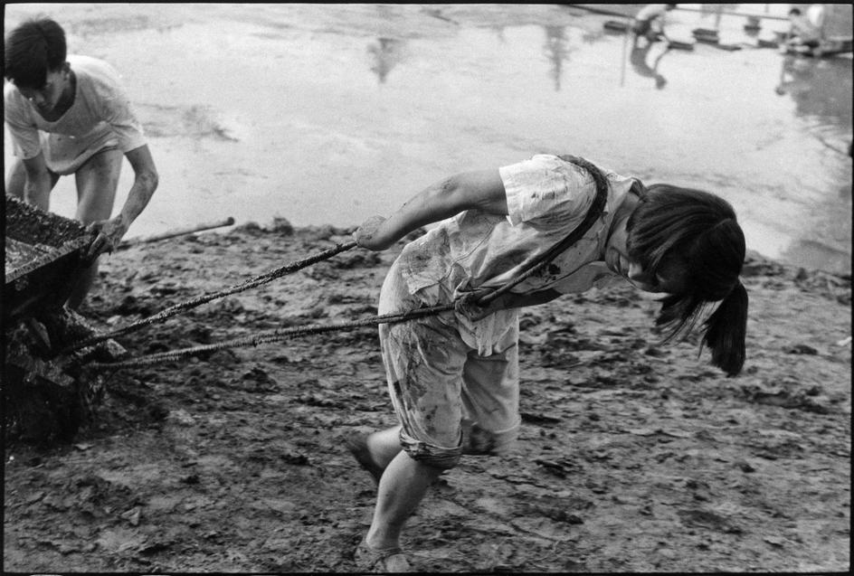
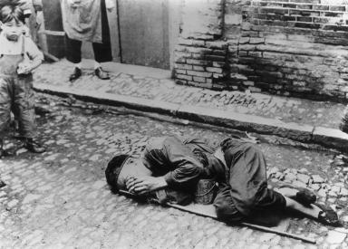
China’s Great Leap Forward: Facts

Slide 21
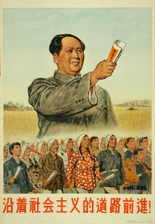
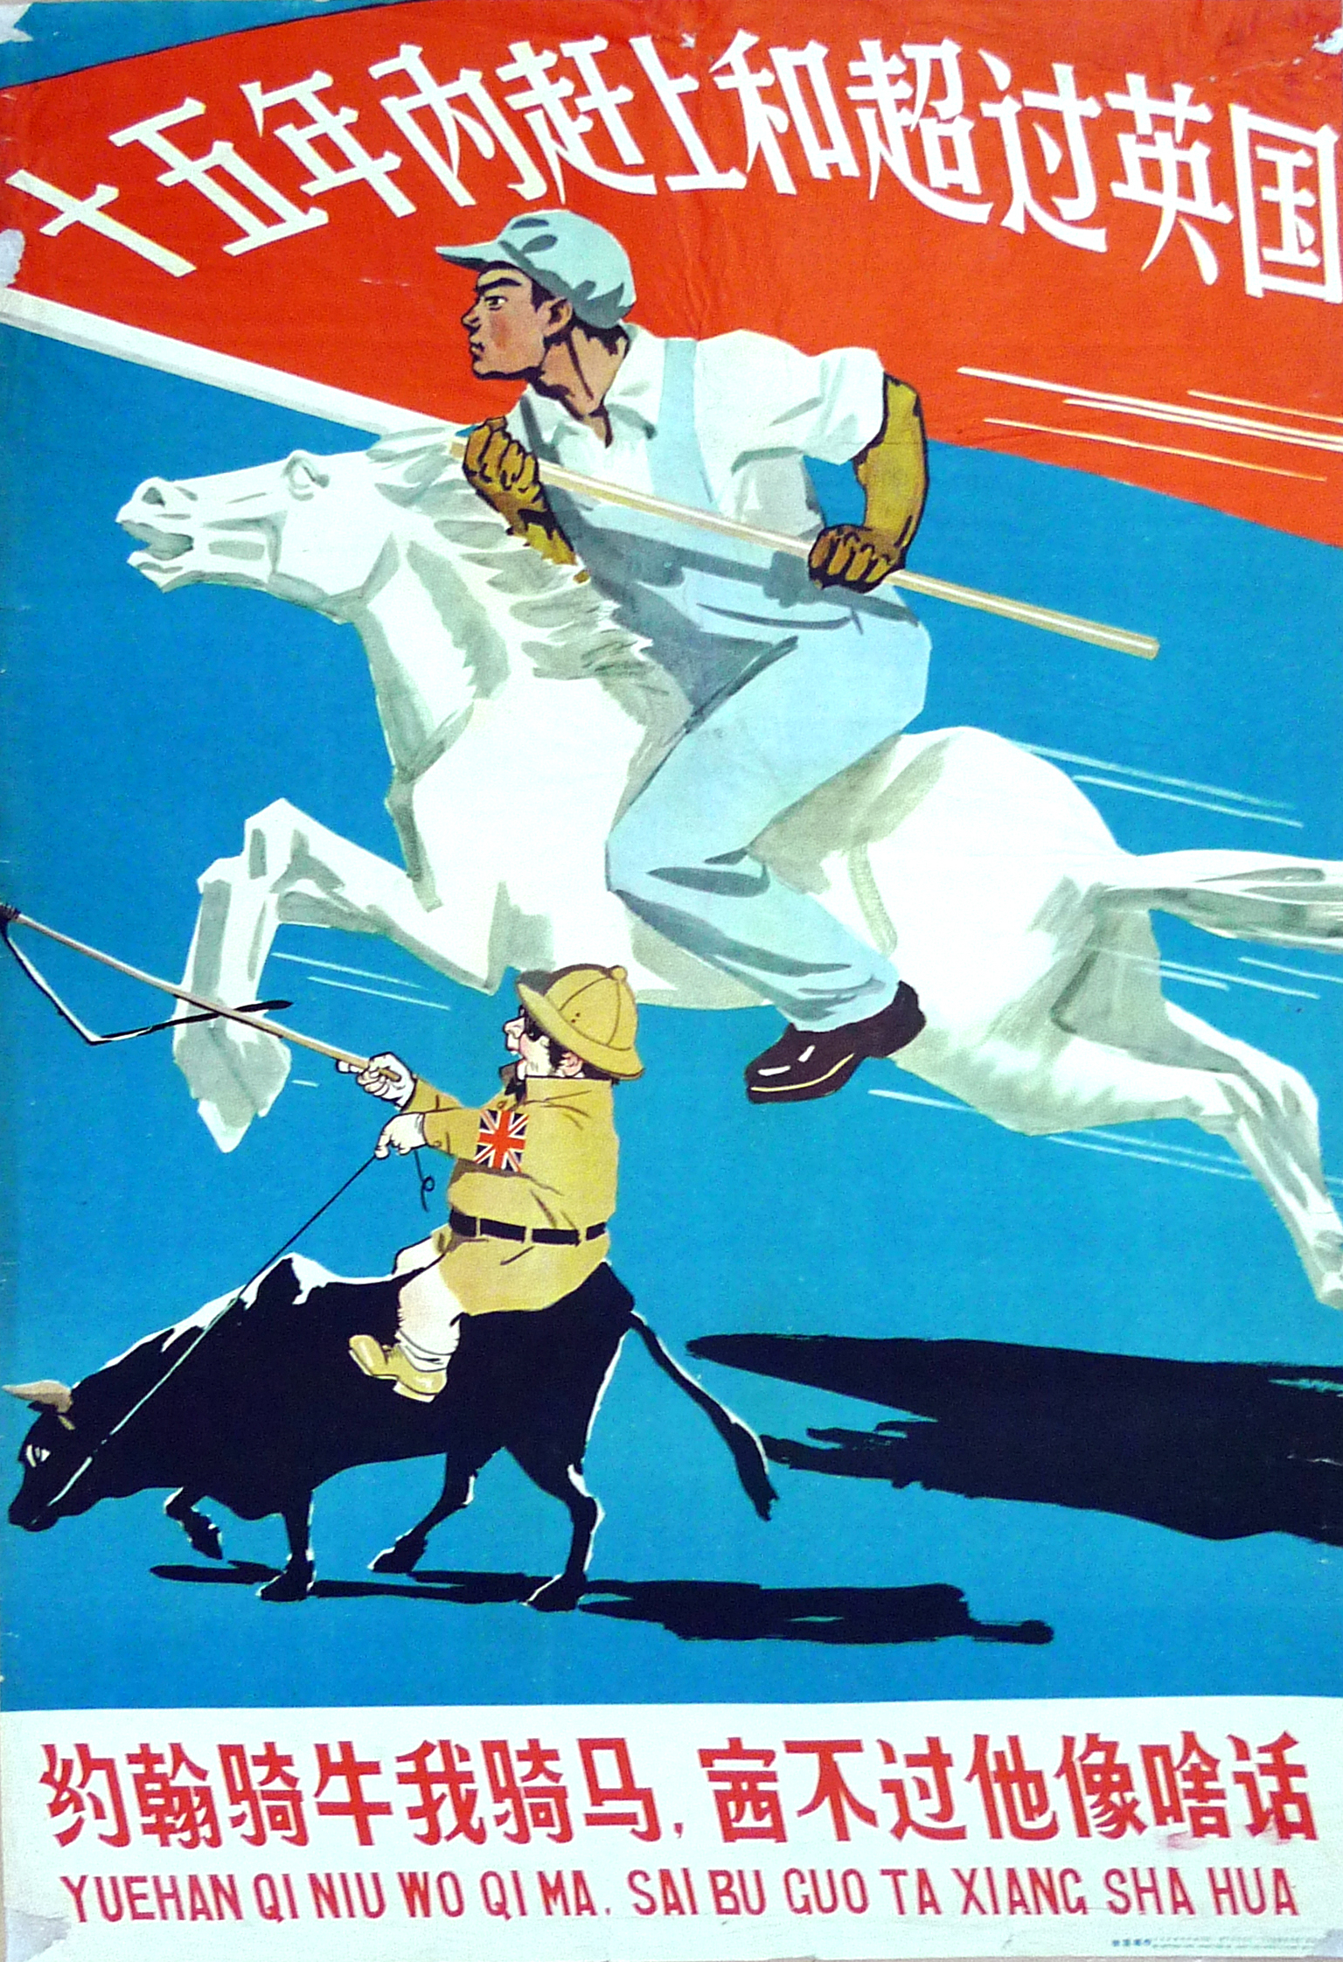
China’s Great Leap Forward: Context
China became a communist country under the dictatorship of Mao Zedong in 1949.
China was overwhelmingly agricultural and Mao wanted to industrialise China and wanted to surpass Britain in steel production in only 15 years.
The plan to industrialise China was called the Great Leap Forward which operated from 1958-1962.

Slide 22
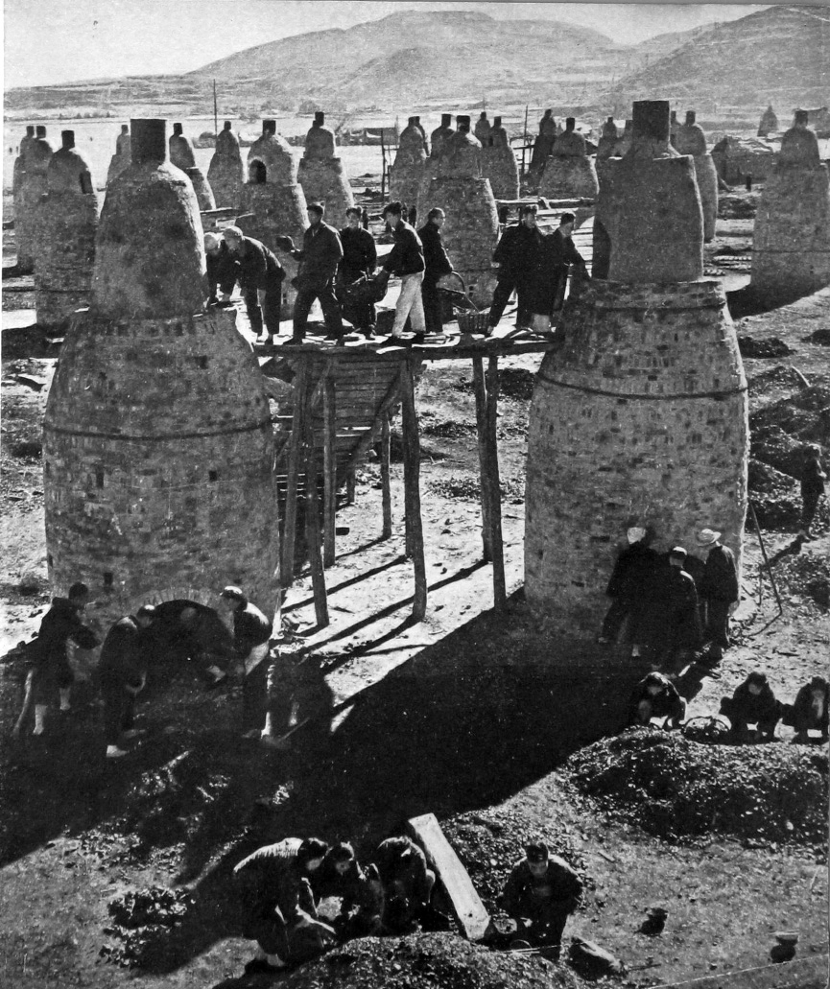
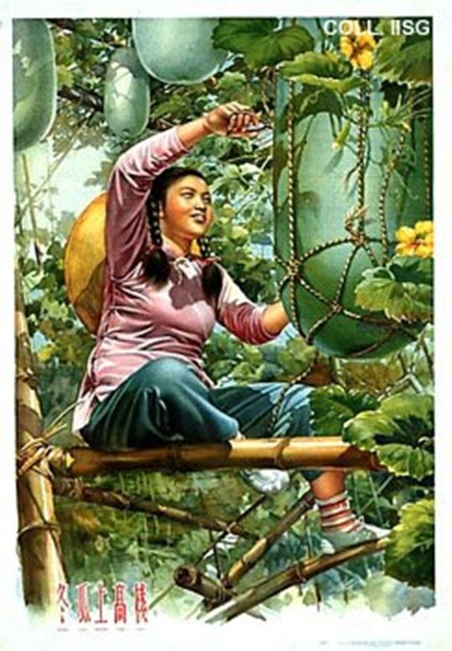
China’s Great Leap Forward: Context
Mao started a Villagisation programme which would be emulated by Julius Nyerere in Tanzania.
The Great Leap Forward encouraged people to build backyard furnaces instead of farming. These furnaces produced very low quality, and in some cases, almost useless steel.
People exaggerated how much steel and food they were producing. There was a government quota that used exaggerated statistics which meant that too much food was compensated and not enough was given to feed people.

Slide 23
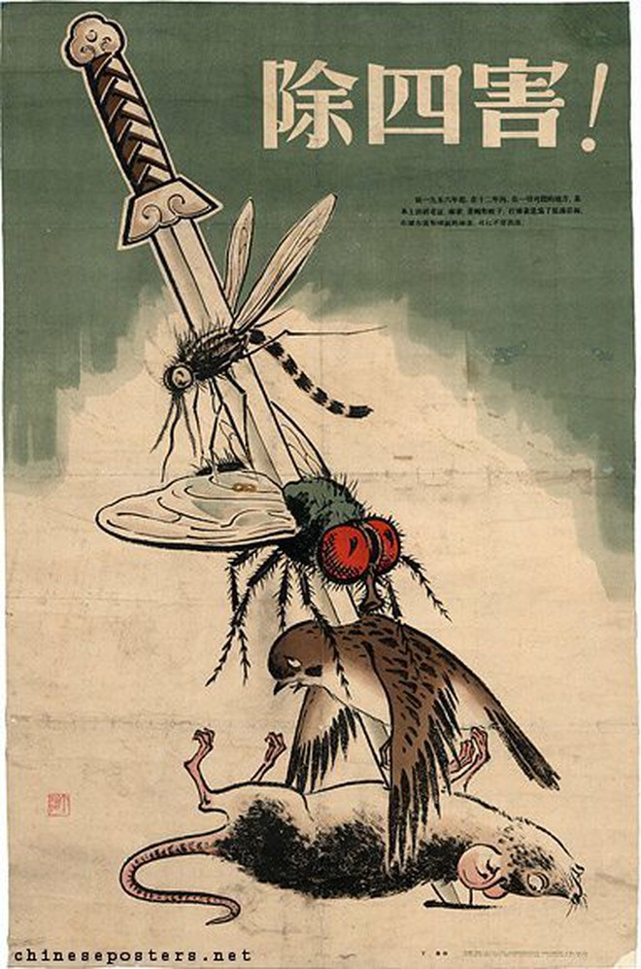
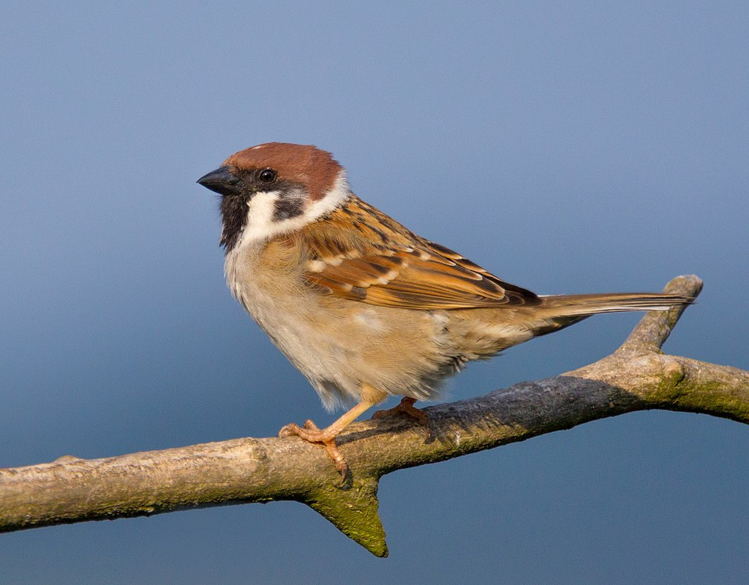
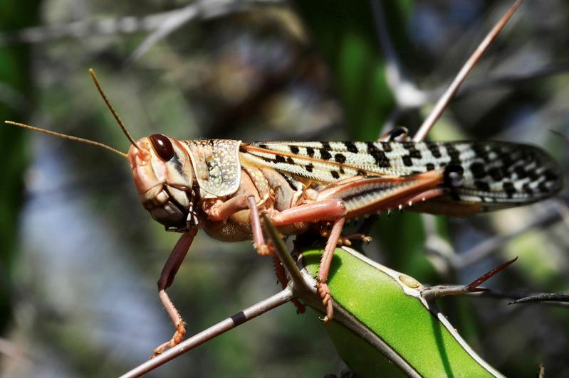
China’s Great Leap Forward: Context
Mao designated Sparrows as one of the Four Pests that should be eliminated because they ate grain seed.
Millions of sparrows and their eggs were killed and smashed.
However, the killing of sparrows led to a boom in the locust population which significantly more grain than the sparrows.
China ended up importing 250,000 sparrows from the Soviet Union to rebuild their population.
How does this relate to what you have learned in science class?

Slide 24
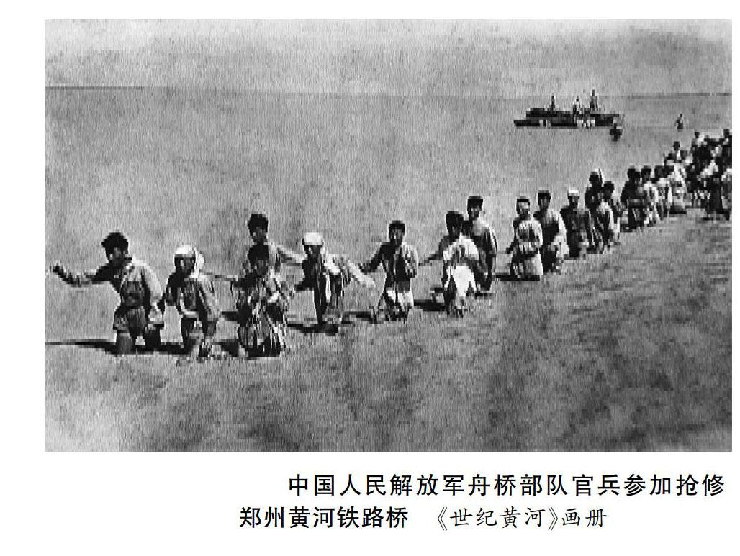
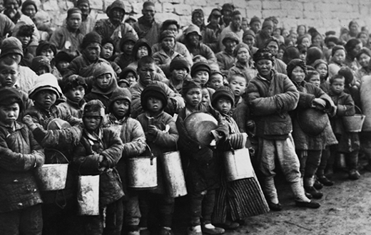
China’s Great Leap Forward: Context
In 1958, the Yellow River Flood caused the destruction of over 1.5 million acres of farmland.
In 1959, there was a drought that caused crop failures in two important provinces to drop by 50% and 25%.

Slide 25
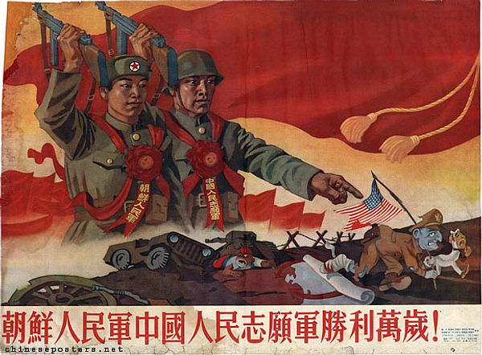

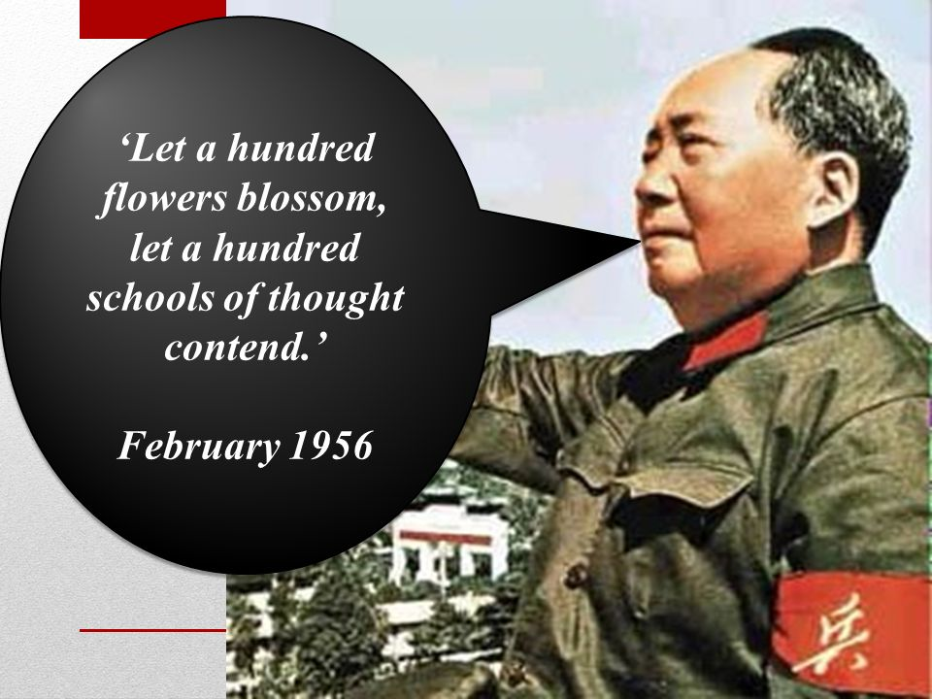
China’s Great Leap Forward: Taboo
People realised early on that crops were being left to rot in order to produce useless metals which was not sustainable. However, many people did not feel like they were able to critique the Great Leap Forward. This was because critiquing your government was a taboo:
“You are criticising our country? Does that mean you support our enemy the USA who does nothing but critique our country? Are you a traitor who hates our country? The US even invaded us , does that mean you support the previous US invasion?”
In 1956, Mao encouraged freedom of speech but as soon as people critiqued the government they were arrested.

Slide 26
Great Leap Forward: Spectrum of Nuanced Opinions
100% Natural: Physical Geography is to blame.
0% Natural: Human Geography is to blame.
Nuanced Opinion:
To what extent was the Great Leap Forward a natural or unnatural disaster? Provide your percentage with an explanation that uses facts, context, and taboos.
Official Chinese Government Opinion:
1962-1968: "30% of the famine was caused by natural disasters and 70% to man-made errors."
1968-1981: "Three Years of Natural Disasters."
1981-present: "Three Years of Difficulty.”
What trends do you notice overtime and why do you think they changed?
Video

Slide 27
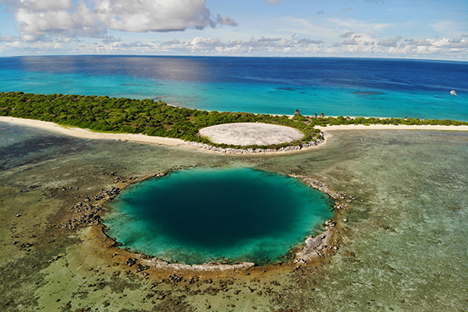
Lesson 4: Health Issues in the Marshall Islands
Date: Monday January 20 (AB), Friday January 24 (CD)
Theme: Case Studies
Unit 4: Unnatural Disasters
Grade 8: Individuals & Societies

Slide 28
Today’s Inquiry Questions & Learning Targets
Inquiry Questions:
What facts, context, taboos can help us gain a spectrum of nuanced opinions that explain the health issues in the Marshall Islands?
Learning Targets: By the end of this lesson, I can…
Provide facts, context, and taboos that can help create a spectrum of nuanced opinions that explain the health issues on the Marshall Islands.

Slide 29
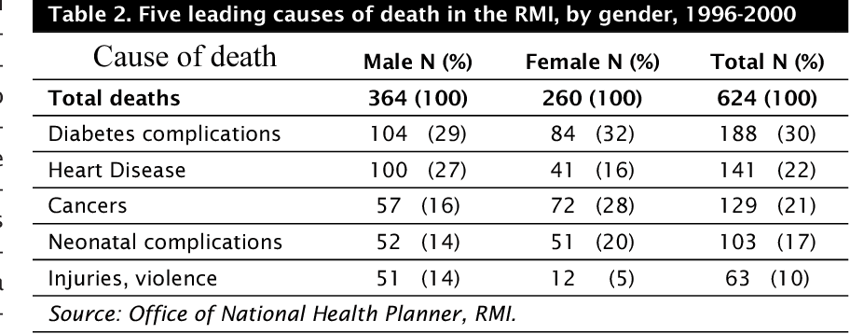
Bikini Atoll (Marshall Islands) Health Issues: Facts
RMI = Republic of Marshall Islands

Slide 30
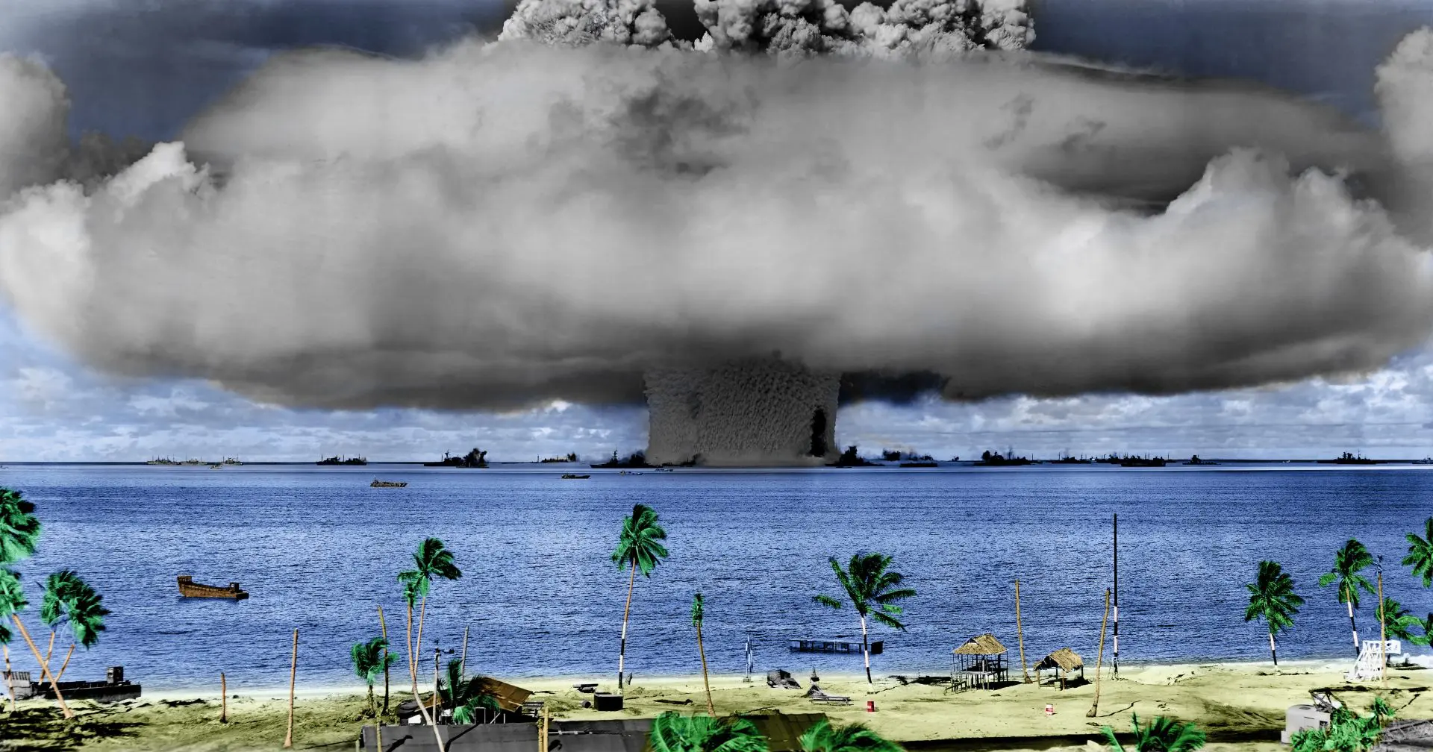
Bikini Atoll (Marshall Islands) Health Issues: Facts

Slide 31
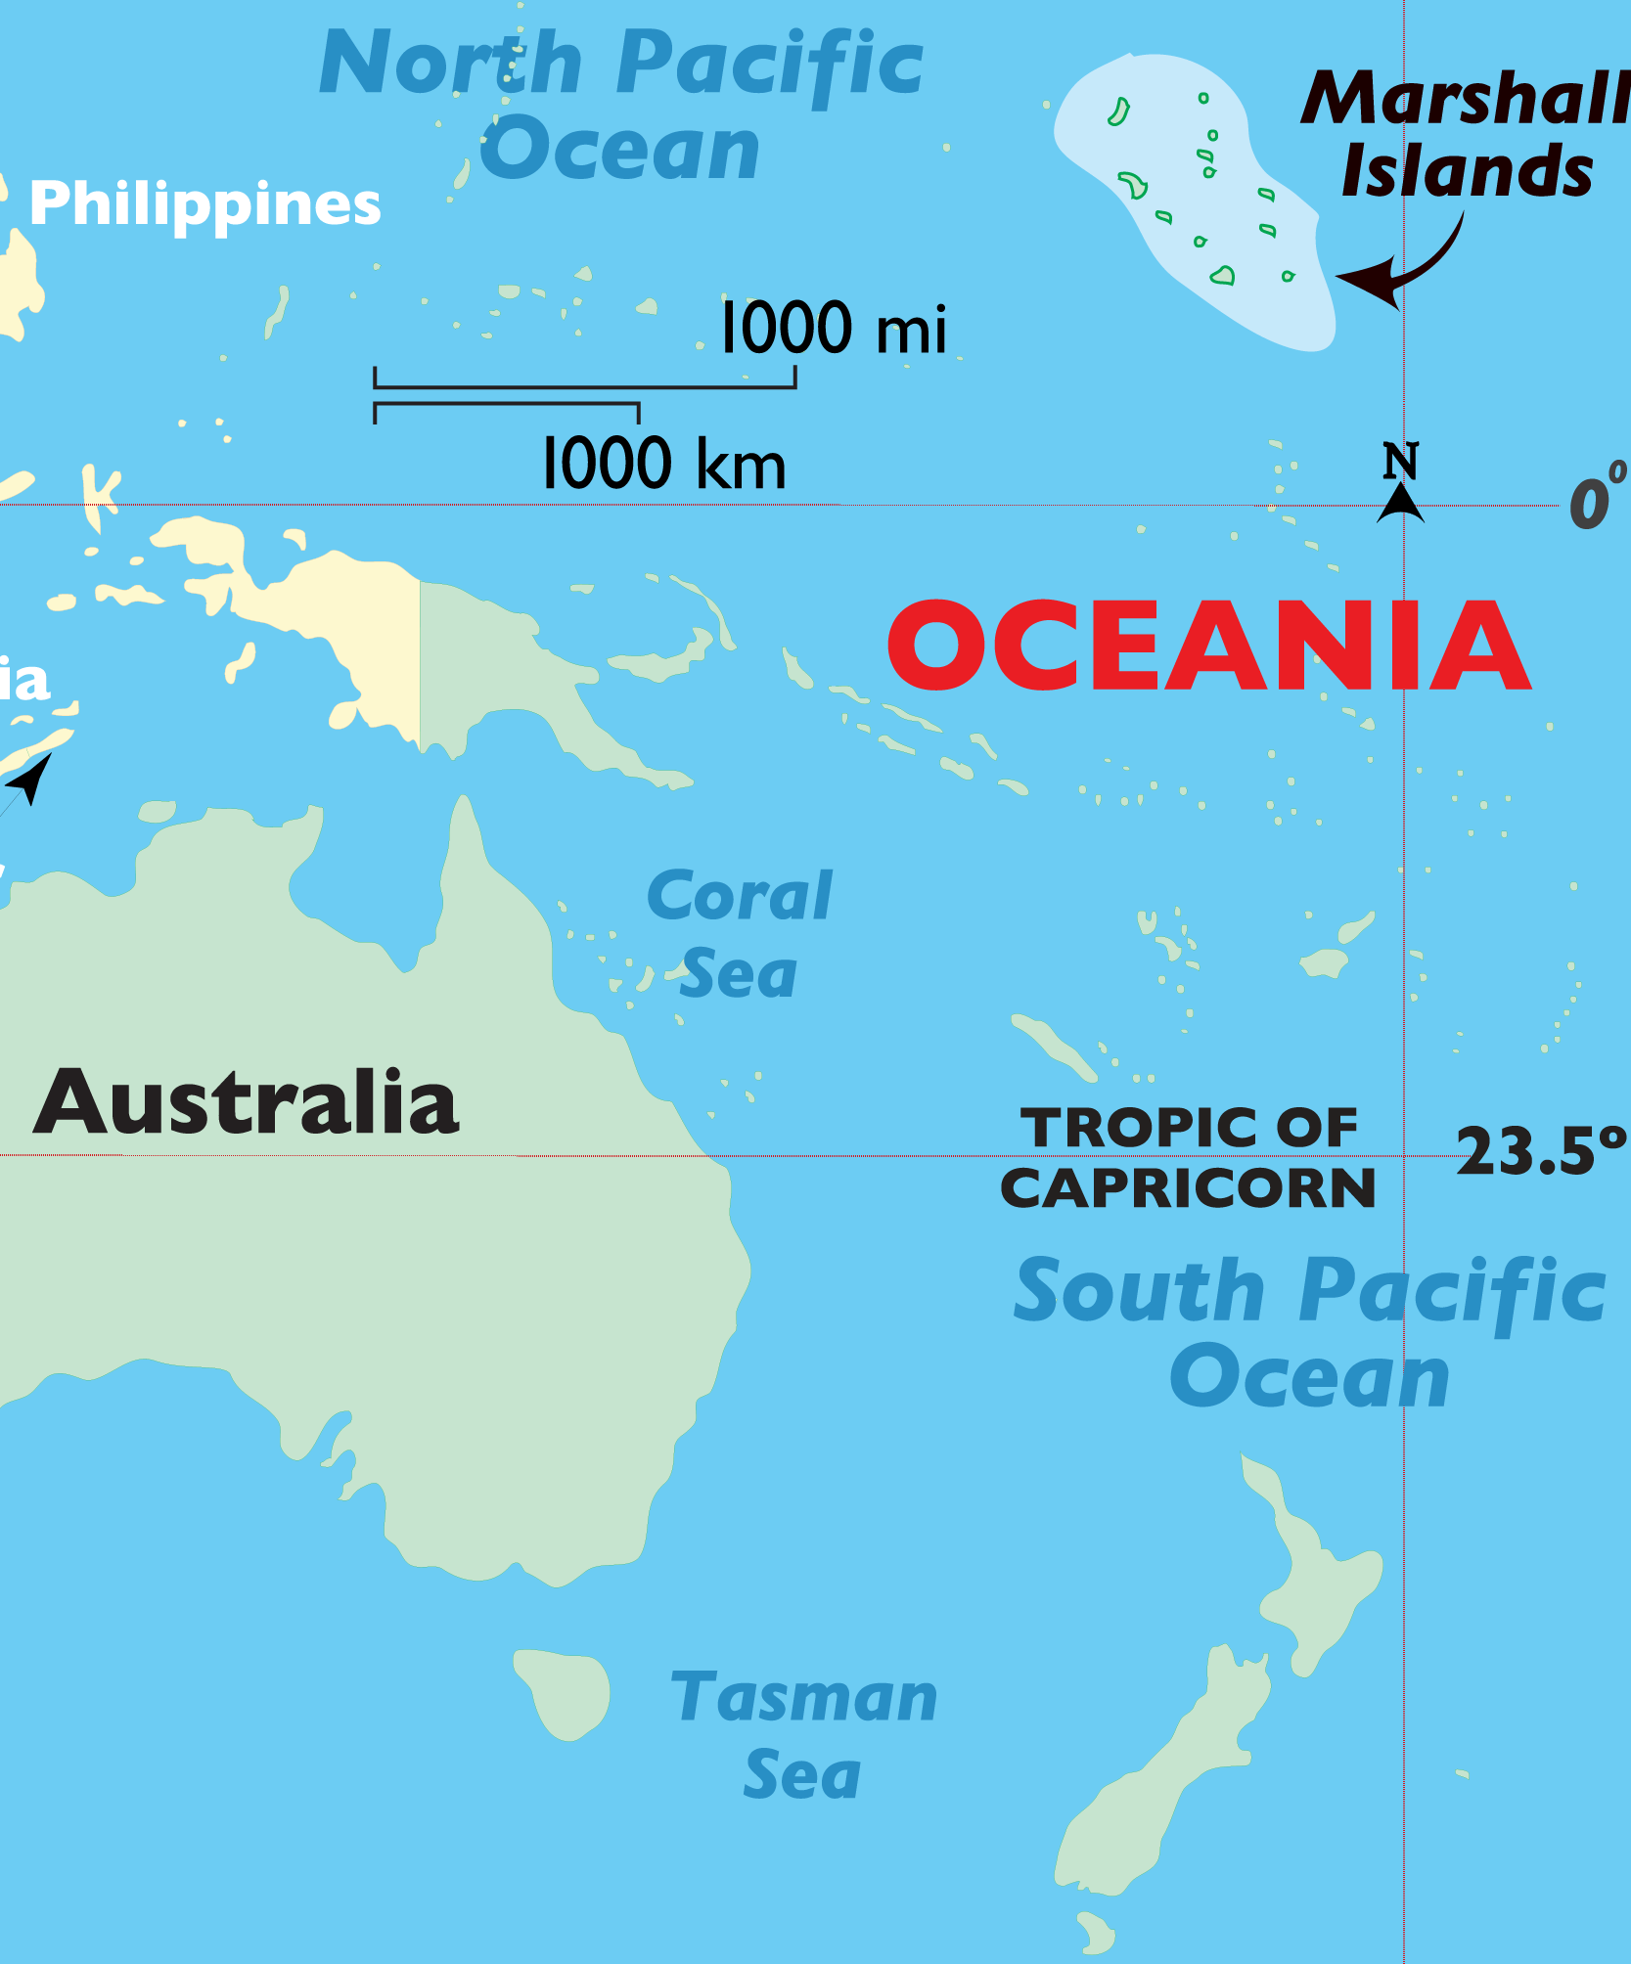
Bikini Atoll Nuclear Radiation: Context
Bikini Atoll is part of the Marshall Islands. From 1944-1979, it was a territory of the USA.
67 nuclear weapons were tested in the Marshall Islands. 23 on Bikini Atoll.
One explosion on Bikini Atoll was three times larger than what US scientists expected.
People were evacuated and then put back on the island after the bombings while it was still radioactive.
People ate contaminated food after US supplied rations were finished. As much of the local fish and plants became inedible, the island became dependent on cheap imported fast foods.

Slide 32
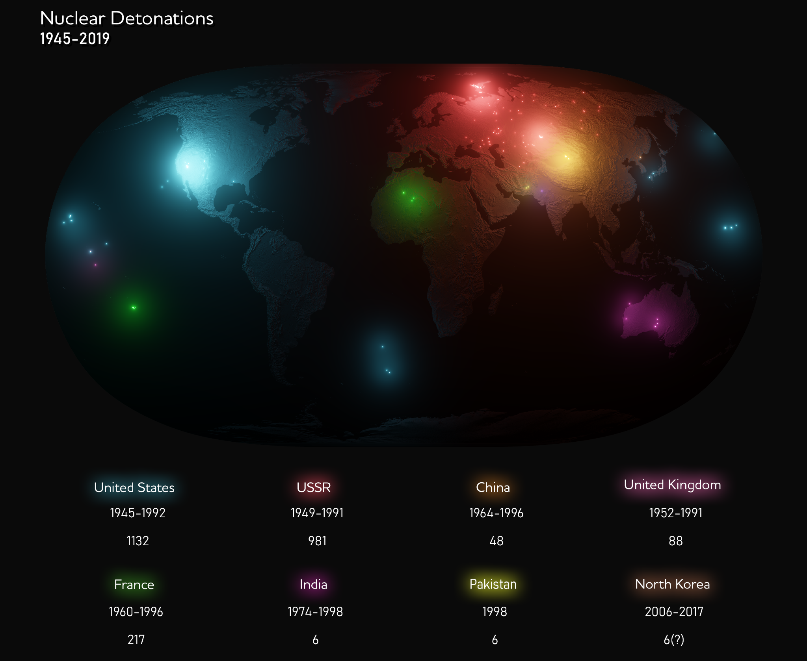

Slide 33
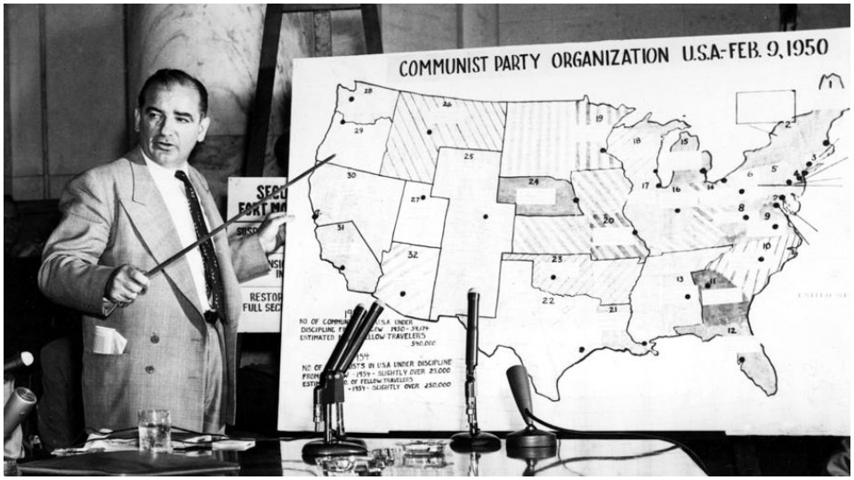

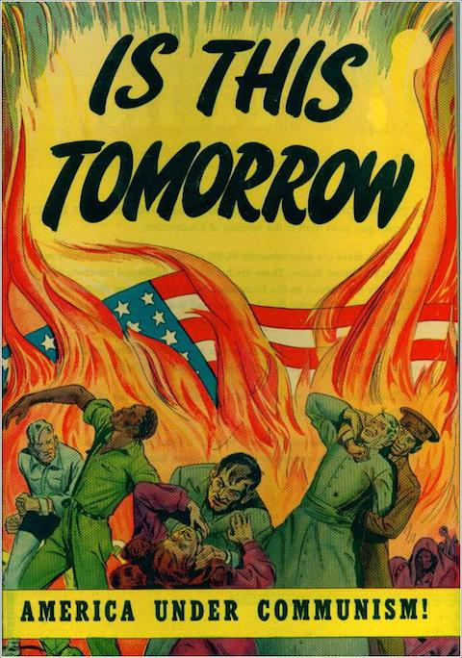
Bikini Atoll Nuclear Radiation: Taboo
People released from the atomic bombings of Japan that radiation was a problem. However, many people did not feel like they were able to critique the American nuclear programme. This was because critiquing your government was a taboo during the Red Scare of the 1950s as people who were accused of being a communist could be blacklisted and lose their jobs:
“You are criticising our country? Does that mean you support our enemy the USSR who does nothing but critique our country? Are you a communist traitor who hates our country?

Slide 34
Health Issues in the Marshall Islands: Spectrum of Nuanced Opinions
100% Natural:
Physical Geography is to blame.
0% Natural:
Human Geography is to blame.
Nuanced Opinion:
To what extent are the health issues in the Marshall Islands natural or unnatural? Provide your percentage with an explanation that uses facts, context, and taboos.
If US scientists believed the blasts would be 3 times less large, would that change your answer?
Video

Slide 35
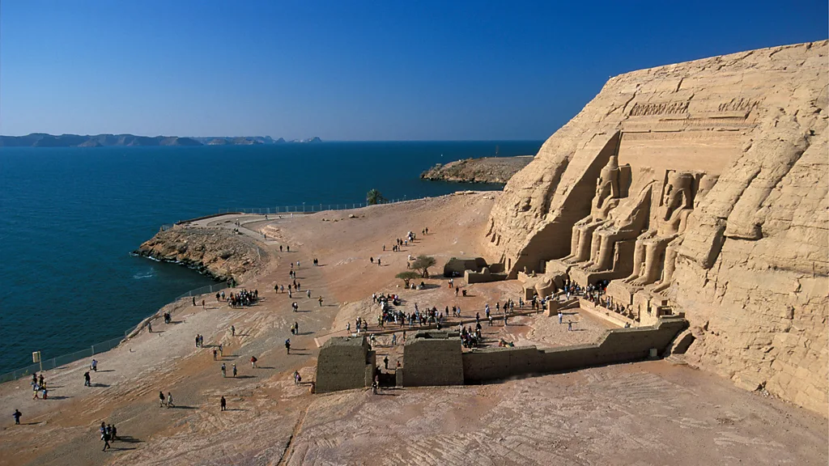
Lesson 5: Flooding of Abu Simbel
Date: Wednesday Jan 22 (AB), Monday Jan 27 (CD)
Theme: Case Studies
Unit 4: Unnatural Disasters
Grade 8: Individuals & Societies

Slide 36
Today’s Inquiry Questions & Learning Targets
Inquiry Questions:
What facts, context, taboos can help us gain a spectrum of nuanced opinions that explain the Flooding of Abu Simbel.
Learning Targets: By the end of this lesson, I can…
Provide facts, context, and taboos that can help create a spectrum of nuanced opinions that explain the Flooding of Abu Simbel

Slide 37
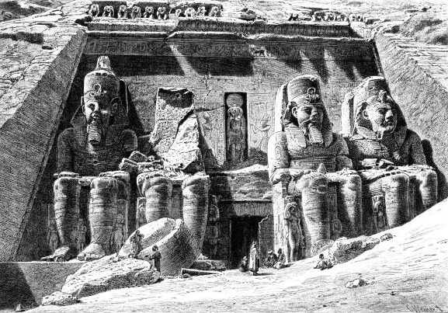
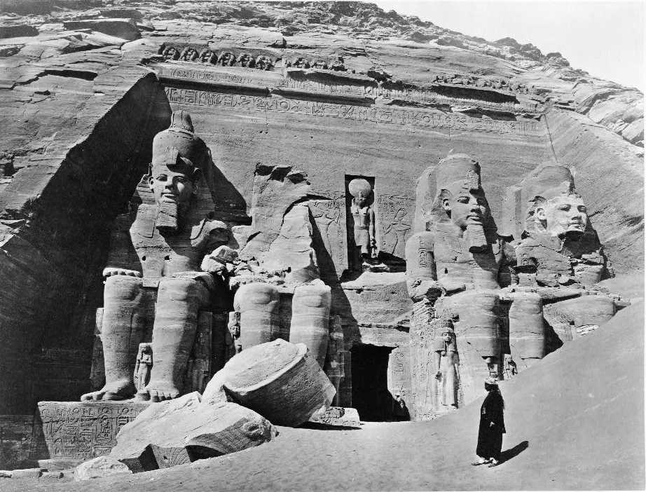
Flooding of Abu Simbel: Facts
19th century drawing of Abu Simbel.
19th century photo of Abu Simbel.

Slide 38
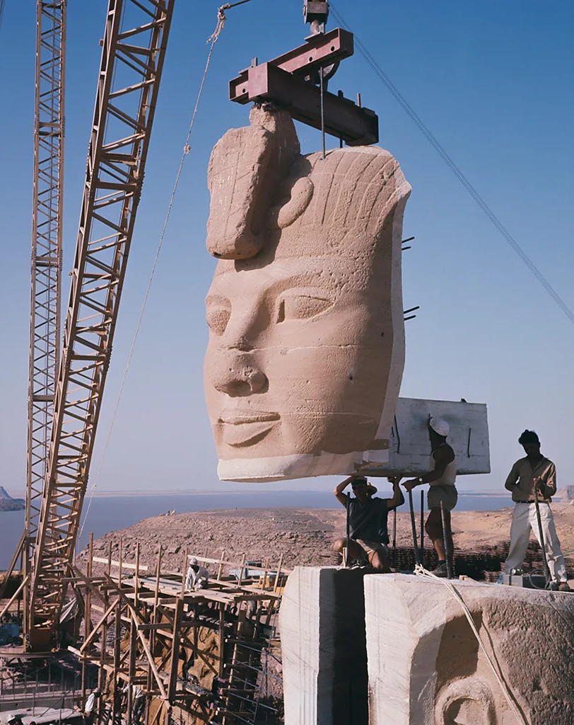
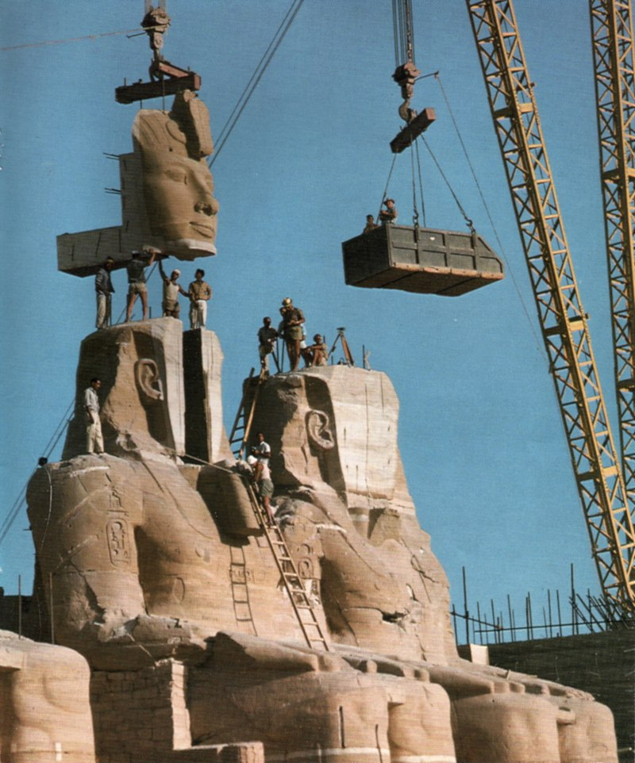
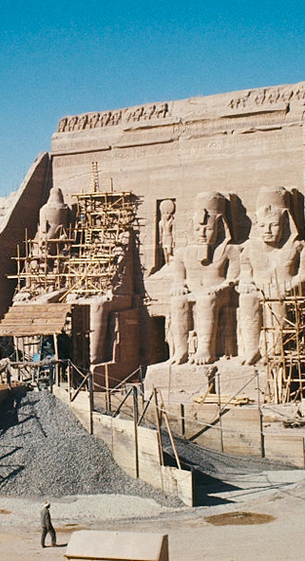
Flooding of Abu Simbel: Facts
Abu Simbel in the 1960s.

Slide 39
Flooding of Abu Simbel: Facts
Abu Simbel today

Slide 40
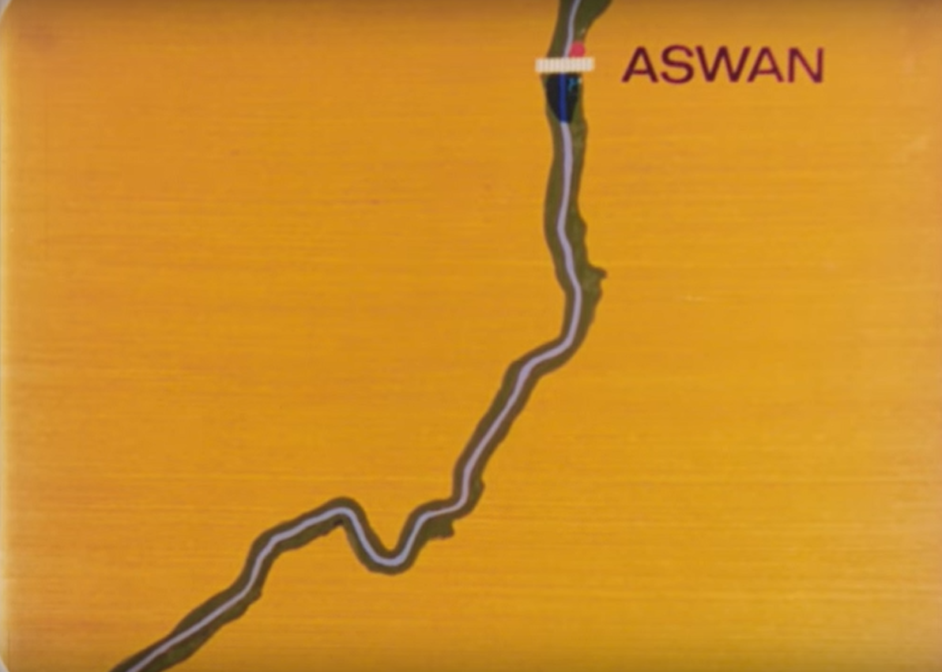
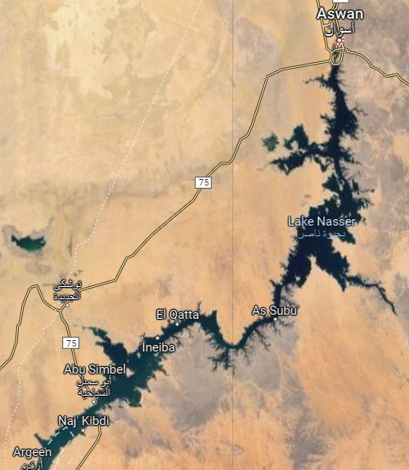
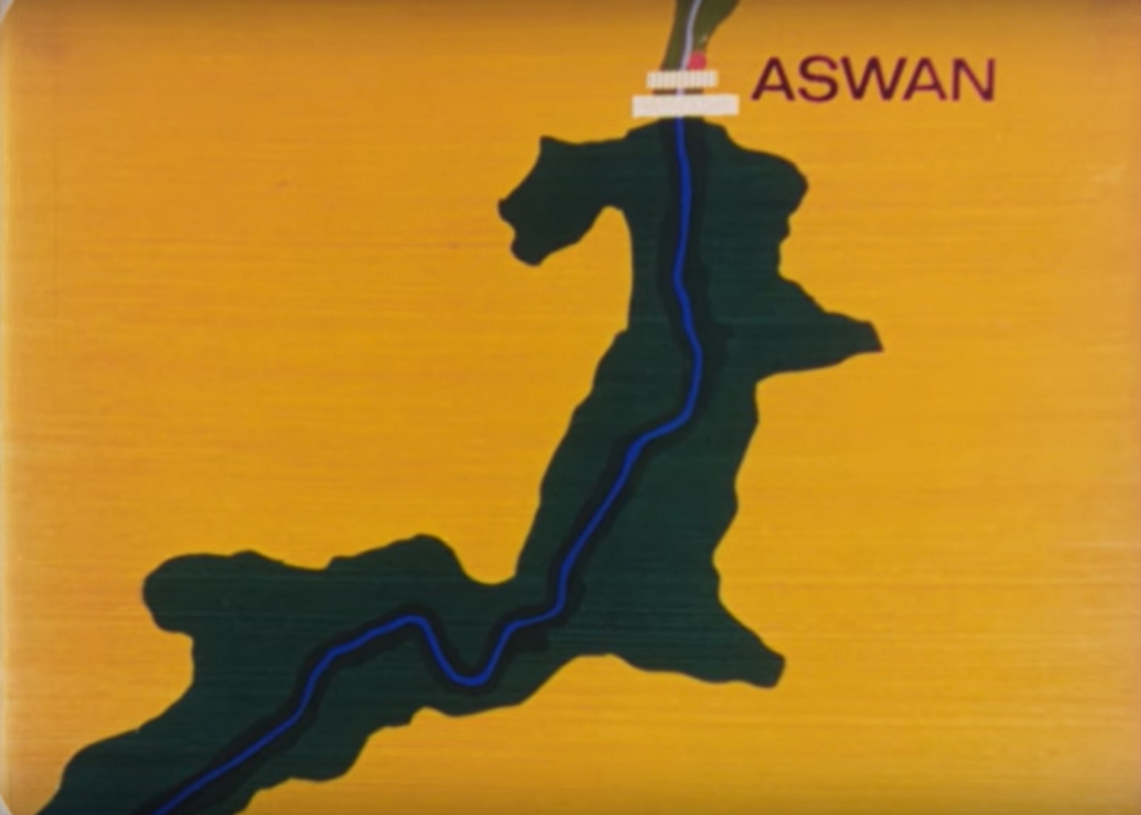
Flooding of Abu Simbel: Facts
← Nile river around the city of Aswan before 1960.
Satellite image of the Nile River around the city of Aswan today.
← Nile river around the city of Aswan after 1970.

Slide 41

Flooding of Abu Simbel: Context
Abu Simbel is over 3,000 years old and is one of the most important archeological sites in the world.
Abu Simbel is located in southern Egypt, close to the border with Sudan.
Egypt’s first leader after British Colonialism: Nasser, wanted to build a dam on the Nile called the Aswan Dam.
The Aswan Dam created the Nasser Lake. This displaced 100,000 people, damaged the local ecosystem, and flooded multiple historical sites.
Abu Simbel was considered too important to flood. There were many ideas of how to relocate it. Video 1. Video 2.
The building of the dam resulted in massive amounts of new electricity, jobs, and new farmland for the whole nation.

Slide 42



Flooding of Abu Simbel: Taboo
Gamal Abdel Nasser was very popular in Egypt because he defeated the British and Israel in the 1956 Suez War. He is considered to have freed Egypt from colonial rule.
Nasser was still a dictator. It was more harsh than during America’s Red Scare but less harsh than life in the Soviet Union or China.
If you criticised Nasser’s Aswan Dam, you would be accused of being pro-British or pro-Israel.

Slide 43
Flooding of Abu Simbel: Spectrum of Nuanced Opinions
100% Disaster:
The Aswan Dam was a terrible idea.
0% Disaster:
The Aswan Dam was a great idea.
Nuanced Opinion:
To what extent should the flooding caused by the Aswan Dam be considered a disaster? Provide your percentage with an explanation that uses facts, context, and taboos.
Questions to consider in your answer:
Should we value economic growth or historical preservation?
Is the tourist attraction of Abu Simbel less ‘authentic’ to you, now that you know it has been moved?
How many displaced people will it take for you to consider it to be a “disaster”?

Slide 44
If I could only grab one thing from my home before it was gone, I would take…..

Slide 45

Lesson 6: Los Angeles Fires
Date: Thu Jan 23 (AB), Thu Jan 30 (CD)
Theme: Case Studies
Unit 4: Unnatural Disasters
Grade 8: Individuals & Societies

Slide 46
Today’s Inquiry Questions & Learning Targets
Inquiry Questions:
What facts, context, taboos can help us gain a spectrum of nuanced opinions that explain the Los Angeles Fires.
Learning Targets: By the end of this lesson, I can…
Provide facts, context, and taboos that can help create a spectrum of nuanced opinions that explain the Los Angeles Fires.

Slide 47



Los Angeles Fires: Task
Now that we have studied 4 cases together, this time you will investigate the causes of a new case study to practice for what you will do for your summative.
After watching the video, you will use your computers to identify:
3 Natural Causes (Bullet points: According to the source _______ a natural cause was ______.)
3 Unnatural Causes (Bullet points: According to the source _______ an unnatural cause was ______.)
A nuanced opinion (I believe the LA Fires were ___% natural and ___% unnatural because ______.)
A solution (Based upon my research, I believe these fires could have been prevented with ___.)

Slide 48

Lesson 6: Introduction to Socratic Seminars
Date: Mon Jan 27 (AB), Fri Jan 31 (CD)
Theme: Socratic Seminar
Unit 4: Unnatural Disasters
Grade 8: Individuals & Societies

Slide 49
Today’s Inquiry Questions & Learning Targets
Inquiry Questions:
What is the purpose of a Socratic Seminar?
What is Responsive Language?
Learning Targets: By the end of this lesson, I can…
Understand the purpose of a Socratic Seminar.
Participate in a Demo Socratic Seminar, while acknowledging it is not the full experience, in order to practice “Responsive Language”.

Slide 50

What is a Socratic Seminar?
Socratic Seminars were created by the Ancient Greek Philosopher Socrates.
Socratic Seminars have some similarities and differences with Debates.
Socratic Seminars and Debates both use dialogue to challenge ideas. However, Debates are much more confrontational, performative, and competitive.
You are more likely to use Socratic Seminar Skills on a Daily Basis while you are talking to friends or family over dinner for example.

Slide 51

What is a Socratic Seminar?
Socratic Seminars use questions to help challenge ideas and gain new perspectives. This is especially important in our increasingly polarised world.
Today we are going to introduce some components of Socratic Seminars. We will slowly introduce more concepts to you over the next few lessons so that you do not feel overwhelmed.
This is a demo Socratic Seminar. It is not the full experience.
TED Ed Video.
NPR Video.

Slide 52

Socratic Seminar Demo: How natural were the LA fires?
There will be one assigned Facilitator per table. The Facilitator will start the conversation and try to revive it if it begins to die down.
Only one person should talk at a time. However, everyone on the table must talk at least once.
You must also be respectful and not laugh. This will count against you in the summative.
Try to use at least 6 prompts in the “Socratic Seminar Bingo Paper”. Once you have used one, check it off. These are examples of “Responsive Language”.

Slide 53

Socratic Seminar Logistics
The people in the inner circle will be taking part in the Socratic Seminar.
The people in the outer circle will be ‘peer assessing’ (it won’t be on the final grade) the person in front of them.
One person will volunteer (or be nominated if no one volunteers) to be the ‘facilitator’ to just kick start the conversation.
Encourage people who have not spoken to speak. Do not monopolise the conversation.
If the conversation begins to die, the debatable questions are good to restart them.
Remember to remain respectful the entire time or it will count against you (whether or not you are in the inner or outer circle).
There will be two Socratic Seminars per day. Each approximately 30 minutes.

Slide 54
Today’s Instructions
Please make sure you have given Ms. Smith your paper by checking your bags.
Final check: Has everyone finished their Socratic Seminar and reflection?
We will start our next unit on Wednesday after the break. Today we will watch a documentary on Ethiopian history. Mr. Larson will be taking ⅓ of students at a time for 10 minutes to watch the DP Students’ Art Exhibition.

